Slide 1




RarePurposing
Past Successes and Future Economics
Dr. Bruce E. Bloom
President and Chief Science Officer
APBDRF Scientific Conference
Dec. 6, 2016

Slide 2
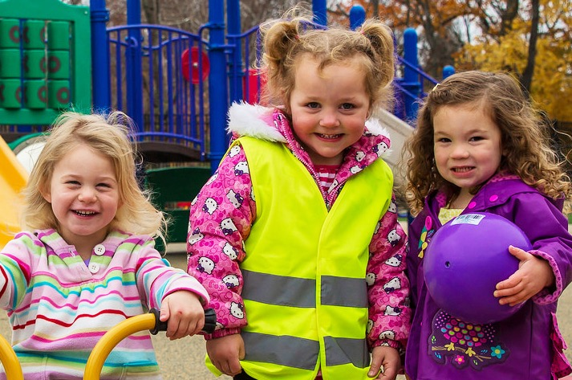

The Problem
Notes:
Lily is born with a rare unsolved disease. Unfortunately, she will die before her 5th birthday. There might be an inexpensive generic drug on her pharmacist’s shelf that could save her life, but which one? There isn’t funding for Dr. Rodriguez, who proposes a drug repurposing clinical trial in Lily’s disease, so we never discover the drug repurposing “cure.” Lily isn’t alone-350M people suffer from unsolved rare diseases. Dr. Rodrigues is one of thousands of researchers' whose repurposing solutions remain unfunded. Instead of funding superhero researchers who quickly repurpose inexpensive generic drugs, we rely on pharma to annually create a few new, expensive rare disease drugs.

Slide 3
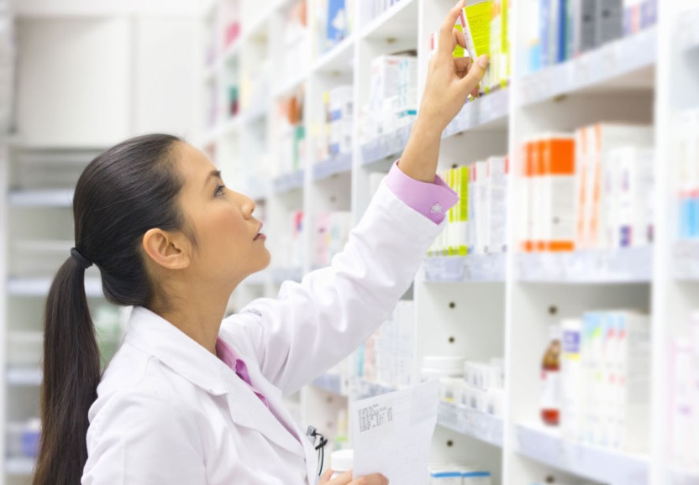
The Problem
Notes:
Lily is born with a rare unsolved disease. Unfortunately, she will die before her 5th birthday. There might be an inexpensive generic drug on her pharmacist’s shelf that could save her life, but which one? There isn’t funding for Dr. Rodriguez, who proposes a drug repurposing clinical trial in Lily’s disease, so we never discover the drug repurposing “cure.” Lily isn’t alone-350M people suffer from unsolved rare diseases. Dr. Rodrigues is one of thousands of researchers' whose repurposing solutions remain unfunded. Instead of funding superhero researchers who quickly repurpose inexpensive generic drugs, we rely on pharma to annually create a few new, expensive rare disease drugs.

Slide 4
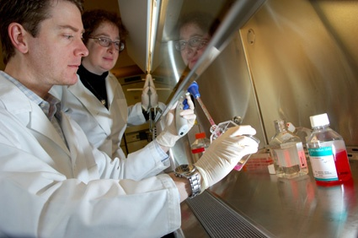
The Problem
Notes:
Lily is born with a rare unsolved disease. Unfortunately, she will die before her 5th birthday. There might be an inexpensive generic drug on her pharmacist’s shelf that could save her life, but which one? There isn’t funding for Dr. Rodriguez, who proposes a drug repurposing clinical trial in Lily’s disease, so we never discover the drug repurposing “cure.” Lily isn’t alone-350M people suffer from unsolved rare diseases. Dr. Rodrigues is one of thousands of researchers' whose repurposing solutions remain unfunded. Instead of funding superhero researchers who quickly repurpose inexpensive generic drugs, we rely on pharma to annually create a few new, expensive rare disease drugs.

Slide 5
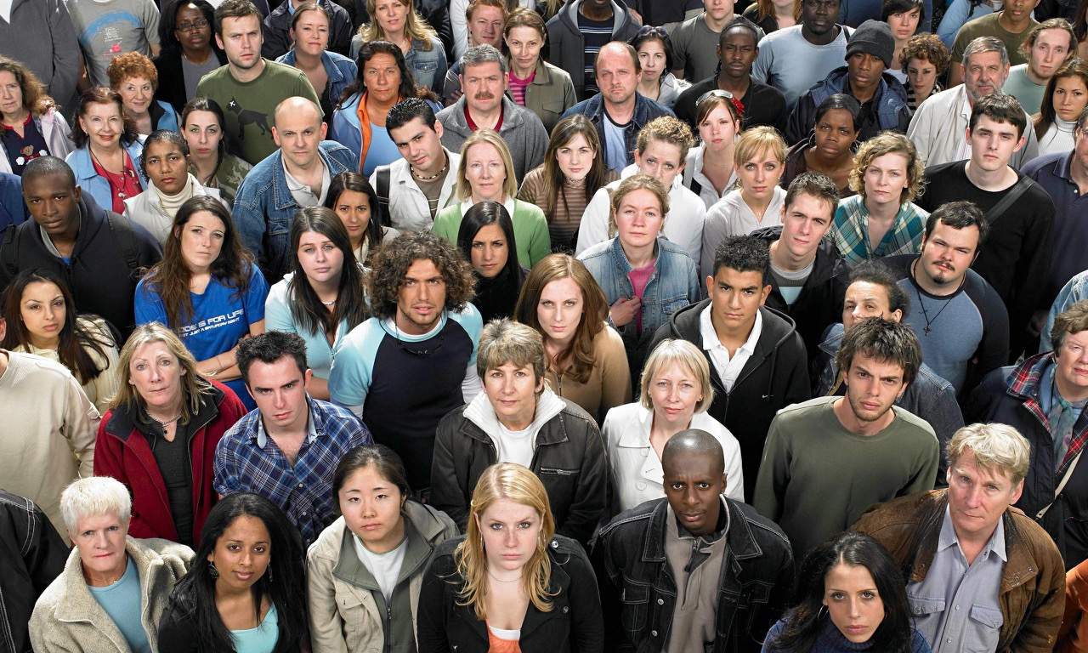
The Problem
7000+ unsolved rare diseases
500M people affected
Few new therapies each year
New therapy cost/development time

Slide 6

ONE Solution
REPUPROSING

Slide 7

Cures Within Reach is a global non-profit organization catalyzing Repurposing Research to quickly and affordably improve patient lives, using existing drugs and devices
What we do:
Connect researchers and funding
Facilitate crowd-sourcing and community
Identify new economic engines/incentives to support repurposing

Slide 8
Repurposing Plusses
3000+ generic drugs
3000+ nutriceuticals
Repurposing research
    Fast, inexpensive, clinical “proof”
    “WHO white paper¹ on repurposing QALYs¹
    ¹http://apps.who.int/iris/bitstream/10665/204522/1/9789241510295_eng.pdf

Slide 9
Repurposing hurdles
Generics cheap and widely available
No/poor IP
    Repurposing in current dose/delivery
    MOU patent hard to enforce
Off-label use

Slide 10
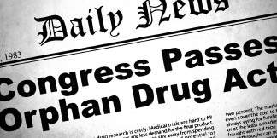
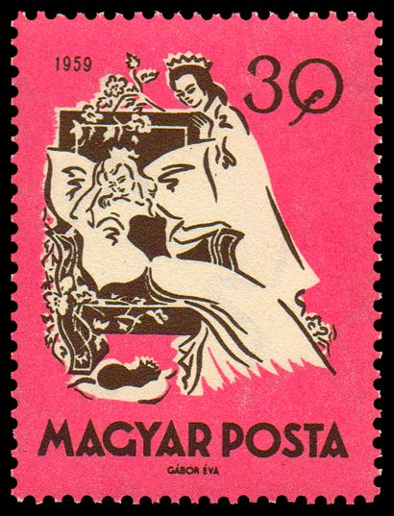
Current initiatives
Notes:
Orphan Drug Act-
Since the ODA was passed in 1983, more than 400 orphan drugs have been developed and marketed in the US,⁶ which suggests that the incentives are having an effect.⁷ Moreover, the last 10–15 years have been the most successful period of development for orphan drugs.⁸ According to the FDA, nearly 200 orphan drugs enter development each year and approximately one third of new drugs approved by the FDA are for the treatment of rare diseases.⁹ ODA incentives are also credited with contributing to ‘breakthrough innovation’ that provides advantages over previously available therapies.¹⁰
Some express concern that orphan drug incentives are not adequately targeted to the diseases with greatest unmet medical needs and that the ODA has favored the development of treatments for ‘diseases that can, through ‘omics data and technologies, be recast as rare, or belong to the larger, more lucrative therapeutic class of oncology products’.¹⁷ Moreover, there are concerns that the ODA does not adequately distinguish between ‘true orphan drugs’ and ‘“Trojan” applicants that seek to co-opt the benefits for drugs that should not qualify as orphans’.¹⁸ However, in 2013, the FDA made a number of important amendments to the ODA Regulations that purport to address many of the challenges raised by the evolving drug development environment, including advances in pharmacogenomics.
The ODA has served as a model for legislation in a number of other jurisdictions, including Europe, Japan, and Australia.
Italy-off-label use
The Italian Medicines Agency (AIFA) must take the view, having taken account of the results of studies into the matter, that the "product
is safe and effective with regard to the proposed use", a Ethical Medicines Industry Group (EMIG) summary of the Italian legal changes,
as described at a recent conference hosted by the European Confederation of Pharmaceutical Entrepreneurs (EUCOPE), said.
In such cases, the 'off-label' use of the drugs would be "reimbursed by the Italian national health service".
Previously, the Italian rules restricted reimbursement for the off-label use of medicines to cases where the medicines were included on
the AIFA's list of approved drugs and where there was no authorised alternative therapy to treat the patient.
The updated Italian laws also now provides for funding of research into the off-label use of medicines.
EUCOPE has said that the changes in the law appear to flout EU rules on marketing authorisations for drugs.
"The Court of Justice of the EU has clearly underlined in [a 2012 case] that (i) exceptions to the marketing authorisation requirement
have to be interpreted narrowly and (ii) that financial considerations in themselves cannot justify such an exception," EUCOPE said.
"Despite this unambiguous case law, the new Italian law directly promotes the non-authorised use of a product for purely financial
reasons."
Life sciences expert Paul Ranson of Pinsent Masons, the law firm behind Out-Law.com, said: "The Avastin and Lucentis case in the UK is
an example where the off-label use of a lower priced drug was evaluated against an on-label use of a higher priced drug. It was concluded
that the two drugs were equally effective in treating 'wet AMD', a condition that causes some older people to lose their sight. Four NHS
bodies in England initially used Avastin, the off-label but cheaper treatment for the condition, but changed its practice after Novartis, the
manufacturer of Lucentis, lowered its prices for use of its drug."
STAMP (Safe and Timely Access to Medicines for Patients)
Draft AGENDA 5th Meeting of the Commission Expert Group on Safe and Timely Access to Medicines for Patients (STAMP) 28 June 2016 (10:00 – 18:00) Berlaymont, meeting room Walter Hallstein 200 Rue de la Loi, 1040 Brussels, Belgium 1. Opening and adoption of the Agenda 2. Endorsement of the minutes of the 4th STAMP meeting 3. Repurposing of established medicines/active substances Reflection on basis of previous discussion - presentation by the Commission services (SANTE) Overview of replies to questionnaire - presentation by the UK 4. Off-label use of medicinal products Draft report of study on off-label use of medicinal products in the European Union – presentation by contractor Report of the Belgian Healthcare Knowledge Centre: ‘towards a better managed off label use of drugs’– presentation by Belgium 5. Health Technology Assessment (HTA) Network Reflection Paper on Regulatory and HTA issues – presentation by Commission services 6. Update on European Medicines Agency activities: Adaptive pathways – presentation by EMA PRIority Medicines (PRIME) – presentation by EMA 7. Council Conclusions on Strengthening the balance in the pharmaceutical system in the EU and its Member States - presentation by the NL delegation 8. Update on other EU initiatives relevant for timely patient access to innovative medicines *

Slide 11

CUREACCELERATOR
120 projects posted
50+ research institutions
11 Requests for Proposals
>1000 Users
Oncology-45 Rare diseases-23 Neuro-20
Infectious-6 Autoimmune-6 Pediatric-5
Hematology-4
Cardiology 4
Ophthalmology-3 Pulmonary-2
GI-1 Nephrology-1

Slide 12
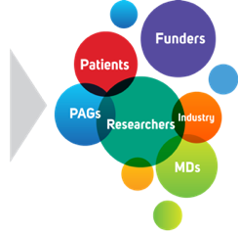
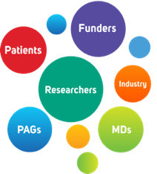

CURRENT FUNDED RESEARCH
14 new projects initiated since August 2015
6 in rare diseases
MDS, Batten, myotubular myopathy
pediatric brain cancer (2), CYP24A1
27 total CWR repurposing projects in process
Global call for RarePurposing 2017

Slide 13
CWR SUCCESSES
60 repurposing clinical trials
13 repurposed therapies; 8 rare
    10 being used off-label
    3 on way to commercialization
  Average trial cost <$200,000
  Average time to patient use <3 years

Slide 14
CWR SUCCESSES
Generic repurposing success-ALPS
    85% of patients complete remission > 3 years
    $100K savings/patient/year on $300K investment
    Leveraged in 5 additional rare pediatric AI diseases
Nutriceutical repurposing success-FD
    8 nutriceuticals repurposed to stop deadly disease
    $50K savings/patient/year on $2M investment

Slide 15


Eureka Moment
REPUPROSING

Slide 16




The British SIB Initiative

Slide 17

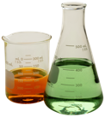
SOCIAL IMPACT BOND
Investor(s)
Service
Contractual relationship
Flow of Funds
1
5
4
1
100% ownership via equity injection (or equity-debt capital mix)
SIB Partnership vehicle
NHS England
Capital passed to service provider
Payment By Result
2
3
Delivery of intervention
Positive Outcomes
2
4
Outcomes payments made (only if outcomes generated)
3
5
Equity return (and interest and capital loan repayment)
Findacure
Intervention
8

Slide 18
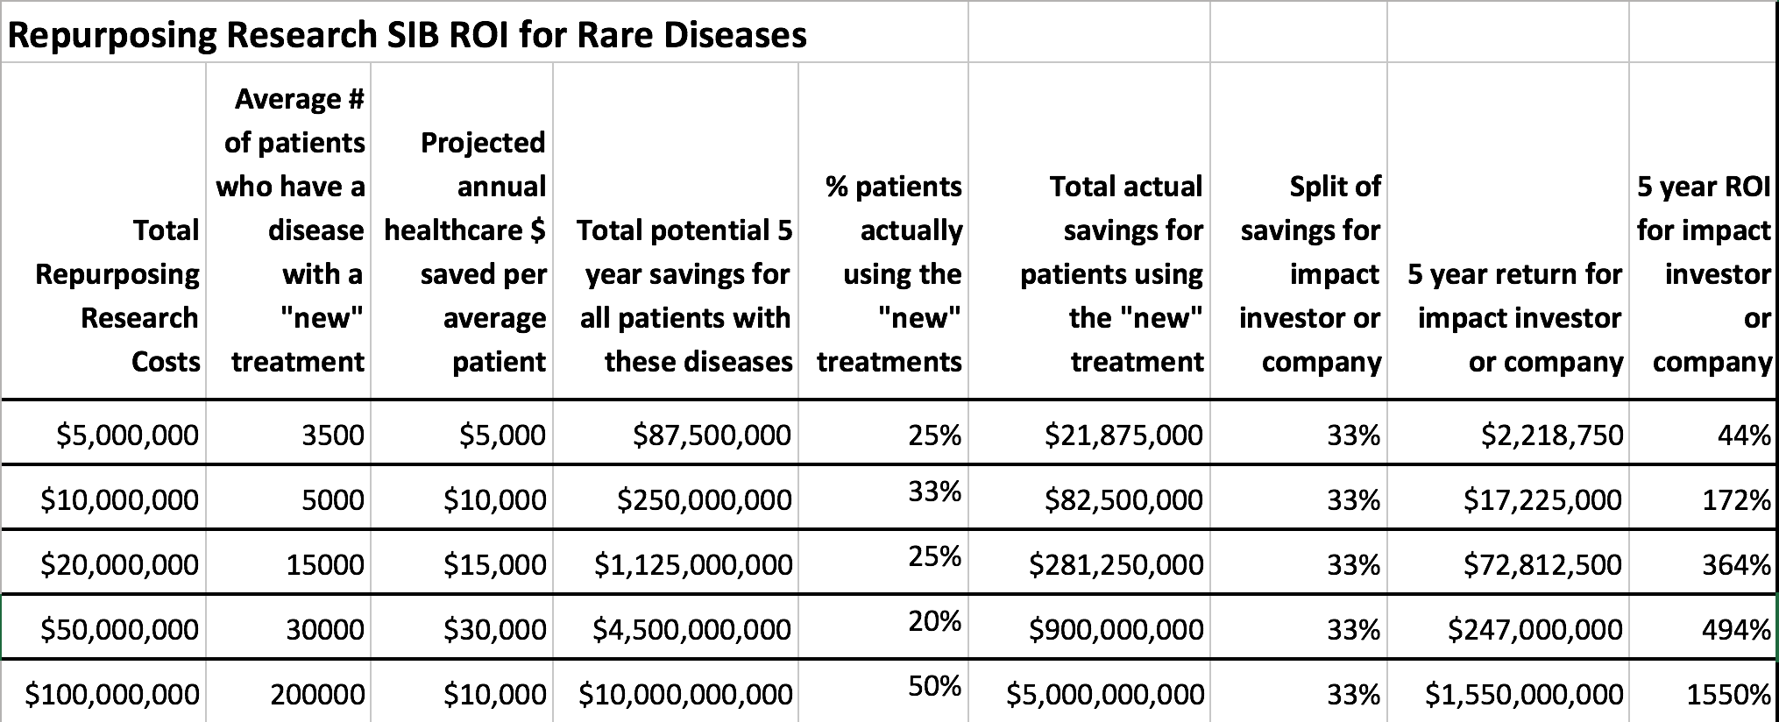
Social Impact Bond Potential

Slide 19

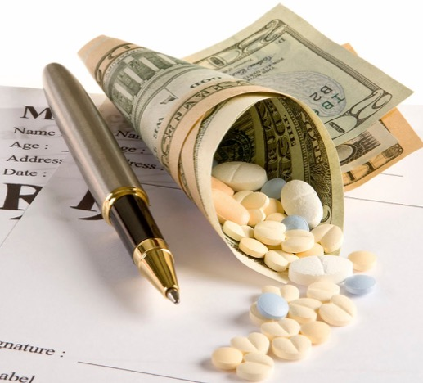
Economic Engines

Slide 20
Future $ INCENTIVES
Notes:
Support for the OPEN ACT (Orphan Product Extensions Now, Accelerating Cures & Treatments) on Capitol Hill is growing. The bill provides incentives for companies to repurpose or “rarepurpose” existing treatments for rare disease indications. The legislation was included in the draft 21st Century Cures discussion bill released by the Energy & Commerce Committee. This is a major positive development as Chairman Upton (R-MI) has expressed interest in having the legislation voted on by Memorial Day.

Slide 21
JOIN US
Partner with us on CureAccelerator https://app.cureaccelerator.org/registration
Share repurposing or off-label successes
Connect us to others
Join our NIH Workshop organizing team

Slide 22
For more information:
www.cureswithinreach.org www.cureaccelerator.org
Dr. Bruce E. Bloom
President and Chief Science Officer
+1 847-745-1245 Bruce@cureswithinreach.org
Cures Within Reach
8025 Lamon Avenue, Suite 440,
Skokie, IL 60077 USA

