Slide 1
A biobank of APBD patient skin fibroblasts
Or Kakhlon
APBDRF 12th Annual Scientific Advisory Board Meeting
NYC December 5-6, 2016

Slide 2
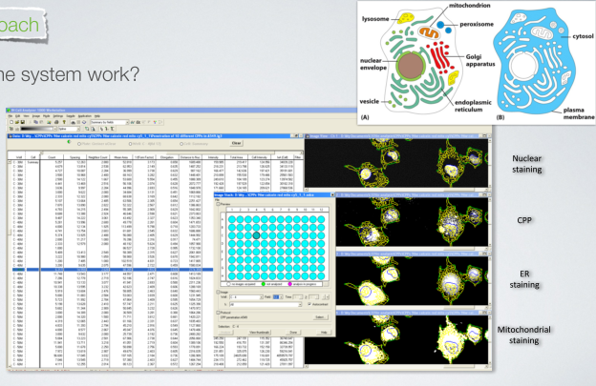

How does High Content Screening work?
Polyglucosans but also: Cell shape, Membrane, Nucleus, ER, Lysosomes, Golgi, Mitochondria, Vesicles, Cellular Proteins, Calcium

Slide 3
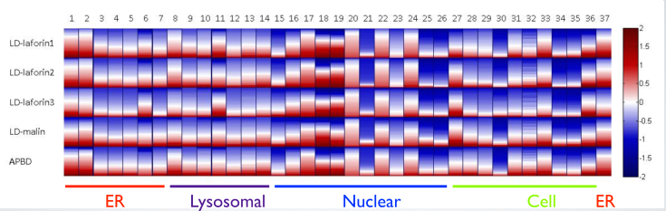
Multiparameter Analysis: Hits affect not only PG.
Test the global effect of hits (here shown: Nucleus, Cell, Lysosomes, Mitochondria)
Eddy Pichinuk
Miguel Weil
En route to personalized medicine:
Testing the effects of hits on numerous cellular phenotypes in cells derived from several patients with several diseases.
What is unique to APBD in comparison to other neurodegenerative diseases? to other storage diseases?

Slide 4
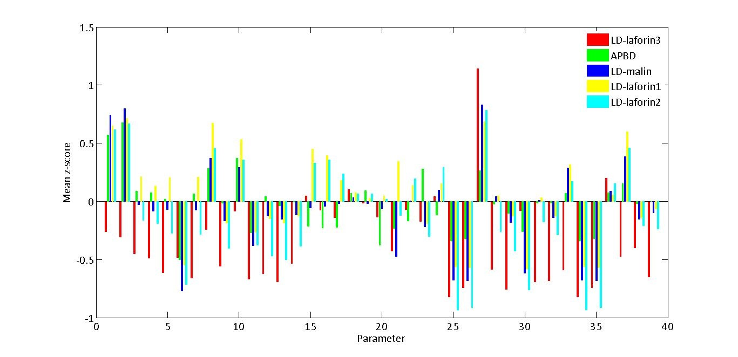

Demonstration of uniqueness
Eddy Pichinuk
Miguel Weil
unique
control-normalized phenoscores

Slide 5
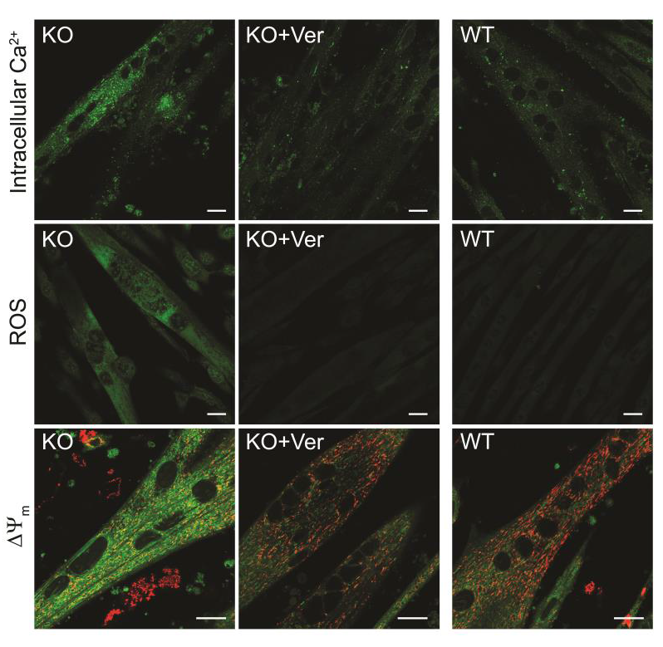
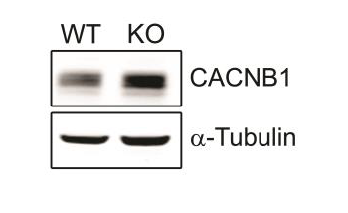
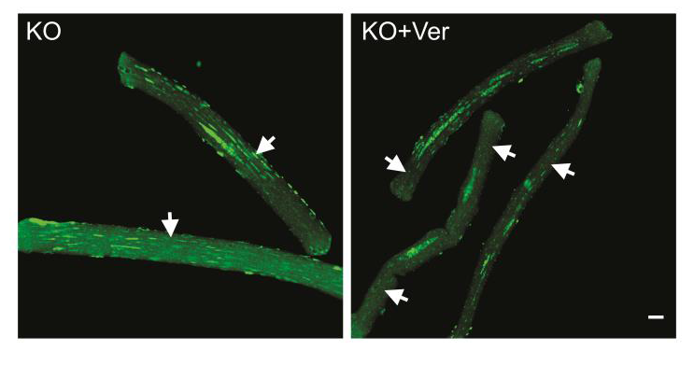
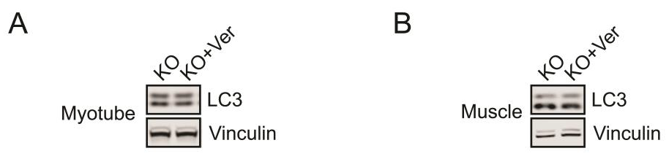
Etiology is not always related to known disease gene: Reversible Ca⁺² accumulation and damage in GAA KO myotubes
Ca channel blocker verapamil reinstated intracellular Ca⁺² , ROS production and ΔΨ_{m} to the normal phenotype. The Western blot shows a dramatic increase in KO in the levels of the CACNB1 calcium channel
Lim et al (2015)
Intracellular Ca was reduced in muscle fibers from GAA KO mice injected with verapamil. However, autophagy was not affected

Slide 6
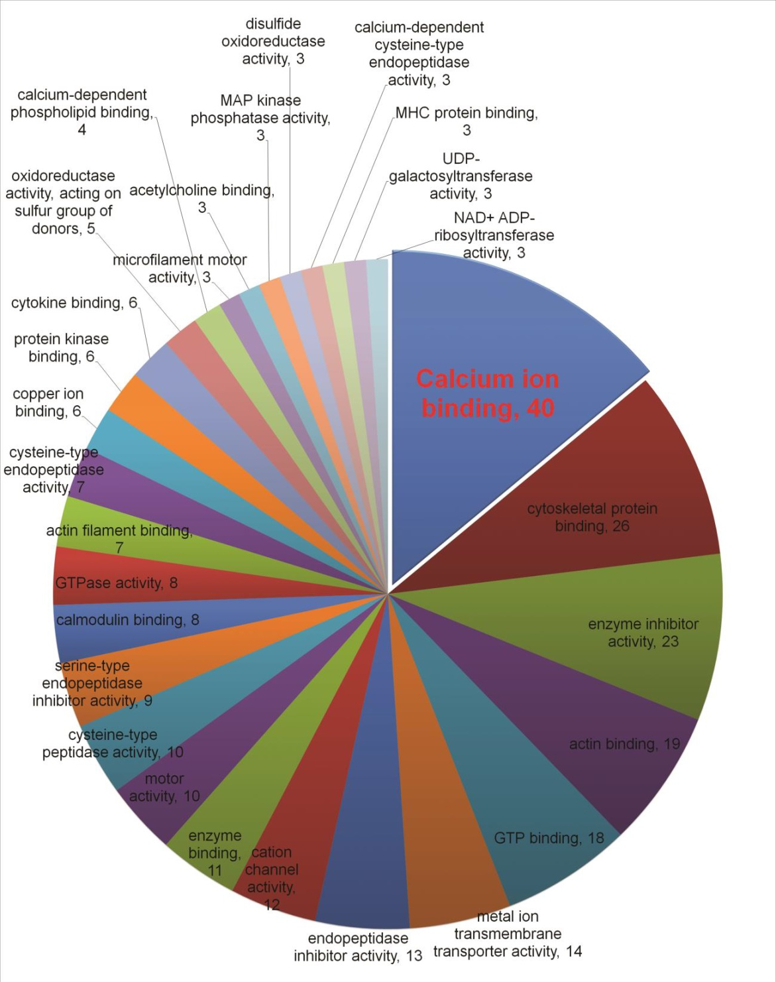
Molecular functions were attributed to 152 of the 551 genes upregulated in the KO GAA using mRNA-seq. A large number (40) of the genes upregulated in KO muscle codes for proteins that govern the levels of cellular calcium.
Lim et al (2015)

Slide 7
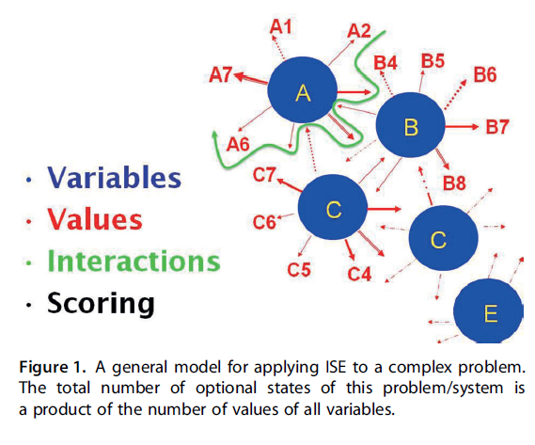
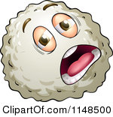

Classification: Using multiparametric phenoscores (machine learning) to predict, given a certain cell, whether it’s sick or healthy.
This cell is sick
This cell is healthy
Stern & Goldblum (2014)

Slide 8
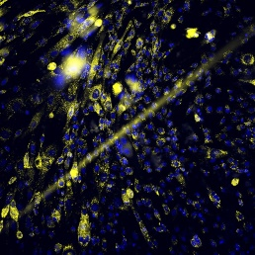
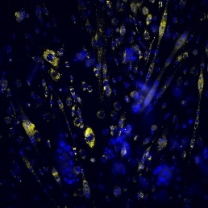
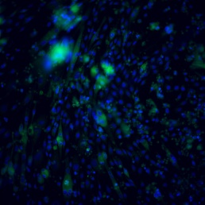
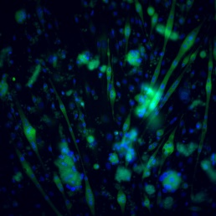
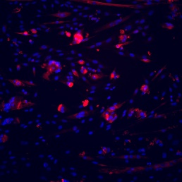
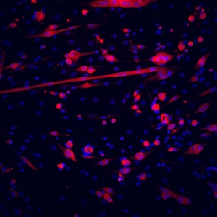
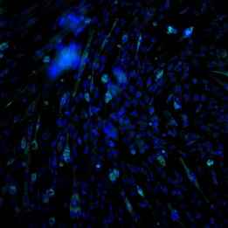
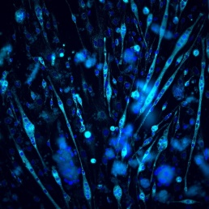
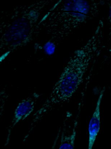
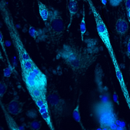
Pompe
WT
Demonstrating classification: Multiparametric analysis of cellular parameters in myotubes derived from Pompe Disease modeling (GAA^{-/-}) and WT mice.
Lyso
ER
Cytos
Mito

Slide 9
Lysosomes
Cell
ER
Lysosomal integrated intensity
Mean lysosomal area
Total lysosomal area
Lysosomal mean intensity
Lysosomal form factor
Lysosomal count
WT
WT
WT
WT
WT
WT
Pompe
Pompe
Pompe
Pompe
Pompe
Pompe
Mitochondria
Cytoskeleton
Nuclei
Analysing such a very large amount of data (28 parameters), we are able to predict with 85% confidence whether a given myotube is PD or WT myotube. Accuracy increases as more data are analyzed.

Slide 10


Machine Learning
Is this cell healthy?
Yes
Is this cell sick?
Yes

Slide 11

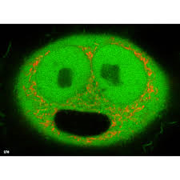
Personalized Drug Screening
Drug Screening
Individual disease phenotypes
Individual healthy phenotypes

Slide 12
So why do we need a biobank of skin cells?
Very simple: The more patients we have the more accurate the classification and APBD fingerprinting is. Increasing the number of patients increases accuracy.

