Slide 1
Testing pharmacophore-based small molecules for stabilizing GBE-Y329S
Or Kakhlon
APBDRF 12th Annual Scientific Advisory Board Meeting
NYC December 5-6, 2016

Slide 2
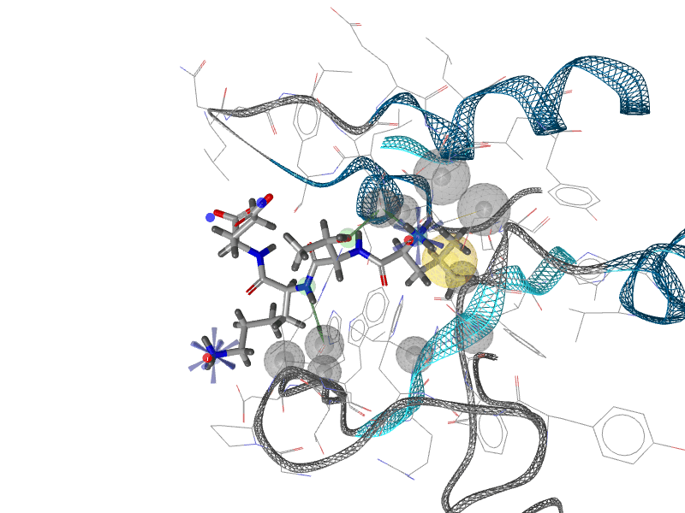
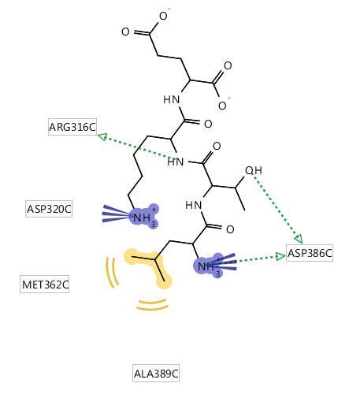
Pharmacophore Modeling
Based on the structure of LTKE in GBE1 – we produced a pharmacophore model by using the program called “Ligand Scout” (Prof. Thierry
Langer, Inssbruk)
The Idea is based on the set of physical interactions between the ligand and the protein: Hydrogen bonding, Van der Waals interactions, lipophilic interactions, charge interactions etc. As it focuses only on the ligand, one can subsequently search for ligands that could fulfill similar or closely similar interactions in space
Only 6 pharmacophore features were identified. Including the “excluded volume” which is a region where protein residues are present and cannot be “invaded” by a ligand.
.

Slide 3
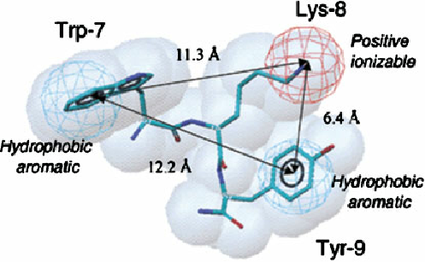
Using the Pharmacophore for Screening Tehila Amran and Amiram Goldblum, Molecules Modeling Lab
A library of 1800 mostly approved drugs was used, some of which are at advanced clinical studies
For each molecule – 200 conformations were produced, in order to find if any of them conforms with the pharmacophore
We found that 44 molecules had at least one conformation (or more) which were similar to 4 out of the 6 pharmacophore features, while obeying also the “excluded volume” demands

Slide 4
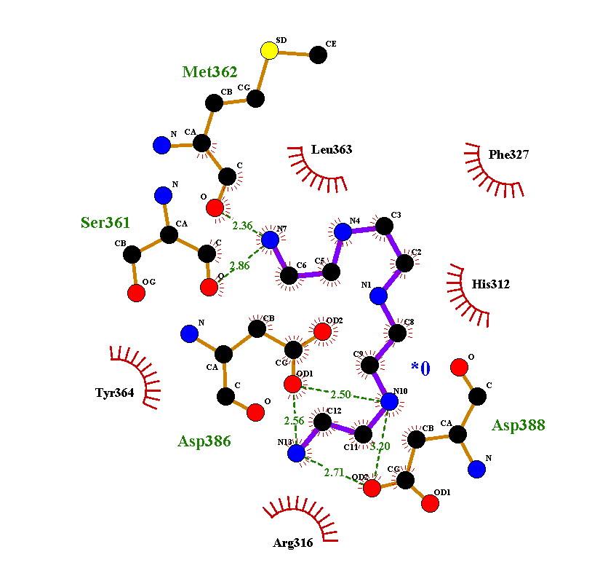
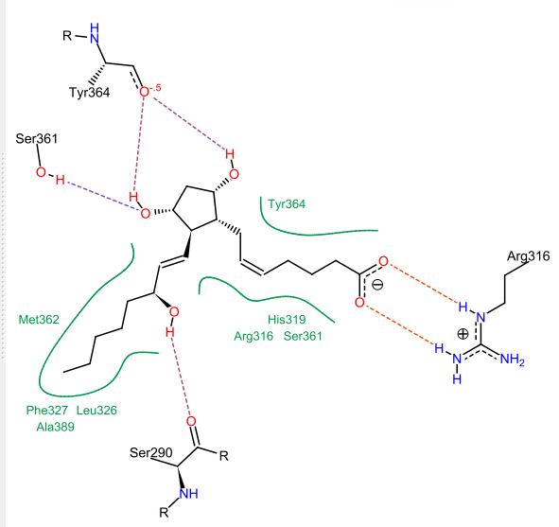
Docking
Subsequently, each of the 44 molecules was tested for its docking efficiency to the X-ray structure 4BZY (originally used for LTKE)
Out of those, 28 were successfully docked with high scores, including a number of H-bonds and hydrophobic interactions.
Each of the 28 was examined for its current use and is being analyzed directly for effect on GBE activity in APBD-derived lymphocytes.

Slide 5
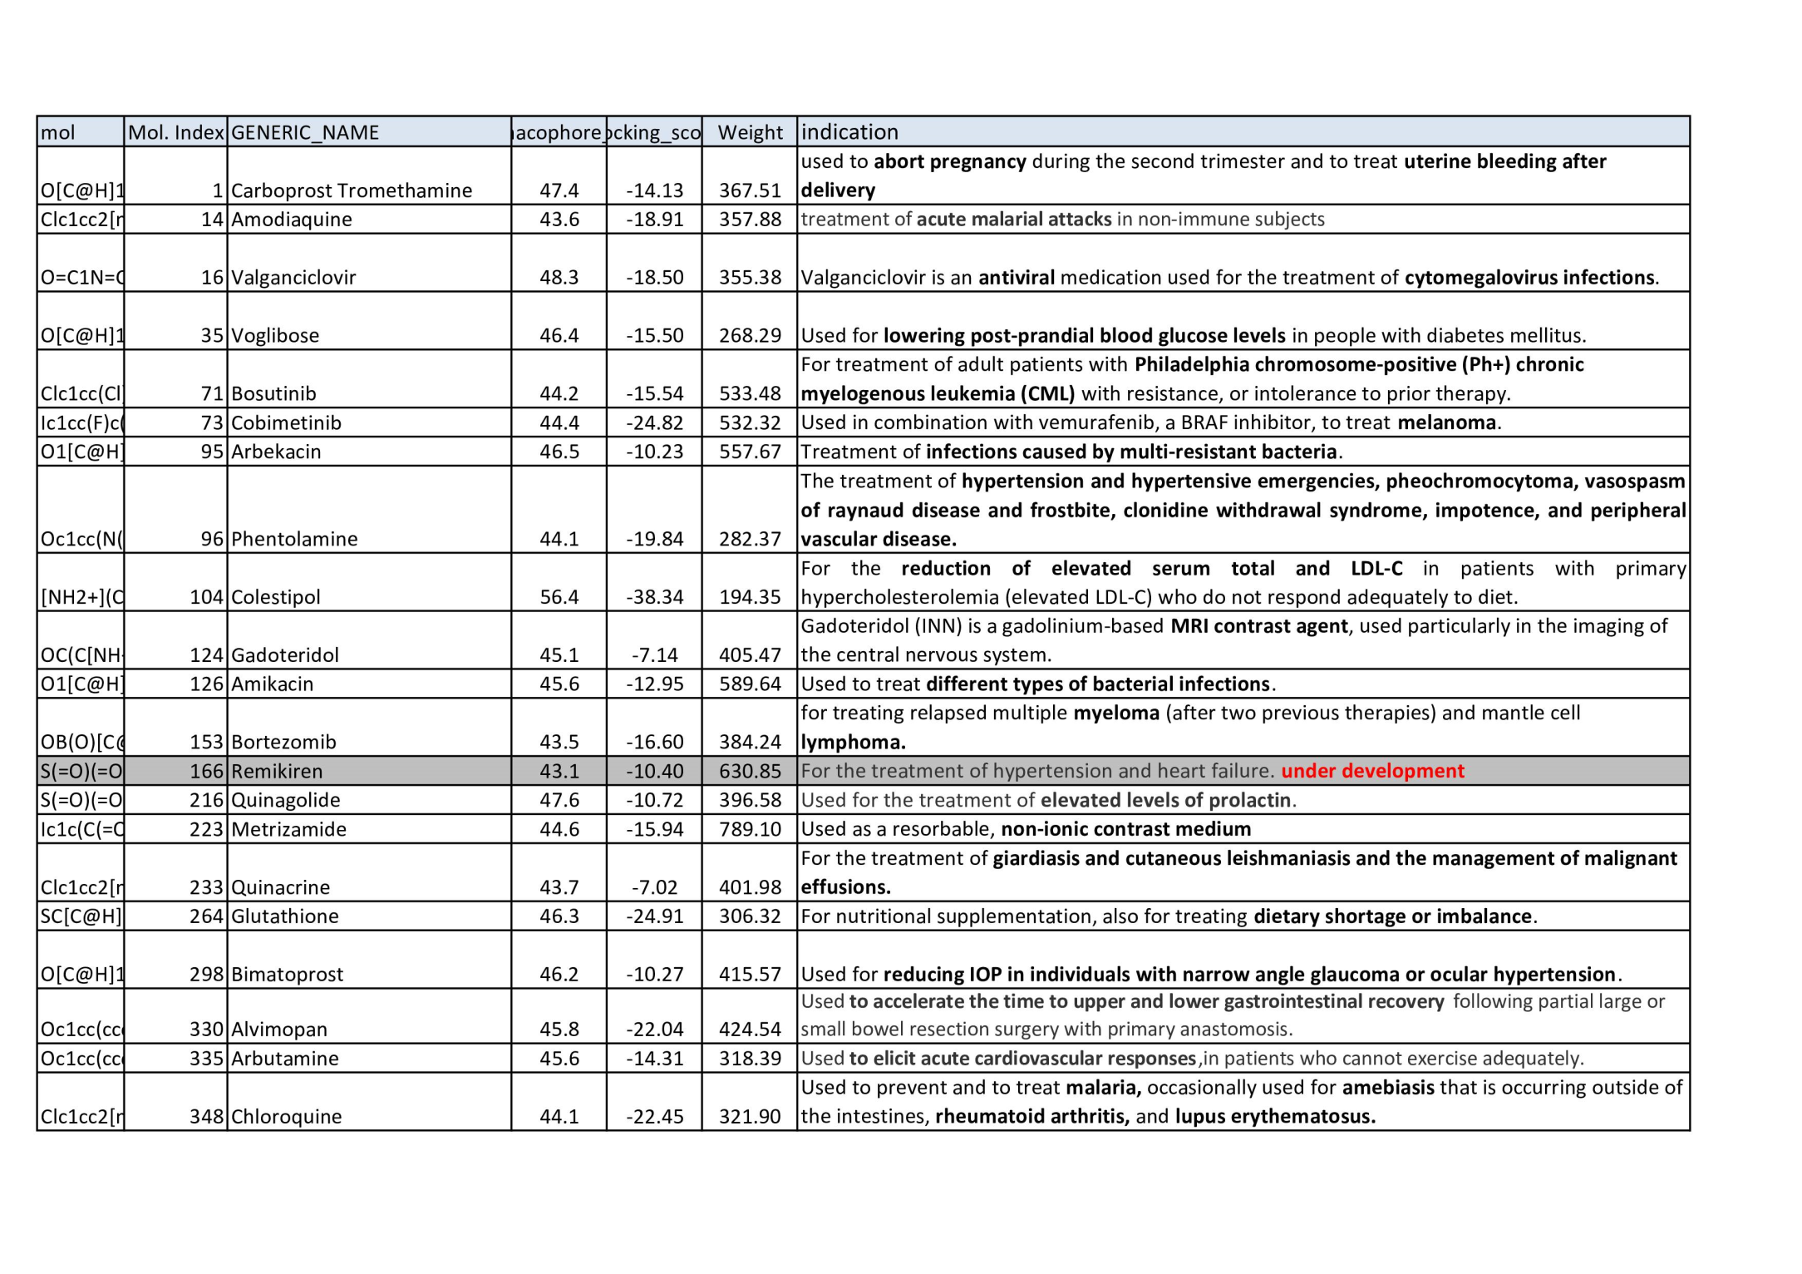

Slide 6
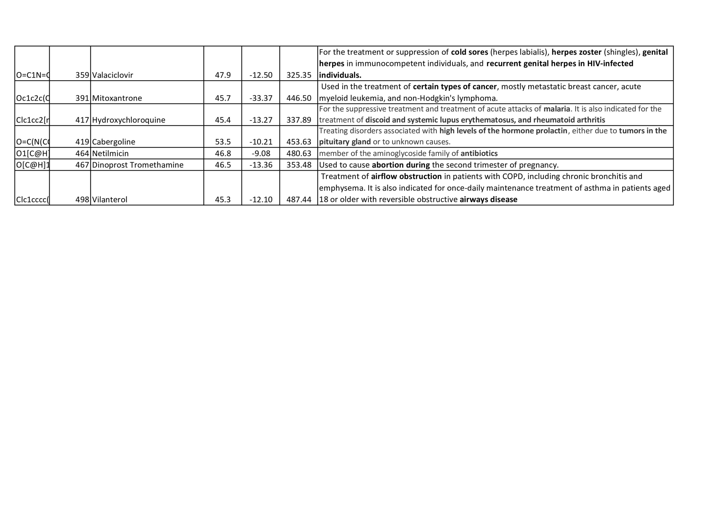

Slide 7
So far 4 of these 28 molecules were tested with no significant improvement of GBE activity

