Slide 1
Using recombinant glycogen branching enzyme and structural biology techniques to understand therapeutic opportunities for APBD
Or Kakhlon & Wyatt Yue
Part 1: A peptide-based targeted approach for stabilizing GBE-Y329S
APBDRF 12th Annual Scientific Advisory Board Meeting
NYC December 5-6, 2016

Slide 2
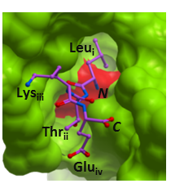
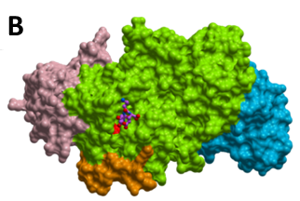
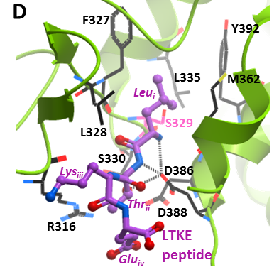
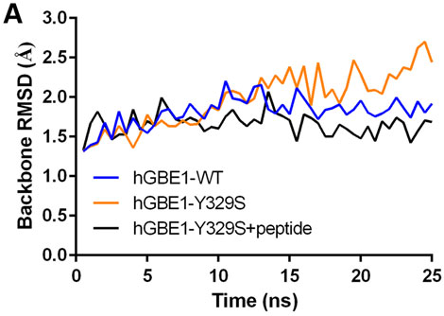
Aim: To discover a peptide which can stabilize and biochemically activate GBE Y329S, presumably by interacting with the cavity generated by the mutation on GBE Y3290S surface.
GBE1-Y329S in complex with the LTKE peptide at the Ser329 (mutant) cavity.
Zoom out
The LTKE peptide can bind GBE Y329S via a number of hydrophobic and polar interactions (predicted hydrogen bonds in dotted lines).
Frose et al (2015)

Slide 3
Figure 6
Demonstration that LTKE binds GBE-Y329S: Hapten Immunoassay
A
Standard curve
anti-FITC-HRP
FITC-LTKE
FITC
Hapten Immunoassay
APBD/Ctrl cells incubated w/ 316nM LTKE
+
LTKE-FITC or ctrl peptides-FITC
Competitive GBE-Y329S-LTKE-FITC hapten
Frose et al (2015)

Slide 4
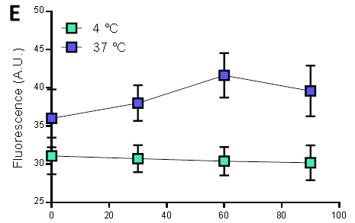
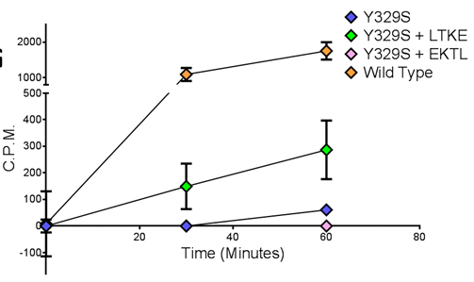
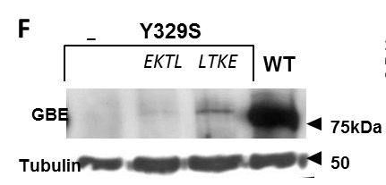
Therefore, we tried adding LTKE to live PBMCs isolated from APBD patients.
Demonstration that LTKE penetrates cells: APBD PBMCs show uptake of FITC labelled LTKE only at 37C and not at 4C.
Time (min)
And also stabilizes GBE Y329S expression
When applied to live APBD PBMCs, LTKE does activate GBE Y329S

