Slide 1

Guaiacol – a novel drug candidate for treating Adult Polyglucosan Body Disease
Or Kakhlon
Department of Neurology Hadassah University Hospital
APBDRF 12th Annual Scientific Advisory Board Meeting
NYC December 5-6, 2016

Slide 2
Dose response in APBD patient skin fibroblasts of positive hits from HTS on APBD mouse model of the LOC library
No
addition
Guaiacol
Mitotane
Terpin
Benzbromarone
PG Mean Intensity
Concentration (0-10 uM)

Slide 3
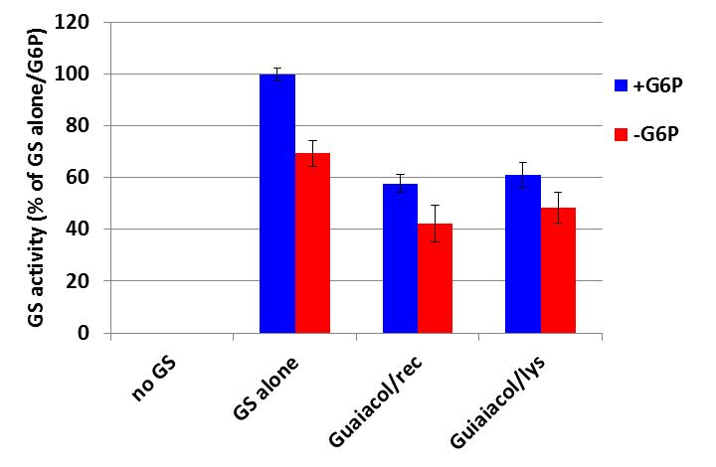
Establishing mode of action: 3 hits from the LOC library were demonstrated to inhibit recombinant GYS.
Guaiacol was the most potent inhibitor acting on both recombinant GYS and cell lysate
*
*

Slide 4

GYS inhibition by Guaiacol was also demonstrated by a completely independent manner: On Gel glycogen synthesis assay
B
Wyatt Yue
Igor Fereira
(A) Isolated GYS1-GYG1 complex shows staining only with the glycogen synthesis substrate UDP-Glucose (UDPG).
(B) UDPG dose responsively increases the MW of the GYS1-GYG1 construct as glycogen chain increases.

Slide 5
C
D
E
Wyatt Yue
Igor Fereira
(C, D) Guaiacol inhibits GYS1-GYG1 gel migration indicating inhibition of glycogen synthesis, which is dose responsive (E).

Slide 6
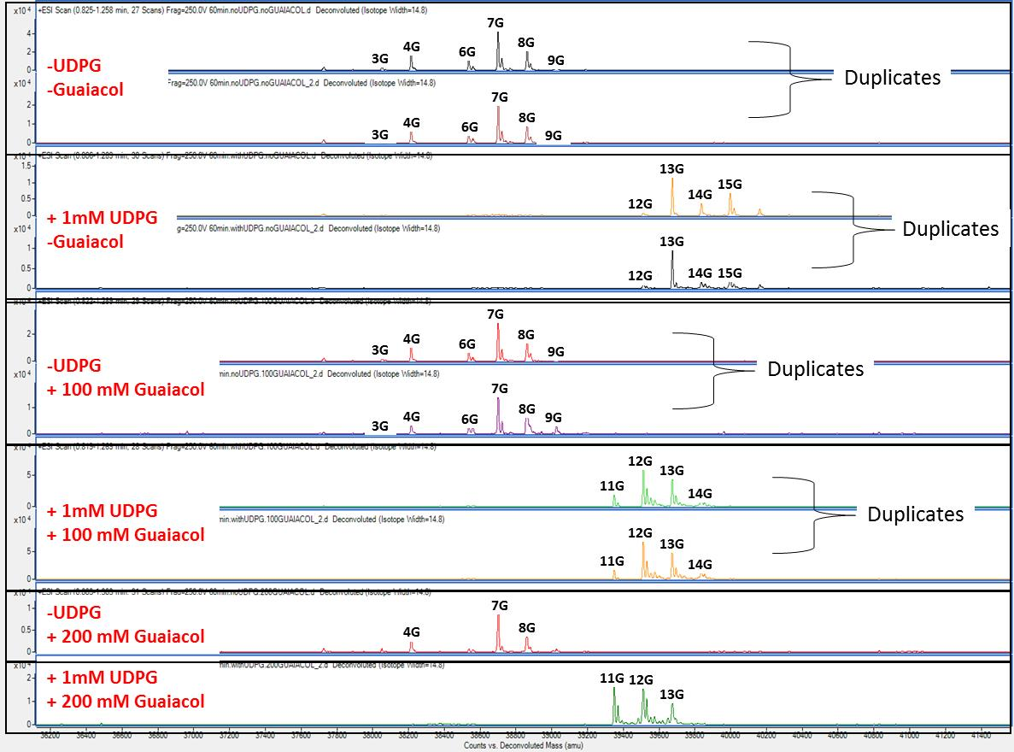
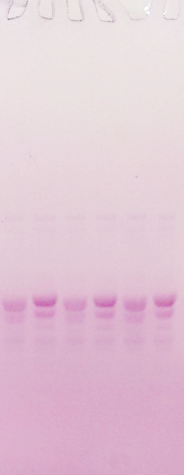
+UDPG + 100 mM Guaiacol
-UDPG + 200mM Guaiacol
+UDPG + 200 mM Guaiacol
-UDPG + 100mM Guaiacol
-UDPG -Guaiacol
+UDPG -Guaiacol
- Full length hGYG1
Wyatt Yue
Igor Fereira
GYG1 expressed in the absence (0mM) or presence of Guaiacol has the same pattern and level of endogenous self-glucosylation, as also revealed by MS.

Slide 7
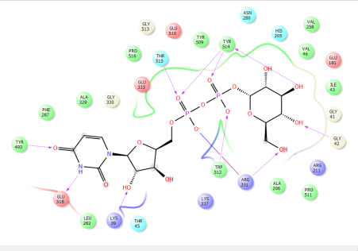
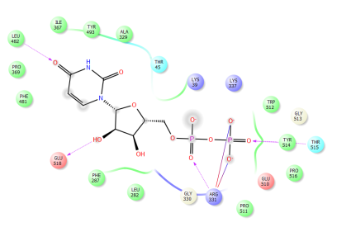
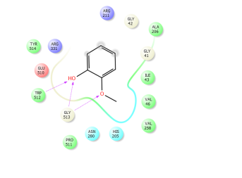
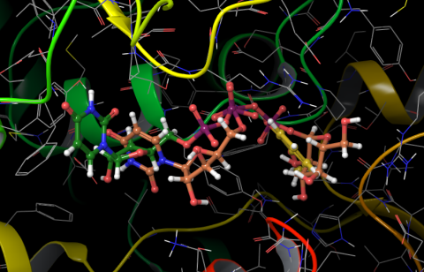
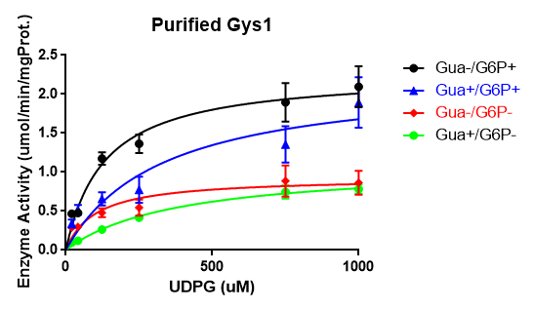
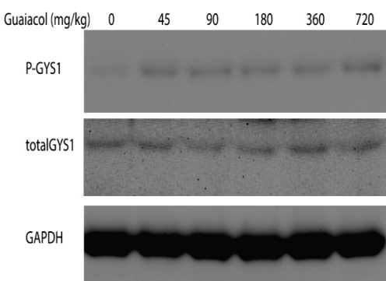
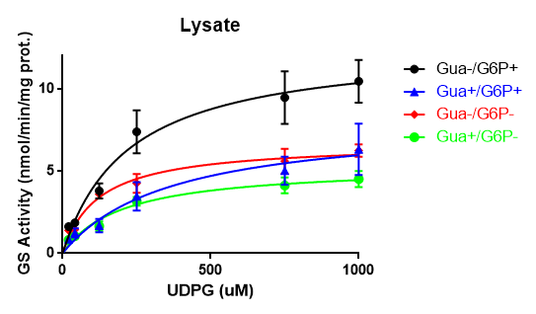
Mode of action of Guaiacol compatible with competitive inhibition of purified GS and mixed inhibition in cell lysate
Docking to the UDP binding site of homology model of human GS
UDP - Green carbon
UDP-Glucose - Brown carbon
Guaiacol - Yellow carbon
Guaiacol Glide Gscore= -5.040
UDP Glide Gscore= -5.692
UDP-Glucose Glide Gscore= -7.980
Netaly Khazanov
Hanoch Senderowitz
Guaiacol increases GS phosphorylation
Orhan Akman

Slide 8
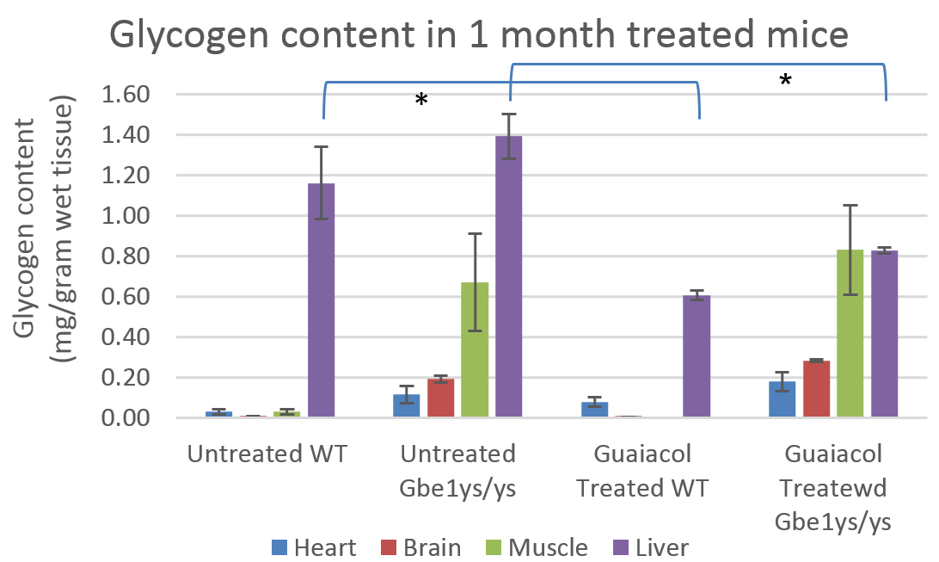
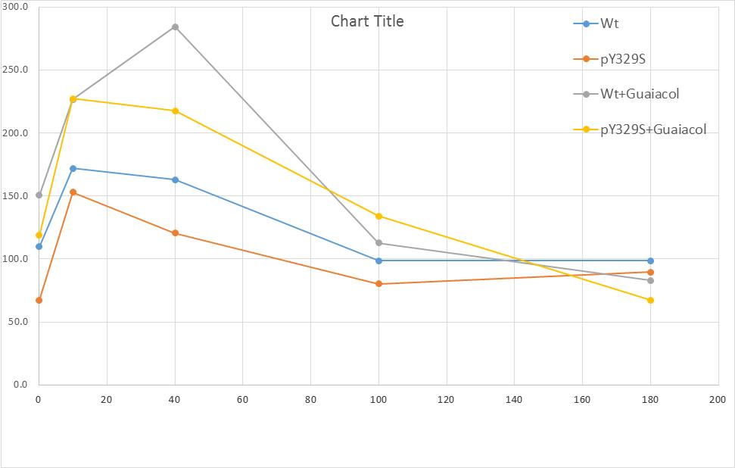
Guaiacol behaves as a GS inhibitor in APBD modeling mice
Reduced glycogen content (liver only)
Guaiacol
Guaiacol
Reduced glucose tolerance
Orhan Akman

Slide 9
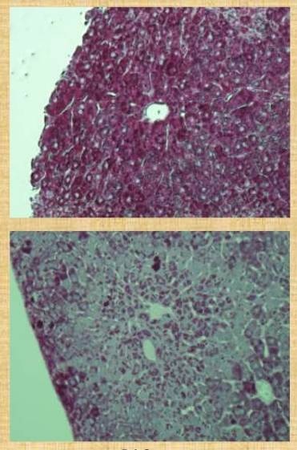
Guaiacol was able to reduce polyglucosan (diastase resistant) staining in liver of APBD mouse models
-Guaiacol
No effect on brain PG.
Possible complications: Insulin resistance and increased gluconeogenesis
+Guaiacol
Orhan Akman

Slide 10
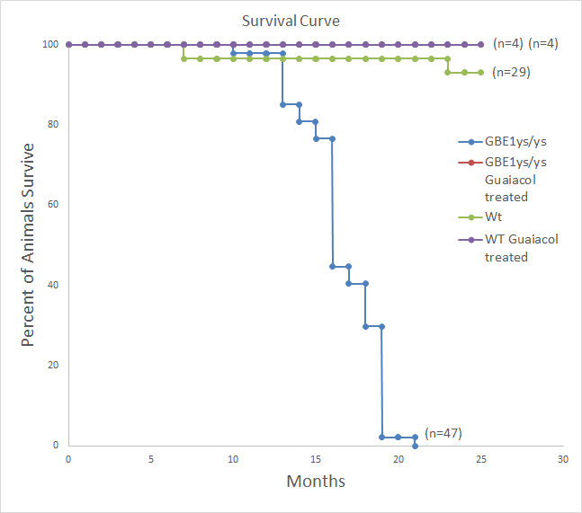
However, most significant effect: Guaiacol increased life span to wild type levels
Figure 6. Kaplan-Meier plot illustrates the incidence of death in Gbe1^{ys/ys} (n=47), versus WT mice (n=29) and guaiacol treated Gbe1^{ys/ys} and Wt mice (n=4 each).
Orhan Akman

Slide 11
Summary
Guaiacol was discovered by HTS assays for polyglucosan reduction both in mouse model and patient-derived cells.
Guaiacol was shown to mildly inhibit GYS activity in vitro and in vivo.
In an APBD mouse model, Guaiacol has also been demonstratd to restrain polyglucosan accumulation in the liver and extend life span.
These data and the lack of side effects in the animal warrant clinical trilals with Guaiacol.

Slide 12
Acknowledgements
Tel Aviv University/BCDD
Leonardo Solmesky
Eddy Pichinuk
Miguel Weil
Columbia University
H Orhan Akman
Oxford University
Wyatt Yue
Igor Ferreira
Hadassah-Hebrew University Medical Center
Alexander Lossos
Bar Ilan University
Netaly Khazanov
Hanoch Senderowitz

