Slide 1

Combining High Throughput Screening with Image-Based Phenotyping to advance APBD drug discovery
Or Kakhlon
Department of Neurology Hadassah University Hospital
APBDRF 12th Annual Scientific Advisory Board Meeting
NYC December 5-6, 2016

Slide 2
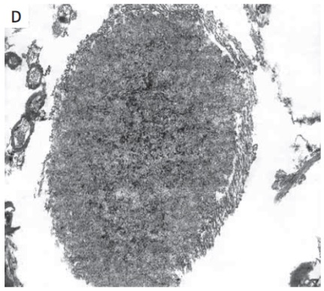
What is polyglucosan and how does it form?
Normal glycogen
Polyglucosan
Julie Turnbull & Berge Minassian
Wierzba-Bobrowicz et al (2008) Pholia Neuropathol

Slide 3
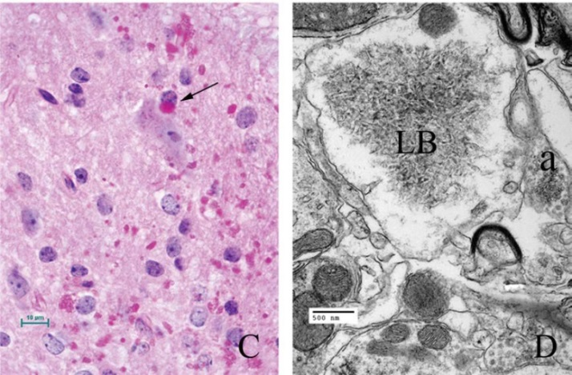
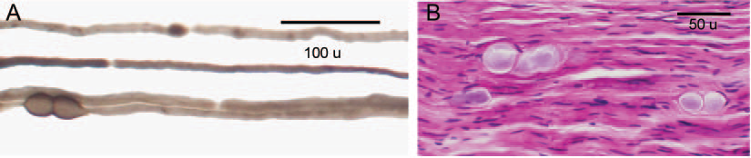
APBD implicates polyglucosans in brain cells (both glia and neurons).
Lafora Disease
Turnbull et al (2010) Ann Neurol
 | Disease Classification | Gene(s) | Mechanism | Onset | Main Polyglucosan location
Lafora Disease | Myoclonic Epilepsy | EPM2A (Laforin) NHLRC1 (Malin) | -GS accumulation -PG non-degradation -Glycogen hyperphosphorylation | Adolescent | Perikaria, dendrites
APBD | ALS-like Leukodystrophy | GBE1 (Glycogen Branching Enzyme) | Deficient glycogen branching | Adult | Axons
APBD
Lossos et al (2009) Neurology
Brain polyglucosans are also reported in aging, axonal neuropathies, Alzheimer and Hereditary Spastic Paraplegia .

Slide 4
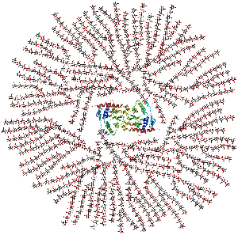
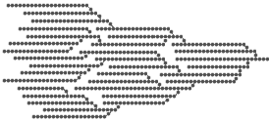
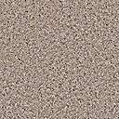
Glycogen biosynthesis involves chain elongation by Glycogen Synthase (GS) and chain branching by Glycogen Branching Enzyme (GBE). If chain elongation outbalances chain branching, glycogen could form starch-like precipitates made up of long, poorly-branched chains called polyglucosans.
Polyglucosan, poorly-branched
Normal glycogen, branched
GS/GBE activity ratio

Slide 5
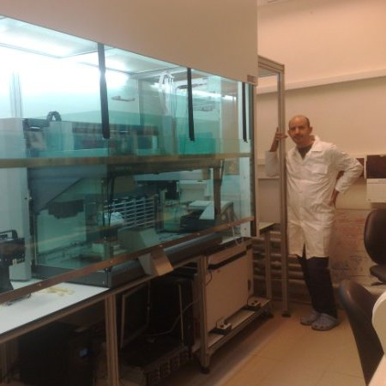
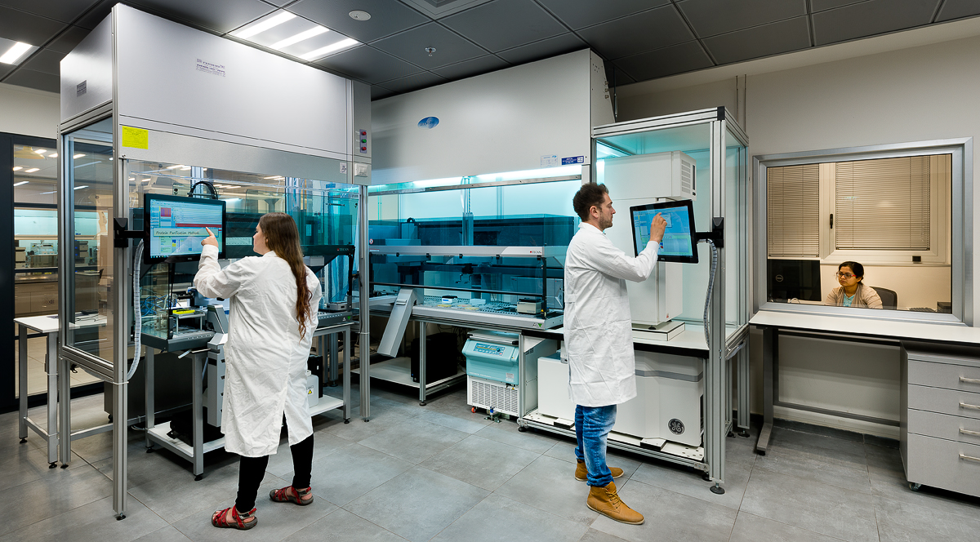
High Throughput Screening for reducing polyglucosan bodies
IN CELL 2200 high throughput microscope coupled to multiparametric analysis software
BDCC
Liquid handling robot
Pre-BDCC (CSFPM)
Leonardo Solmesky
Miguel Weil

Slide 6
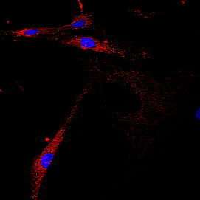
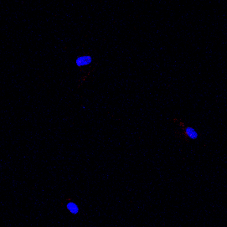
Readout: Periodic Acid-Schiff’s reagent (PAS) staining of polyglucosan (PG) granules. PG granules are found only in APBD model cells
APBD patient
Ctrl patient

Slide 7
HTS assay development
Days of exposure to compounds (evaluated 1, 2 and 3 days… 1 day was chosen).
% of serum in medium (evaluated 0, 5 and 10%... Finally 5% was chosen).
Diastase concentration (0.5%)
Diastase exposure time (5 minutes)
Cell number (800/well)
Fixation type (PFA was chosen and ammonium chloride was added for neutralizing)
Addition of Cell mask for allowing determination of cell area as a reference to PG.

Slide 8
To conduct HCS, proper cell segmentation is required. Nuclear collar is not a good tool for segmentation
CellMask^{TD} as a cytosolic marker determining polyglucosan cell association

Slide 9
Dose-response experiment with a disqualified compound
untreated
0.3125 µM
0.625 µM
1.25 µM
2.5 µM
5 µM
10 µM
This compound decreases the PAS signal gradually with its dose.
BUT WE DIDN’T KNOW IF THAT WAS ACTUALLY A DECREASE IN CELL AREA. ONLY POSSIBLE TO DETERMINE USING CELLMASK

Slide 10
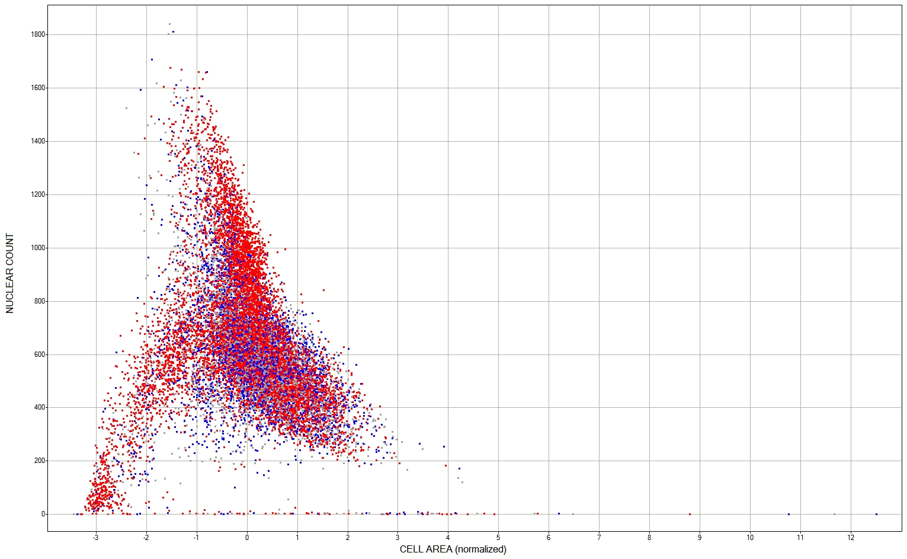

Compounds with cell area< -1.5 z-scores or <300 cells/well were considered toxic
Nuclear Count
Cell Area (normalized)

Slide 11
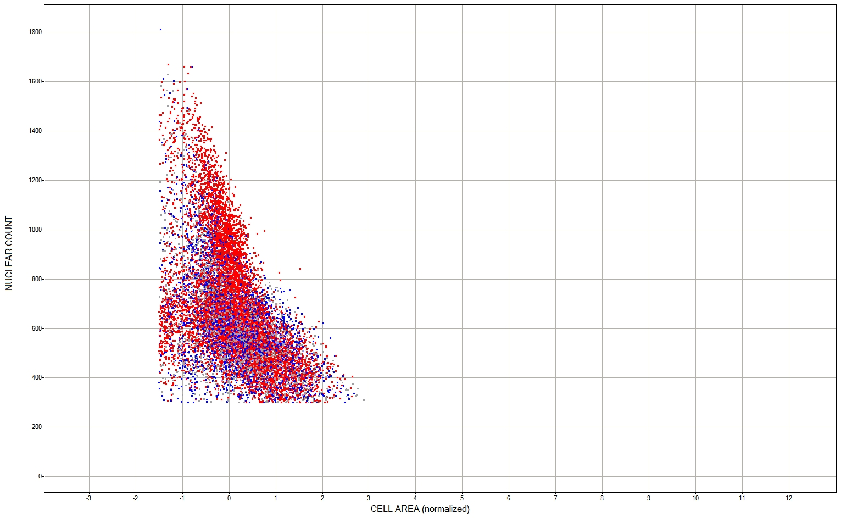
Compounds with cell area< -1.5 z-scores or <300 cells/well were considered toxic
Nuclear Count
Cell Area (normalized)

Slide 12
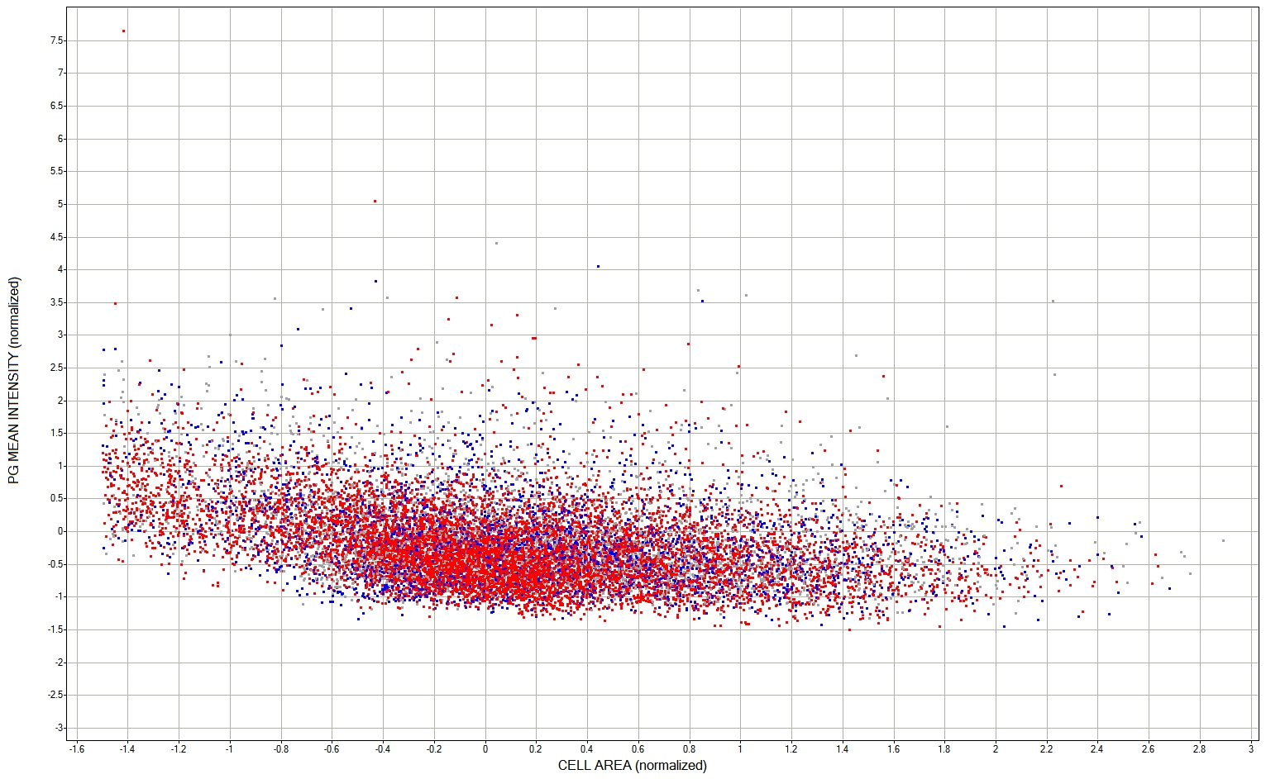
PG mean intensity <-1.2 z-scores for selecting hits
PG Mean Intensity (normalized)
Cell Area (normalized)

Slide 13
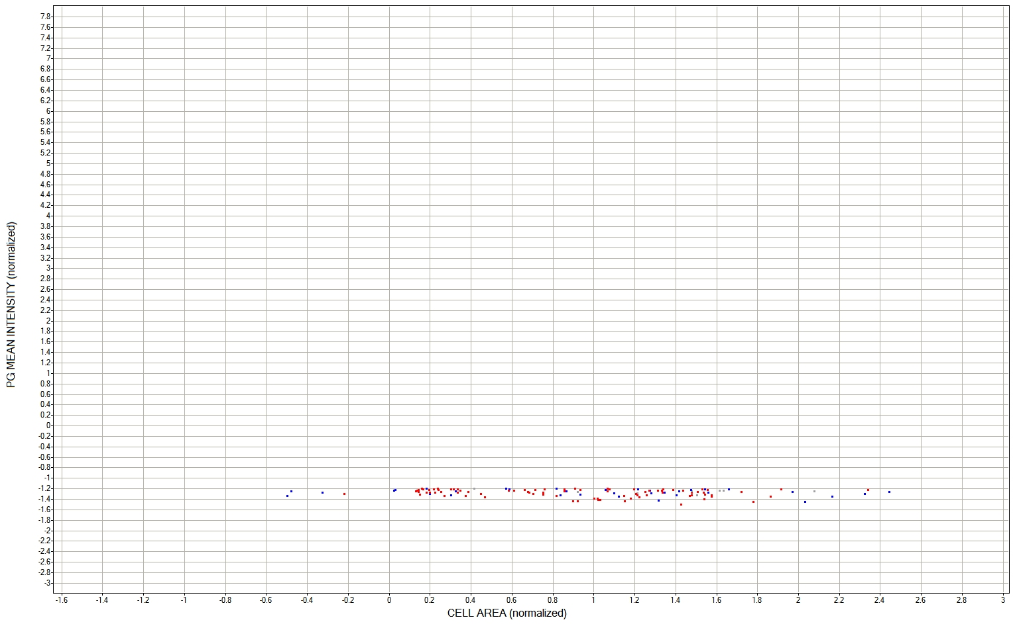
PG mean intensity <-1.2 z-scores for selecting hits
PG Mean Intensity (normalized)
Cell Area (normalized)

Slide 14
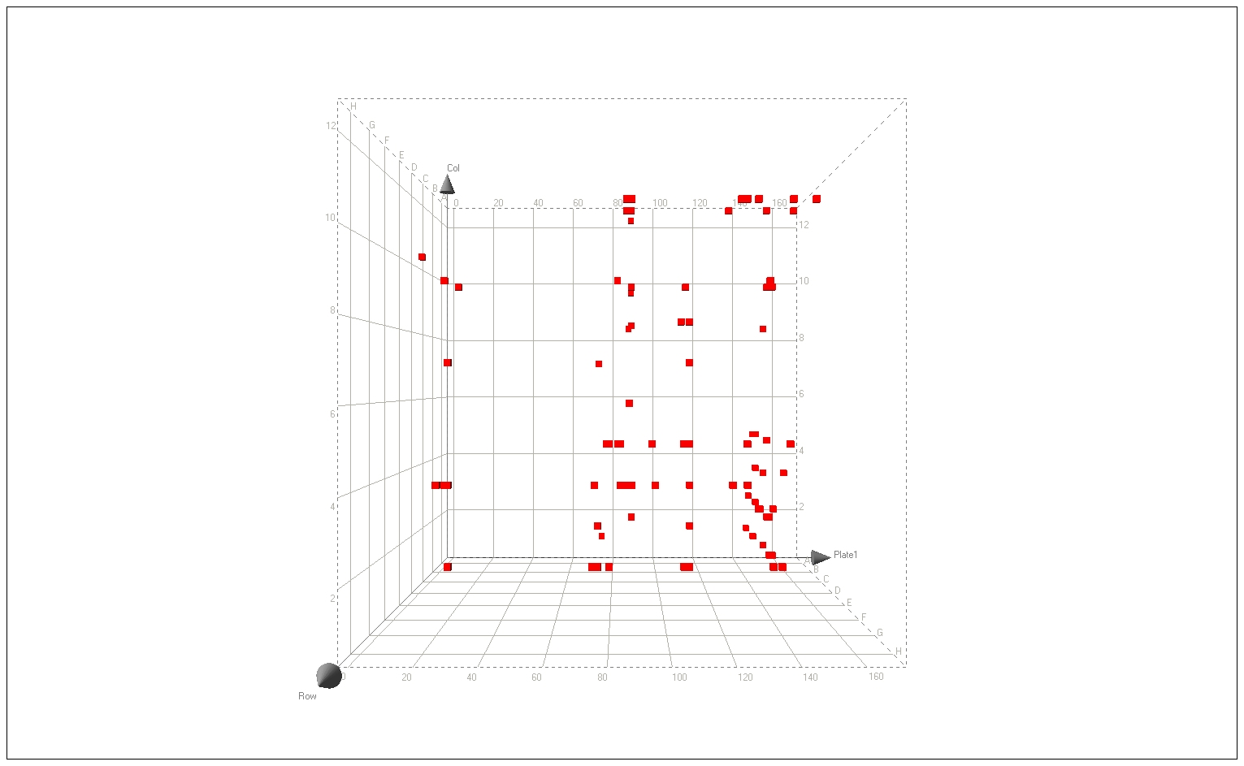
Compounds showing no toxicity & decrease in PG intensity (85 out of 10080 which is 0.84%, expected hit rate 0.5-1%)

Slide 15
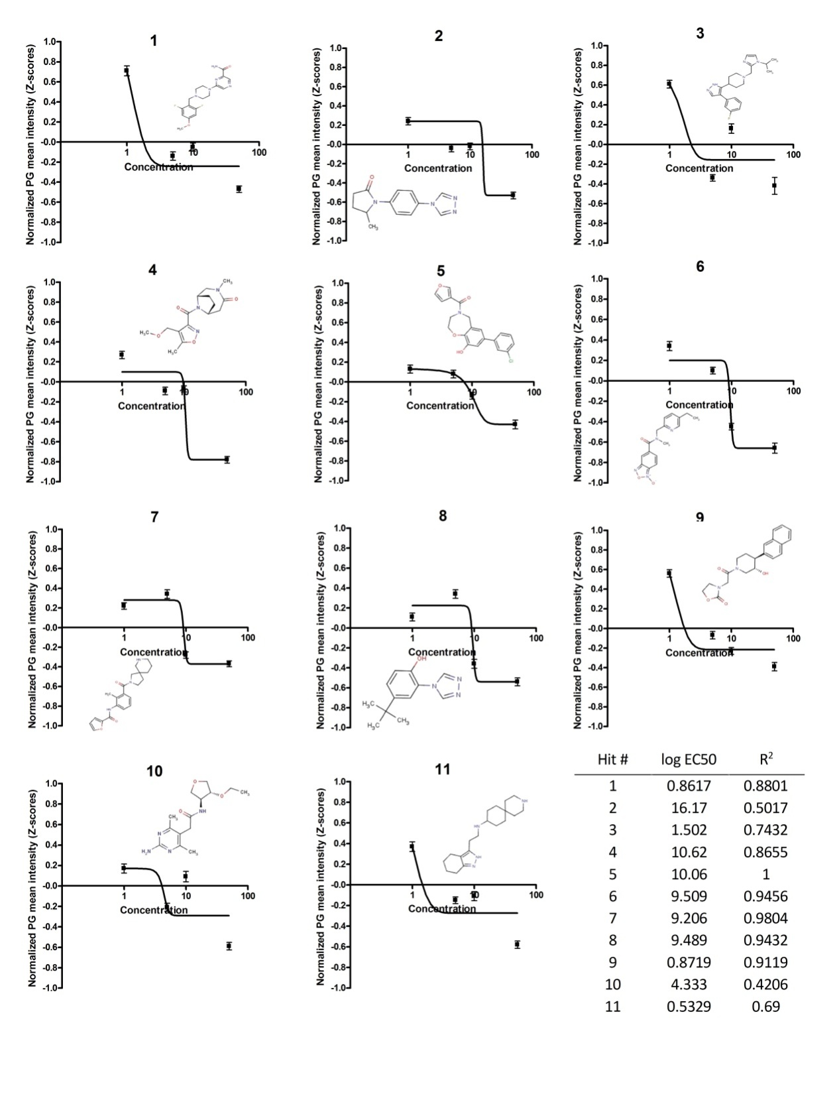
Based on dose response 11 hits from ChemBridge’s DIVERSet-CL library were confirmed
PG Mean Intensity
Concentration (0-50 µM)

Slide 16
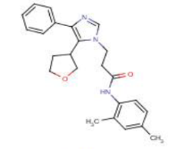
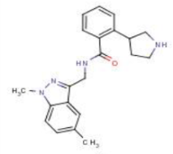
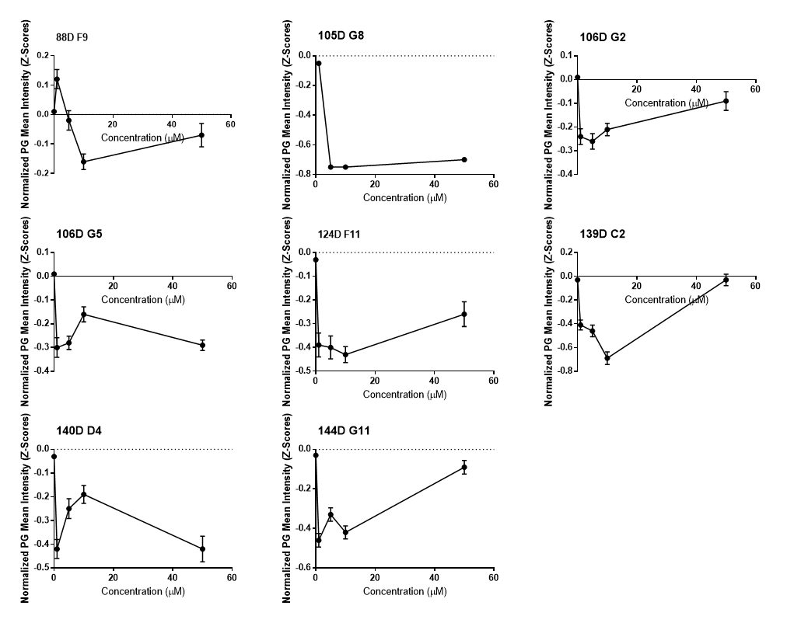
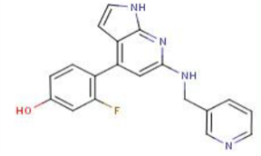
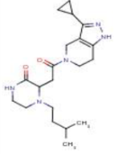
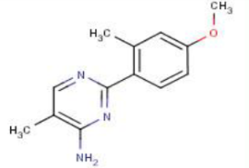
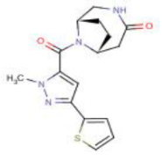
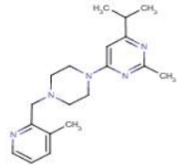
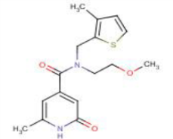
Supplemented by 8 non-dose responding hits

Slide 17
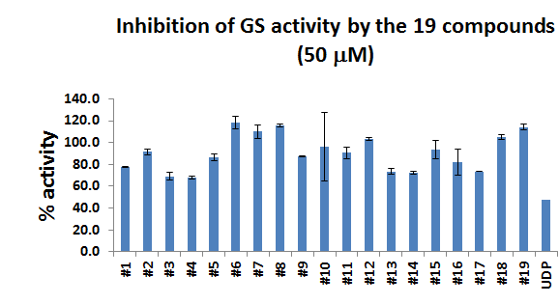
70% of hits have significantly inhibited GS activity
*
*
*
*
*
*
*
*
*
*
Peixiang Wang
Berge Minassian

Slide 18
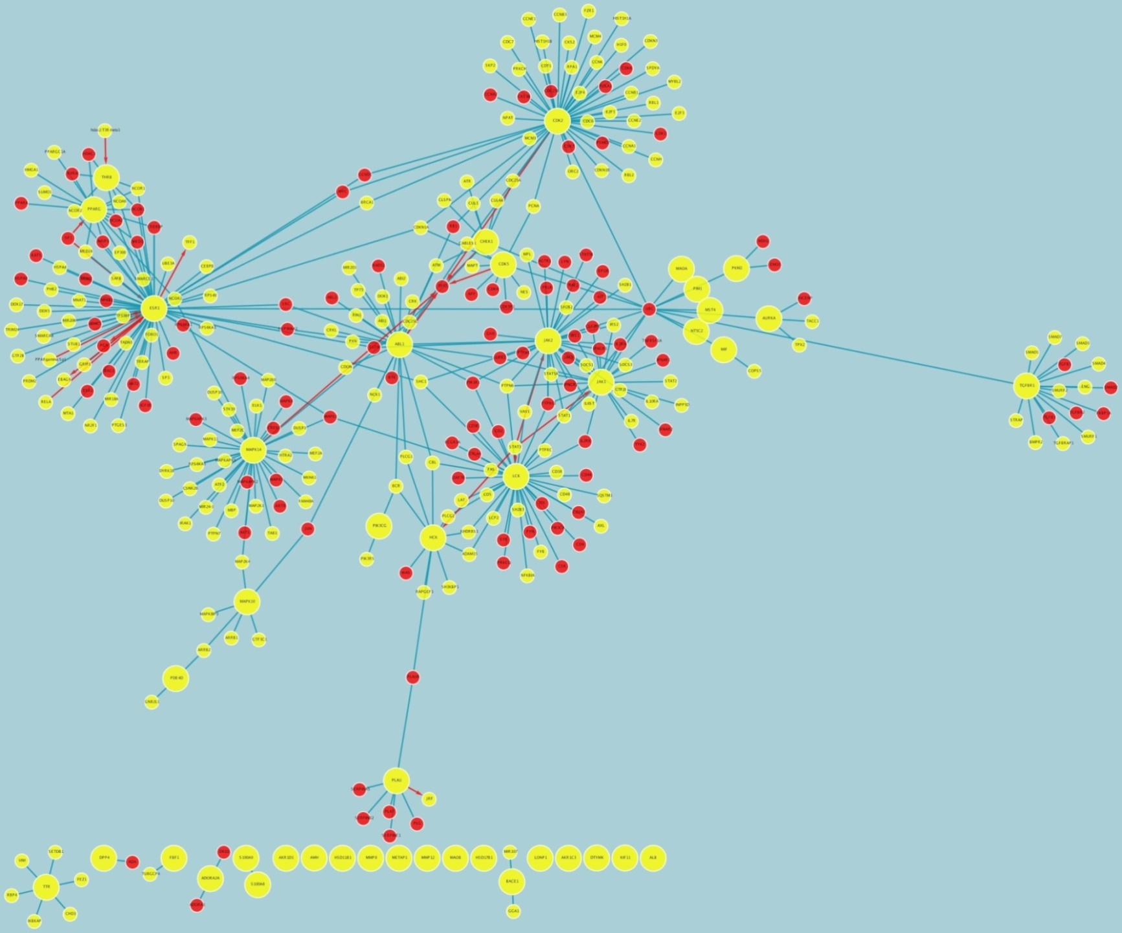
An interactome of the predicted protein targets of the hits discovered.
In red, protein targets of the hits known to interact with drugs and carbohydrate derivatives .

Slide 19
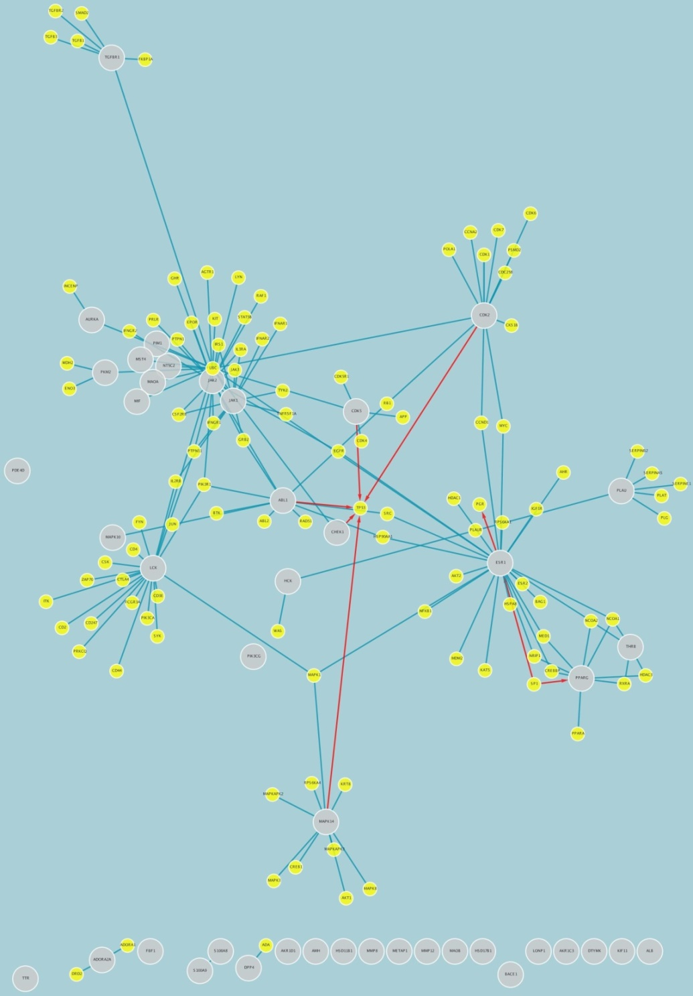
An interactome of only hit-protein targets known to bind drugs and carbohydrate derivatives (red circles in previous slide)
All the hits clustered with these drugs – half of them interact with the GS activator Protein Phosphatase 1 (PP1)
Ergo - PP1 inhibition a possible mode of action

Slide 20
Based on similarity to PP1 interacting drug and on Glycogen Synthase inhibition 4 out of the 19 hits were selected for mouse tests (2 hits per year).
So far safety studies on wild type control mice showed no apparent acute toxicity up to 250mg/kg administered IV for 5 consecutive days.
#4
#9
2 hits being tested:

Slide 21
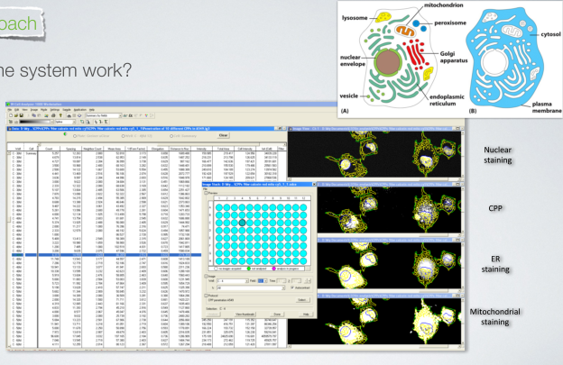
How does High Content Screening work?
Polyglucosans but also: Cell shape, Membrane, Nucleus, ER, Lysosomes, Golgi, Mitochondria, Vesicles, Cellular Proteins, Calcium

Slide 22
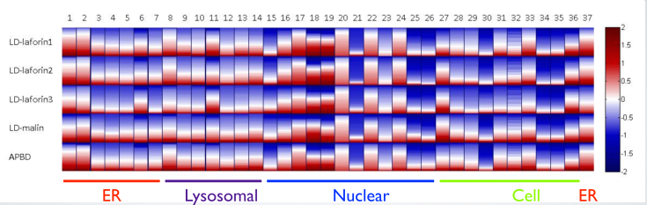
Multiparameter Analysis: Hits affect not only PG.
Test the global effect of hits (here shown: Nucleus, Cell, Lysosomes, Mitochondria)
Eddy Pichinuk
Miguel Weil
En route to personalized medicine:
Testing the effects of hits on numerous cellular phenotypes in cells derived from several patients with several diseases.
What is unique to APBD in comparison to other neurodegenerative diseases? to other storage diseases?

Slide 23
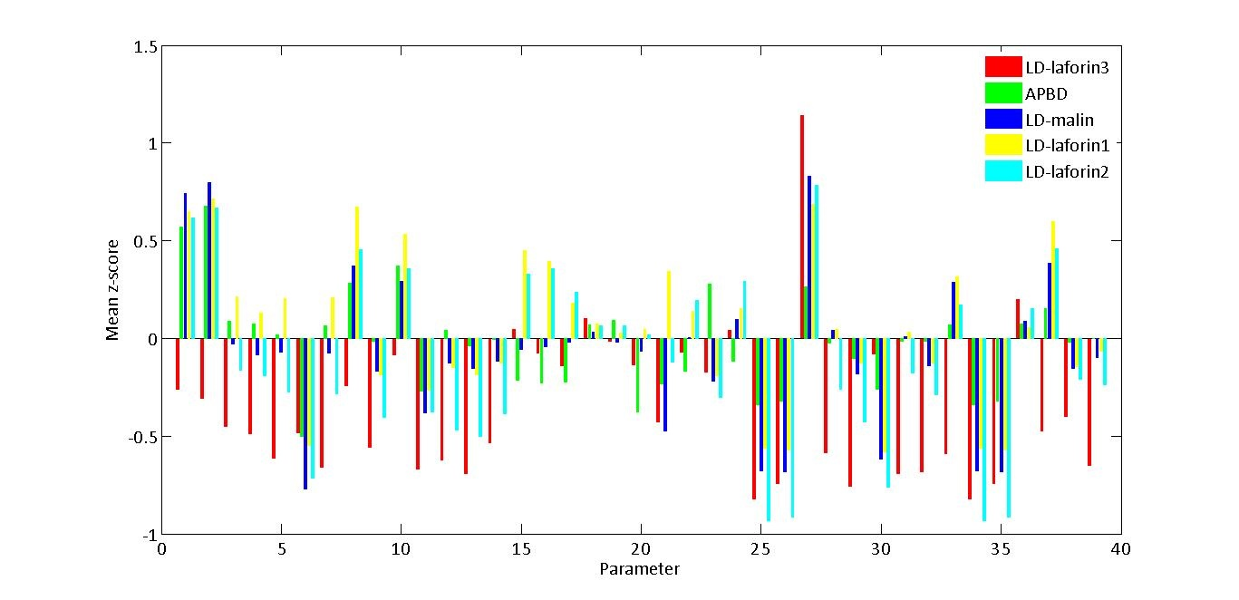

Demonstration of uniqueness
Eddy Pichinuk
Miguel Weil
unique
control-normalized phenoscores

Slide 24
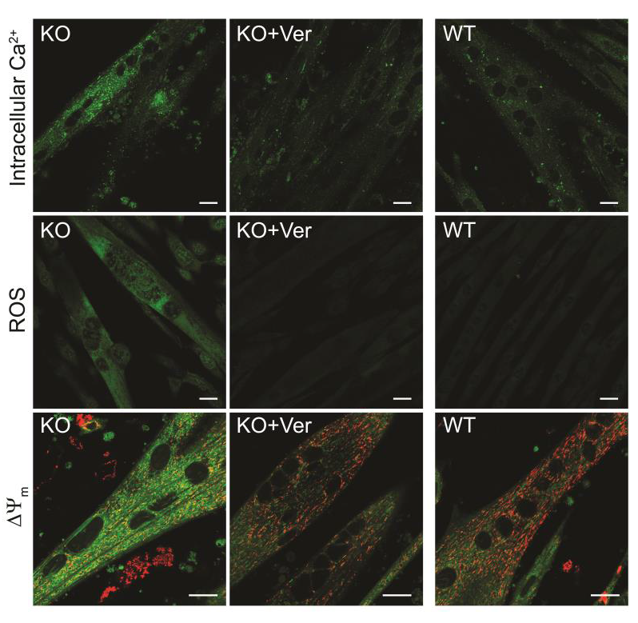
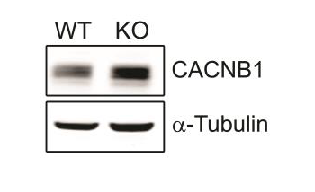
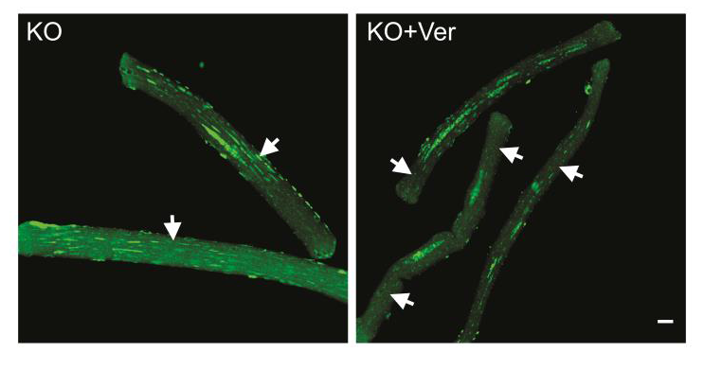
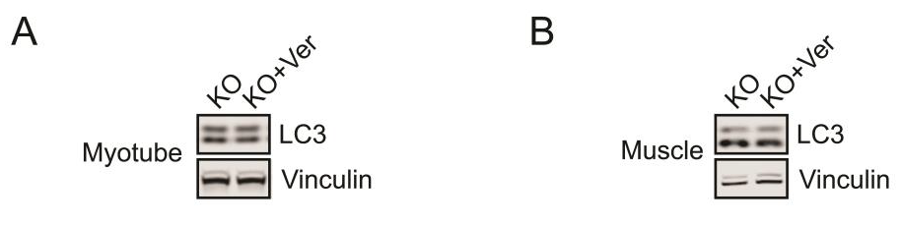
Etiology is not always related to known disease gene: Reversible Ca⁺² accumulation and damage in GAA KO myotubes
Ca channel blocker verapamil reinstated intracellular Ca⁺² , ROS production and ΔΨ_{m} to the normal phenotype. The Western blot shows a dramatic increase in KO in the levels of the CACNB1 calcium channel
Lim et al (2015)
Intracellular Ca was reduced in muscle fibers from GAA KO mice injected with verapamil. However, autophagy was not affected

Slide 25
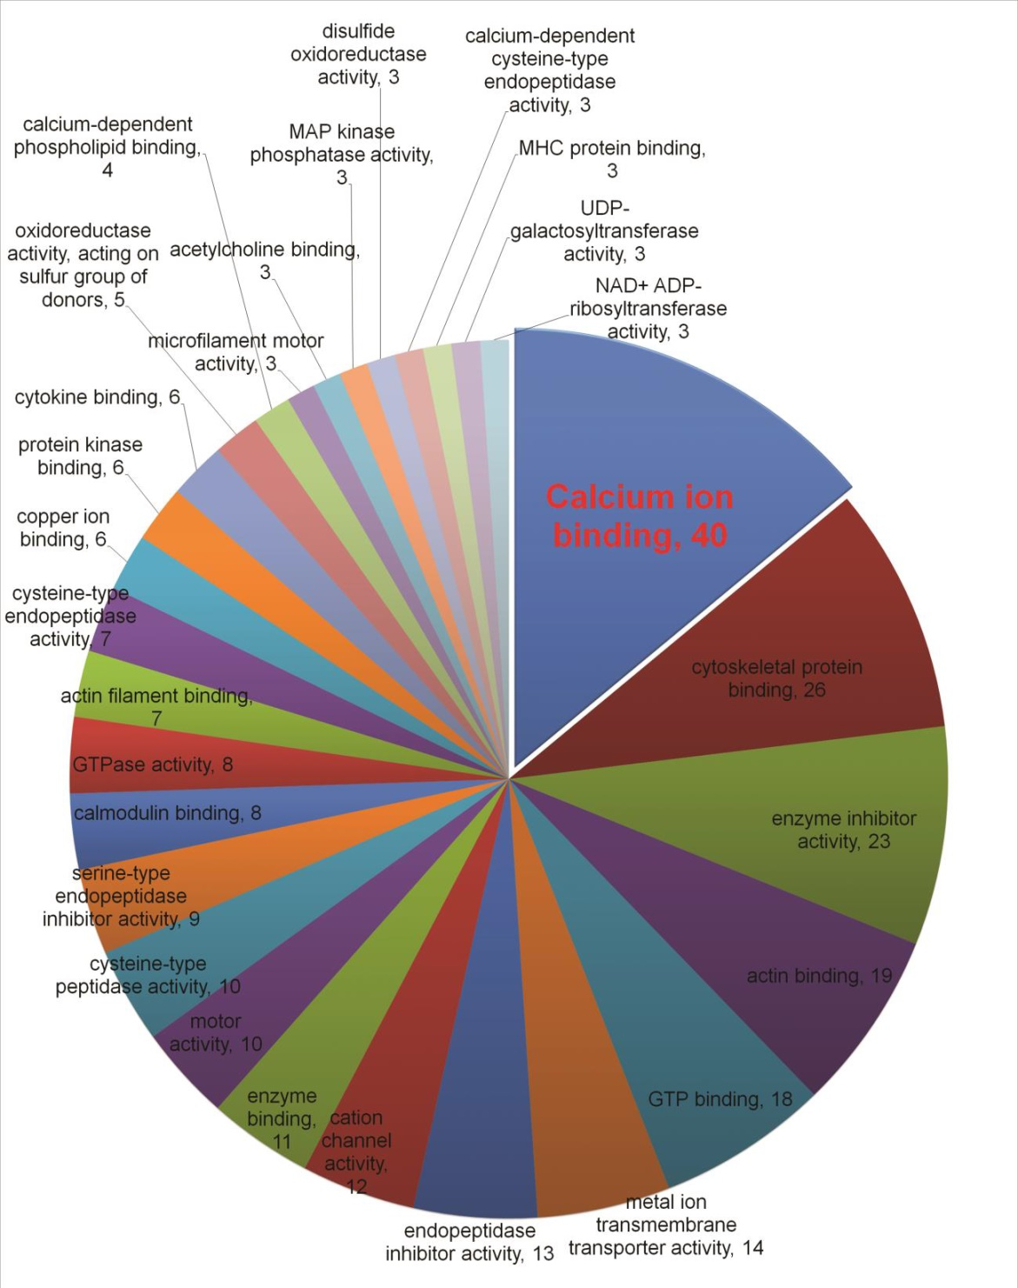
Molecular functions were attributed to 152 of the 551 genes upregulated in the KO GAA using mRNA-seq. A large number (40) of the genes upregulated in KO muscle codes for proteins that govern the levels of cellular calcium.
Lim et al (2015)

Slide 26
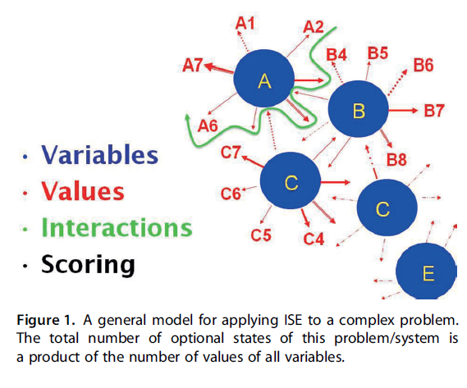
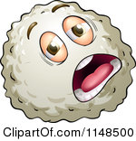

Classification: Using multiparametric phenoscores (machine learning) to predict, given a certain cell, whether it’s sick or healthy.
This cell is sick
This cell is healthy
Stern & Goldblum (2014)

Slide 27
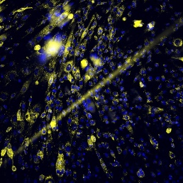
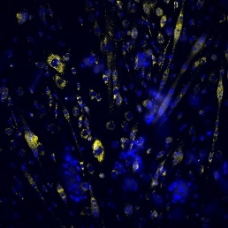
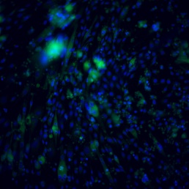
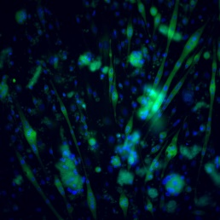
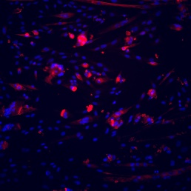
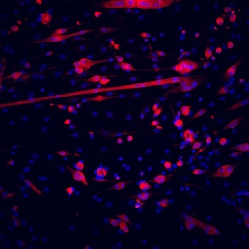
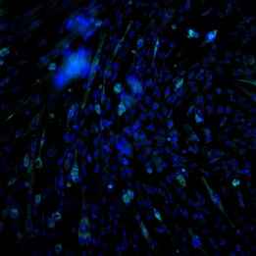
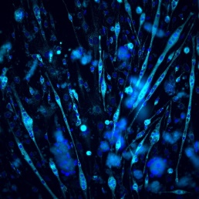
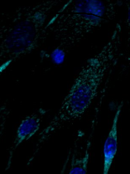
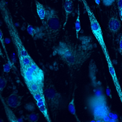
Pompe
WT
Demonstrating classification: Multiparametric analysis of cellular parameters in myotubes derived from Pompe Disease modeling (GAA^{-/-}) and WT mice.
Lyso
ER
Cytos
Mito

Slide 28
Lysosomes
Cell
ER
Lysosomal integrated intensity
Mean lysosomal area
Total lysosomal area
Lysosomal mean intensity
Lysosomal form factor
Lysosomal count
WT
WT
WT
WT
WT
WT
Pompe
Pompe
Pompe
Pompe
Pompe
Pompe
Mitochondria
Cytoskeleton
Nuclei
Analysing such a very large amount of data (28 parameters), we are able to predict with 85% confidence whether a given myotube is PD or WT myotube. Accuracy increases as more data are analyzed.

Slide 29


Machine Learning
Is this cell healthy?
Yes
Is this cell sick?
Yes

Slide 30

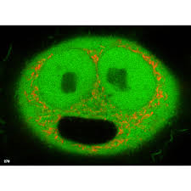
Personalized Drug Screening
Drug Screening
Individual disease phenotypes
Individual healthy phenotypes

Slide 31
Summary
We developed a High Throughput Screening assay which enables us to validate previous screens and discover 11 new hits.
Hits are validated by their effect on glycogen synthesis.
Our novel approach is to personalize APBD drug therapy by applying global comparisons of cellular parameters within and among diseases.

Slide 32
Acknowledgements
Tel Aviv University/BCDD
Leonardo Solmesky
Eddy Pichinuk
Miguel Weil
Hebrew University
Amiram Goldblum
Arijit Basu
Sick Kids Hospital/University of Toronto
Peixiang Wang
Berge Minassian
Hadassah-Hebrew University Medical Center
Alexander Lossos
NIH
Jeong-A Lim
Nina Raben

