Slide 1
Guaiacol Treatment Decreases Resting Glycogen Synthase Activity and Expands the Life Span in the Mouse Models of APBD
H. Orhan AKMAN¹, Yasemin G. Kurt¹, Bulent Kurt², Rebecca J. Levy¹, Salvatore DiMauro¹
Houston Merritt Neuromuscular Disease Research Center
Department of Pathology, Neuromuscular Division,
Columbia University Medical Center New York, NY 10032, USA

Slide 2
Guaiacol
A naturally occurring organic compound
Contributes to the flavor of many food and organic materials, such as roasted coffee and smoke

Slide 3
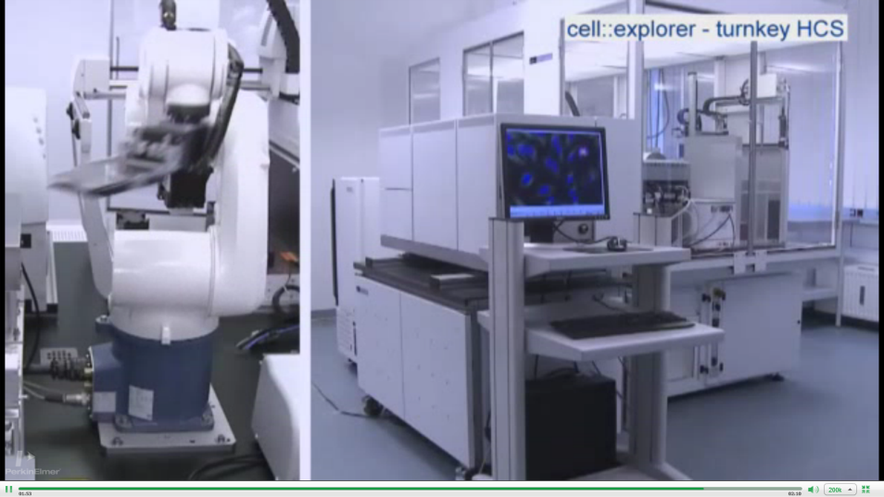
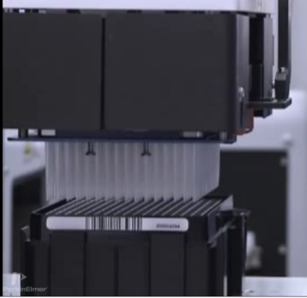
How have We Found Guaiacol?
Guaiacol was one of the 1700 compounds made available by Johns Hopkins University
This or similar compound libraries are being able to be used by automated systems to treat cells, and proteins.

Slide 4
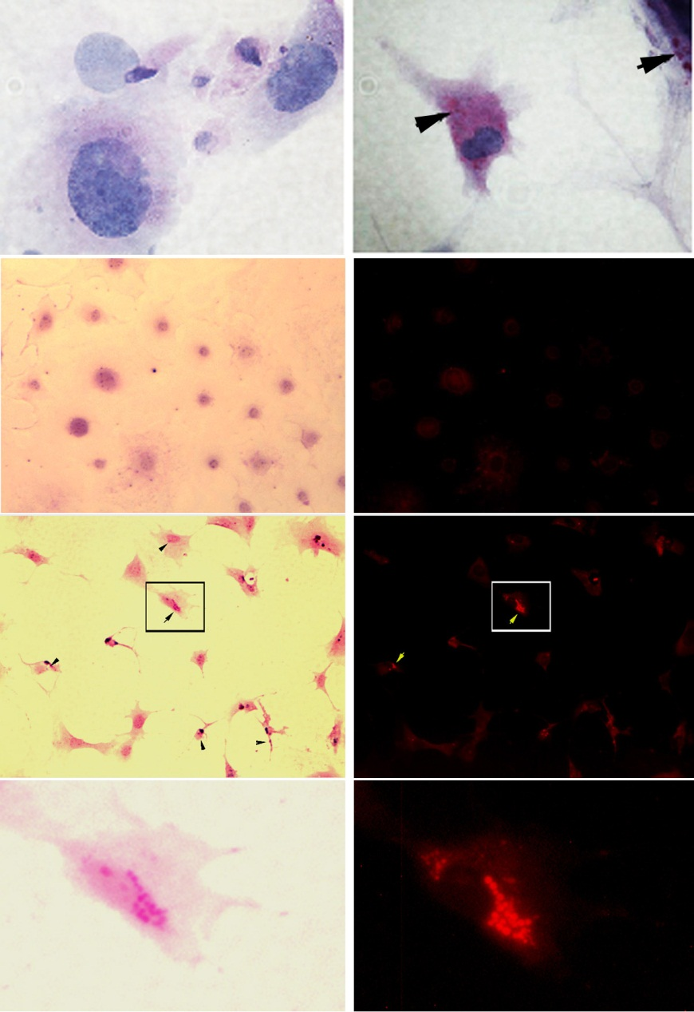
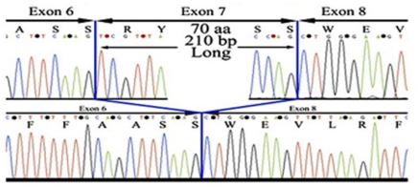
Generation of a cell model for high throughput screening
Gene targeting and molecular characterization of a GBE deficient mouse model. (A) A partial map of the Gbe1 locus and the targeting vector containing FRT sites flanking exon 7, before and after homologous recombination in ES cells. Crossing Gbe1^{+/neo} mice with ROSA 26-flpe mice excises exon 7 from one allele of the Gbe1 gene by Flpe recombinase. Subsequent breeding of heterozygous mice Gbe1^{+/-} creates a Gbe1 knockout mouse (Gbe1^{-/-}). (B) RT-PCR and the sequence analysis of the mRNA extracted from neonatal muscle tissue and electropherograms of exons 6 to 8 shown from the RT-PCR product of wild type (top) and Gbe1^{-/-} (bottom) cDNA

Slide 5
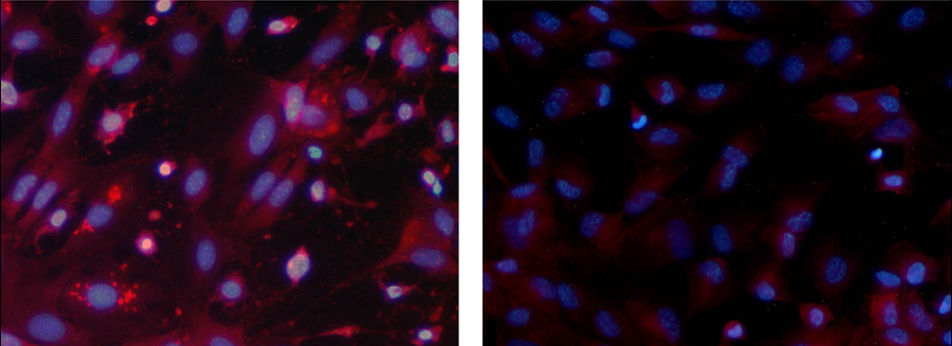
High throughput screening

Slide 6
Guaiacol Decreased Glycogen in Mouse Embryonic Fibroblasts
We have tested these compounds by high throughput screening in a cell line we have obtained from GBE deficient mice.
Guaiacol is one of the best compound that decreased polyglucosan/glycogen content in the cell.

Slide 7
Guaiacol Decreases Glycogen Synthase Activity by Keeping It Phosphorylated
GYS1 Activity 69±1.8 65 ±2.4 66±5.0 69±3.8 59 ±1.1 45±4.8 +Glu6P
(μmol/min/mg ) 19±2 12±2.8 13±1.8 12±3.8 10 ±0.8 9±2.4 - Glu6P

Slide 8
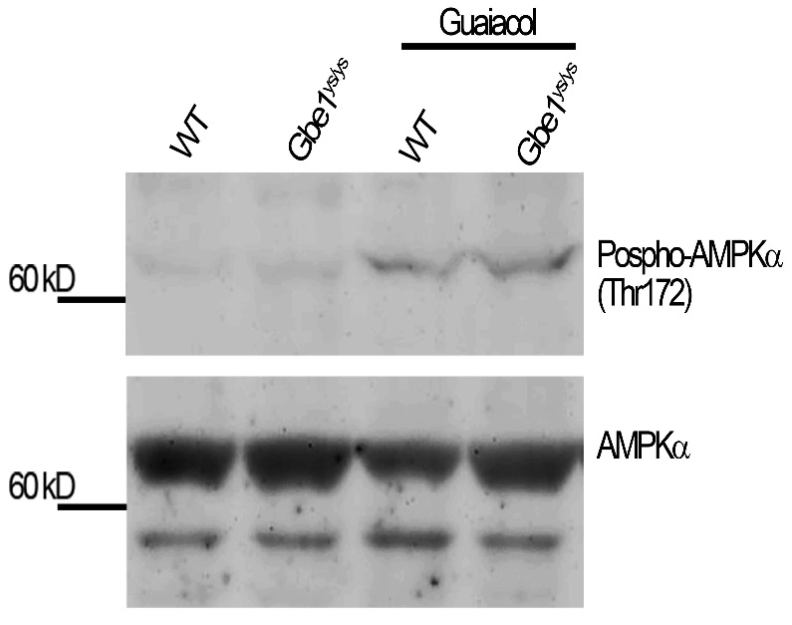
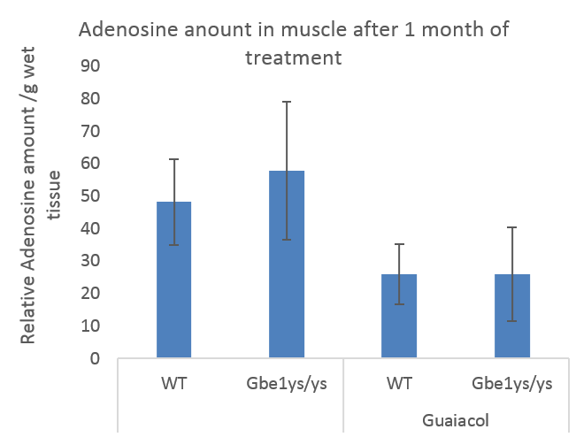
GYS Phosphorylation can be mediated by AMP kinases
Western blot analysis of phospho AMPK-α and total AMPK in muscle extracts obtained from wt Gbe1^{ys/ys} and 1 month treated Wt and Gbe1^{ys/ys} mice.
HPLC analysis of Adenosine in muscle.

Slide 9
Where Does Glucose Go?

Slide 10
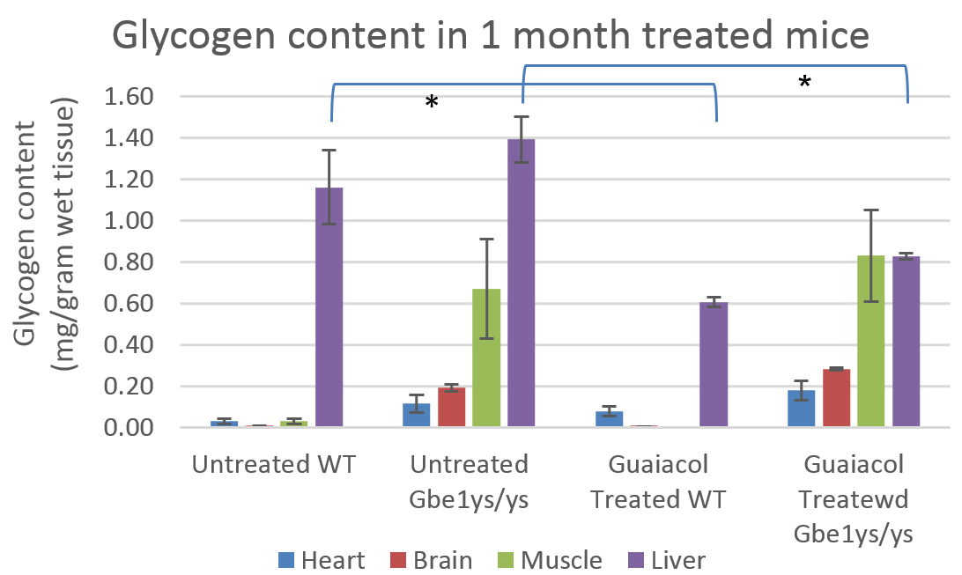
Does Glucose Accumulate as Glycogen Or be Used Up?
3% 3%
7% 2%
7.9% 6%
6% 9%
Liver Muscle Heart Brain
Heart, brain, muscle and Liver glycogen content in wild-type, Gbe1^{ys/ys} and guaiacol treated wild-type, Gbe1^{ys/ys} mice. Glycogen was measured after a 16 h fast (n = 4 for each treatment). Glycogen content is expressed as percent glucose mg/gram fresh tissue. Error bars represent the mean ± SD, P < 0.001 where indicated (*).

Slide 11
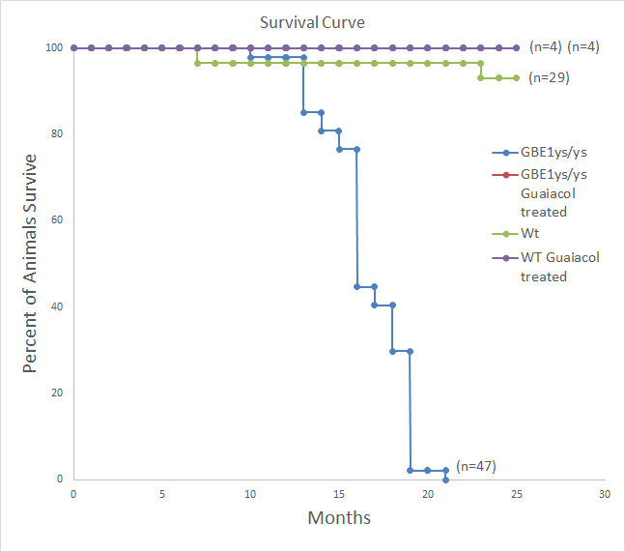
Does It Help APBD Mouse?
Kaplan-Meier plot illustrates the incidence of death in Gbe1^{ys/ys} (n=47), versus WT mice (n=29) and guaiacol treated Gbe1^{ys/ys} and Wt mice (n=4 each).

Slide 12
Conclusion
Guaiacol causes hyper phosphorylation of glycogen synthase
In liver it partially prevents polyglucosan accumulation
Other functions of guaiacol has to be studied which may explain its effect on life span.

