Slide 1
Tamar R. Grossman, PhD
Antisense Oligonucleotide Therapy for Genetic Diseases

Slide 2
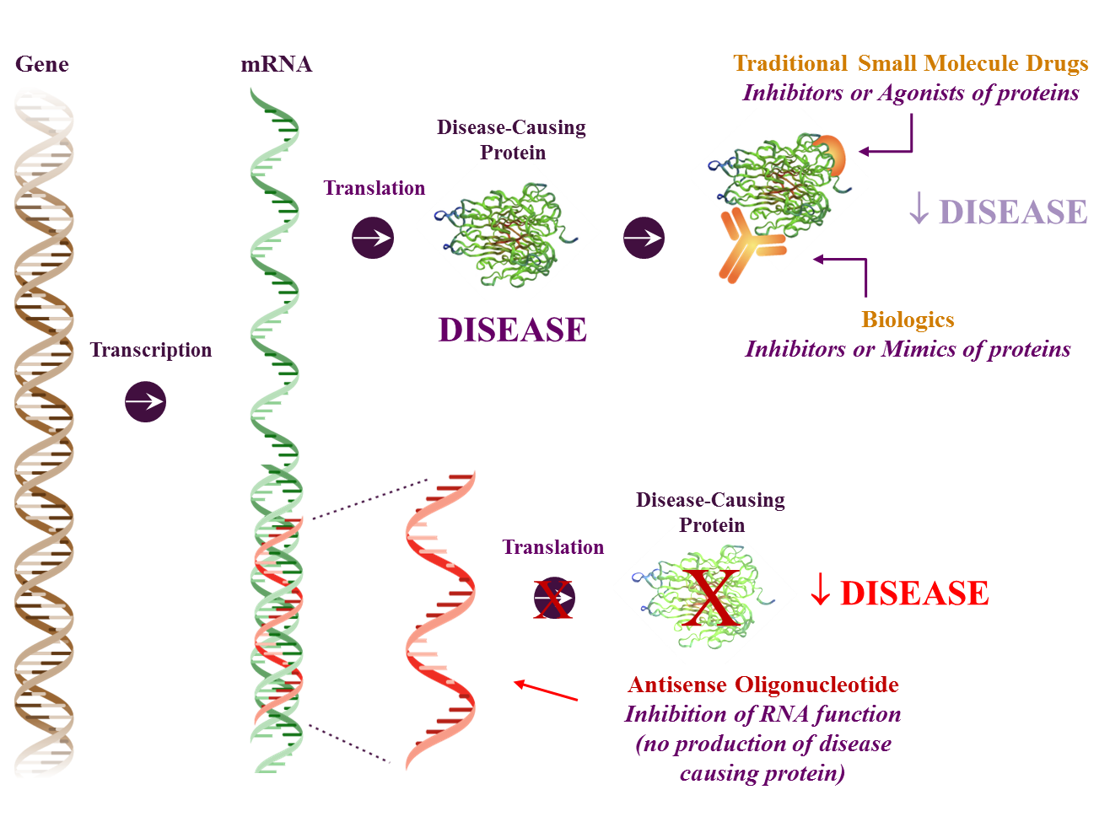
Why Target RNA for Therapeutics?
RNA therapeutics as a platform is a revolutionary approach to discover new and important therapeutic agents for treating human diseases
RNA as a class of molecules plays a major role in the regulation of biological processes and in human diseases
Therapeutic approaches against RNA are generally unapproachable with existing drug platforms (e.g., small molecules)
Non-druggable protein coding RNAs
Alternatively spliced RNAs
Non-coding RNAs
microRNAs
Nuclear retained RNAs
Antisense RNAs
Structural RNAs

Slide 3
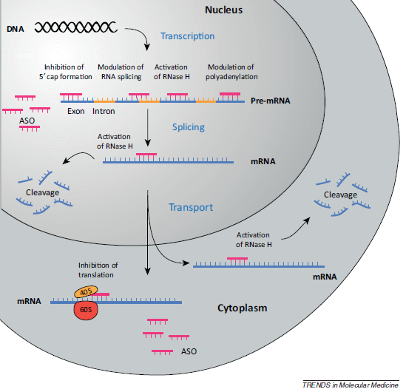
Antisense Mechanism of Action for Oligonucleotide Drugs
Antisense oligonucleotides (ASOs) can interact with both pre-RNA in the nucleus and mature mRNA in the cytoplasm
ASO can target exonic, intronic, and untranslated region (UTR) sites
ASO can reduce or increase gene expression through a variety of mechanisms:
mRNA maturation (5’ cap formation, splicing, and polyadenylation)
RNase H-mediated degradation
Steric translation inhibition
Southwell et al 2012

Slide 4
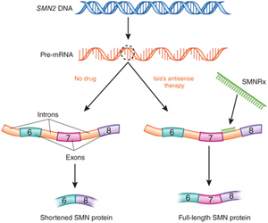
Antisense Technology is the Only Validated Direct Route from Gene Sequence to Drugs
Antisense technology can act on a target RNA in a variety of ways to treat human diseases
Reduces target RNA & prevents production of protein
Removes toxic RNA
(coding and noncoding)
Increases production of therapeutic protein
DMPK_{Rx}
RNase H1
mRNA for disease-causing protein
RNase H1
ASO
Example: IONIS-TTR_{Rx} (Hereditary TTR Amyloidosis)
Example: IONIS-DMPK_{Rx} (Myotonic Dystrophy I)
Example: IONIS-SMN_{Rx} (Spinal Muscular Atrophy)

Slide 5
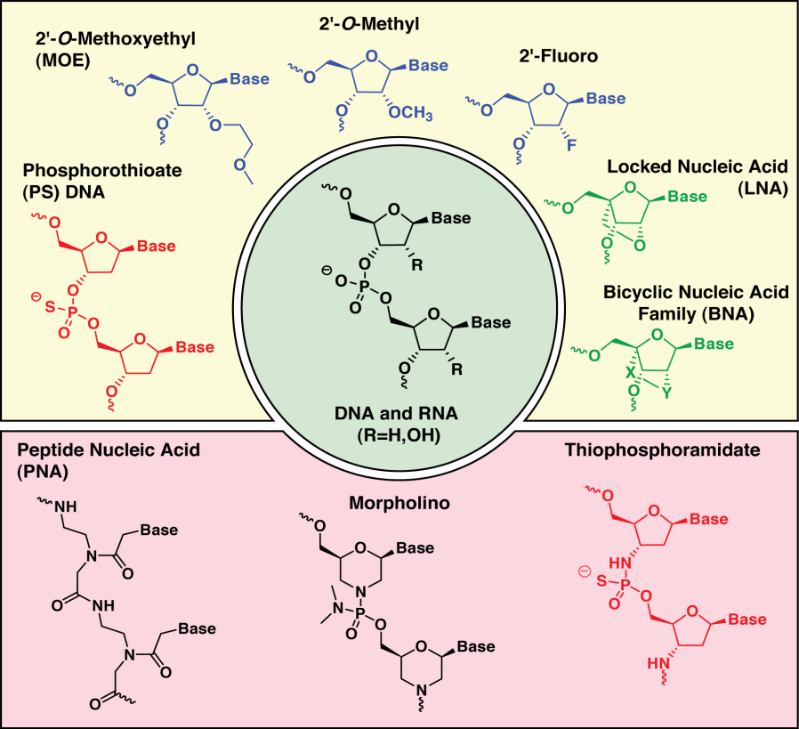
RNase H Antisense Mechanism Oligonucleotide Chemistries
Chimeric RNase H1 Oligo Design
↑ affinity
↑ stability
↑ tolerability
↑ affinity
↑ stability
↑ tolerability
RNase H1 Substrate
MOE
DNA
MOE
2’-O-methoxyethyl (MOE)

Slide 6
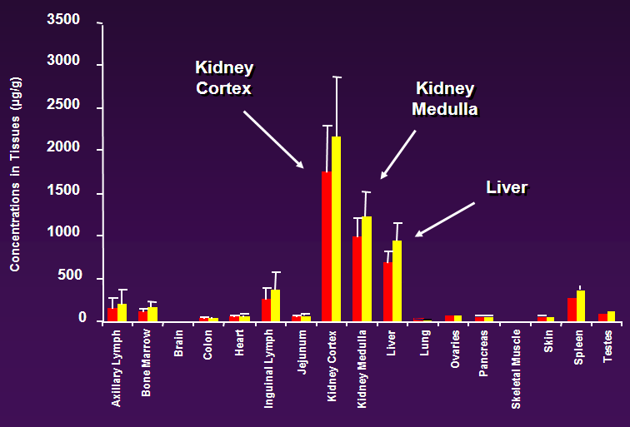
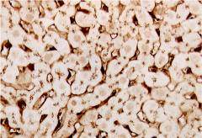
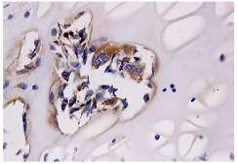
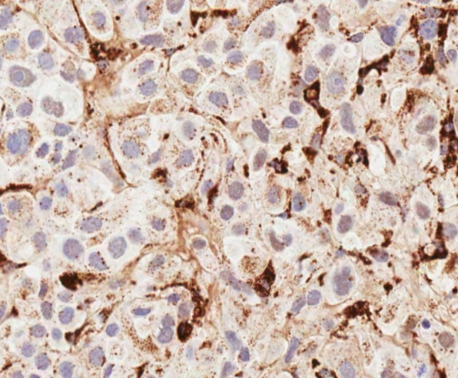
Tissue and Cellular Pharmacokinetics of ASOs Administered Systemically or *Locally
Protein binding critical for uptake by cells
Broad distribution
no CNS by systemic administration
Strong PK/PD correlation demonstrated in tissues such as:
Distribution of 2’MOE Oligonucleotide in Monkey Following Parenteral (IV) Administration (10 mg/kg)
Liver Adipose tissue | Kidney Spleen lymph nodes | Bone marrow Lung Cancer
*CNS | *GI | *Eye
Red (full length oligonucleotide)
Yellow (total oligonucleotide)
Kidney
Liver
Bone
Tumor

Slide 7
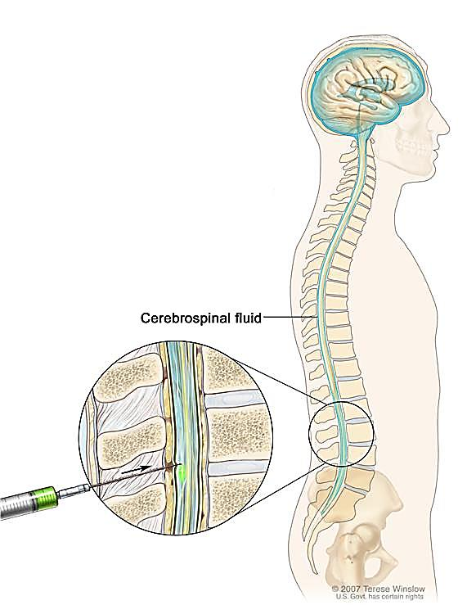
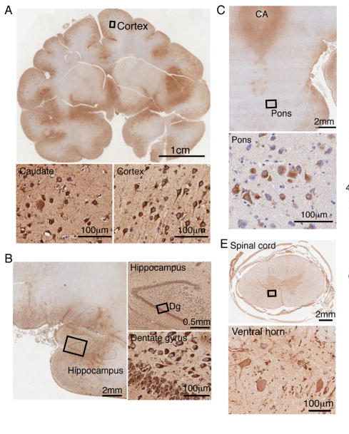
Tissue and Cellular Pharmacokinetics of ASOs Administered Locally by Intrathecal Injection
Broad ASO distribution in a non-human primate brain after ASO infusion into the cerebral spinal fluid
Intrathecal injection
into the fluid surrounding
the spinal cord and brain (cerebrospinal fluid)
IHC with ASO specific antibody
Image adapted from www.cancer.gov
Kordasiewicz et al, Neuron, 2012

Slide 8
Advantages of the Ionis Antisense Platform for Drug Discovery
Rapid identification of drugs
Efficiently screen many targets in parallel
100% success rate in identifying inhibitors
All genes are “druggable” with high selectivity
Predictable pharmacokinetics and safety
Shared manufacturing and analytical processes
Shortened timelines from concept to first human dose
Clinical Experience
> 6,000 subjects dosed
> 90 clinical studies
Multiple therapeutic indications
> 100 patients dosed for > 1 year
Doses as high as 1200 mg tolerated
Target Identification
Oligo Synthesis days
Lead Oligo ID weeks
Cell Culture Assays 1-2 months
Animal Studies 3-6 months
In Man 9-12 months

Slide 9
GYS1 ASO for Treatment of APBD and Lafora Disease
Therapeutic Objective:
Slow the progression of APBD/Lafora disease by inhibition of glycogen synthesis in neurons and formation of LB by GYS1 ASO.
Rational:
Gys1 heterozygous knockout rescues multiple deficits in Lafora disease mouse model (Duran et al 2014)
Glycogen accumulation and lafora bodies reduced
Neurodegeneration reduced as measured by decreased GFAP and Iba1 staining
Increased LTP in malin KO mouse is normalized
Reduced susceptibility to kainate-induced epilepsy to control levels
Autophagy deficit restored
Humans who have total absence of GYS1 are healthy except for a late-childhood cardiomyopathy
No health issues in humans with 50% GS activities (Pederson et al 2013).

Slide 10
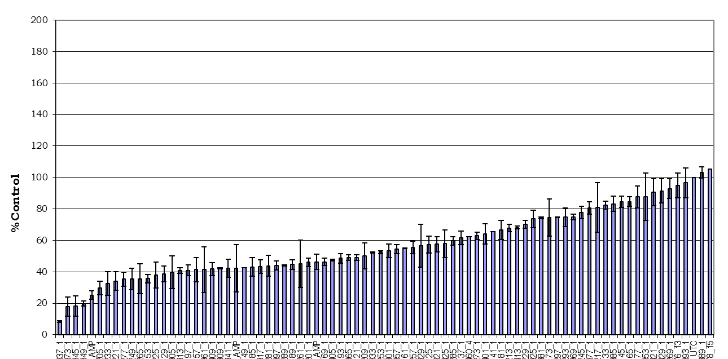
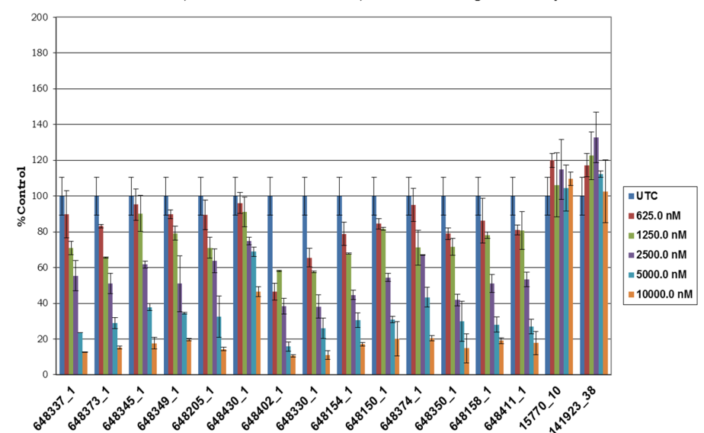
Identification of mouse Gys1 ASO for the Proof of Concept Studies
Design and synthesis of ~400 ASOs targeting Gys1
In vitro single dose screen of all ASOs (~400 ASOs). Gys1 mRNA level measured by qRT PCR
Dose response validation of the top lead ASOs (~30 ASOs)
In vivo screen in wild type mice by ICV administration of most active ASOs (~15 ASOs)
ASO# rank order by activity
IC50uM | 2.5 | 2.4 | 3.6 | 3.0 | 2.9 | 10.7 | 0.9 | 1.5 | 2.3 | 3.0 | 3.6 | 2.3 | 2.7 | 2.7
In vitro screen in B16-F10 cells. ASOs were transfected by electroporation.

Slide 11
Glycogen Synthase ASO Tolerability and Efficacy Screen GYS1 mRNA Knockdown
Cortex
Protocol:
C57/BL6 mice (n=4 per group).
intracerebroventricular (ICV) bolus injection of 300 ug of each ASO to WT mice
Mice sacrificed 2 weeks post-ICV to assess target reduction and tolerability.
% of PBS Control
Hippocampus
Cerebellum
% of PBS Control
% of PBS Control

Slide 12
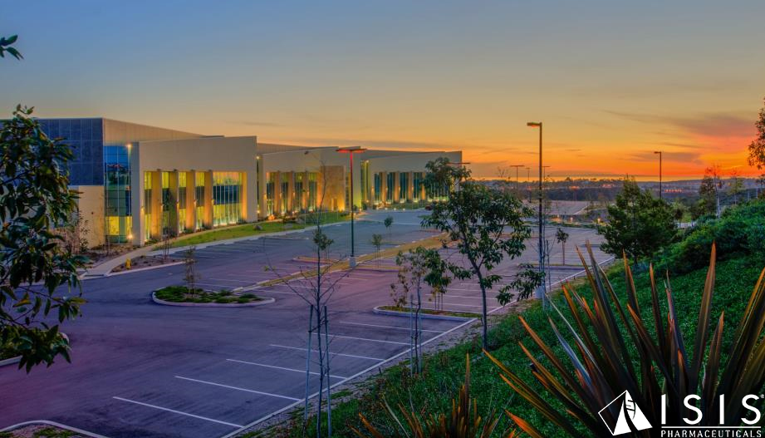
Thank You!
Gys1 ASO Ionis team
Lisa Hettrick
Holly Kordasiewicz
Jose Mendoza
Andy Watt
Melanie Katz
The Hospital for Sick Children, Toronto, Canada
Berge Minassian
Saija Ahonen
Michael McCaleb
Brett Monia
Eric Swayze
Roger Lane
Marc Gleichmann

Slide 13
Ionis Pharmaceuticals Pipeline
Drugs | Indication | Partner | Phase I | Phase II | Phase III
CV
IONIS-FXI_{Rx} | Clotting Disorders | Bayer
IONIS-APO(a)-L_{Rx} | Very High Lp(a) | Ionis/Akcea
IONIS-ANGPTL3-L_{Rx} | Hyperlipidemia | Ionis/Akcea
Severe and Rare
Nusinersen | Infant SMA | Biogen
Nusinersen | Children SMA | Biogen
IONIS-TTR_{Rx} | Familial Polyneuropathy | GSK
IONIS-TTR_{Rx} | TTR Cardiomyopathy | GSK
Volanesorsen | Familial Chylomicronemia Syndrome | Ionis/Akcea
Volanesorsen | Familial Partial Lipodystrophy | Ionis/Akcea
IONIS-DMPK-2.5_{Rx} | Myotonic Dystrophy 1 | Biogen
IONIS-HTT_{Rx} | Huntington’s Disease | Roche
IONIS-GCCR_{Rx} | Cushing’s Syndrome | Ionis
IONIS-PKK_{Rx} | Hereditary Angioedema | Ionis
Onco
IONIS-AR-2.5_{Rx} | Cancer | AstraZeneca
IONIS-STAT3-2.5_{Rx} | Cancer | AstraZeneca
Other
IONIS-HBV_{Rx} | HBV | GSK
IONIS-GSK4-L_{Rx} | Ocular Disease | GSK
Metabolic
IONIS-GCGR_{Rx} | Diabetes | Ionis
IONIS-GCCR_{Rx} | Diabetes | Ionis
IONIS-PTP1B_{Rx} | Diabetes | Ionis
IONIS-FGFR4_{Rx} | Obesity | Ionis
IONIS-DGAT2_{Rx} | NASH | Ionis

