Slide 1
A double-blind placebo-controlled trial of triheptanoin in adult polyglucosan body disease (APBD)
Raphael Schiffmann MD, MHSc, Mary E. Wallace, MSRD, LD, CCRC, Daisy Rinaldi PhD, Jean-Yves Hogrel MD, Orhan Akman, PhD, Derek Blankenship, Jacob Turner PhD and Fanny Mochel MD, PhD
Institute of Metabolic Disease, Baylor Research Institute, Dallas, Texas, USA
Department of Genetics, AP-HP, Pitié-Salpêtrière University Hospital, Paris, France

Slide 2
Disclosure
Research Support: Protalix Biotherapeutics, Shire, Inc., Amicus Therapeutics
Honoraria: Genzyme, Protalix Biotherapeutics, Shire, Inc., Amicus Therapeutics
This study was funded by the Baylor Research Institute and Ultragenyx Pharmaceutical

Slide 3
Introduction
Rare autosomal recessive disease
Glycogen branching enzyme deficiency – GBE1 mutations
It is the adult form of GSD IV
Onset 5th – 6th decade of life
Progressive gait disorder caused by a myelopathy (motor and sensory deficits)
Neurogenic bladder
Peripheral neuropathy

Slide 4
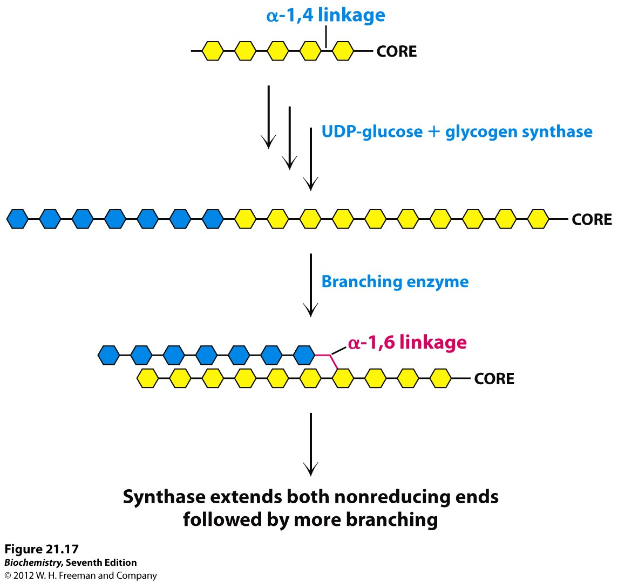
Glycogen Synthesis

Slide 5
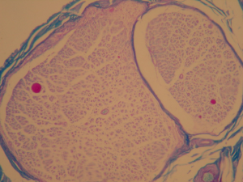
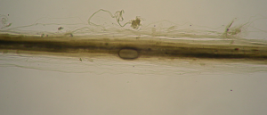
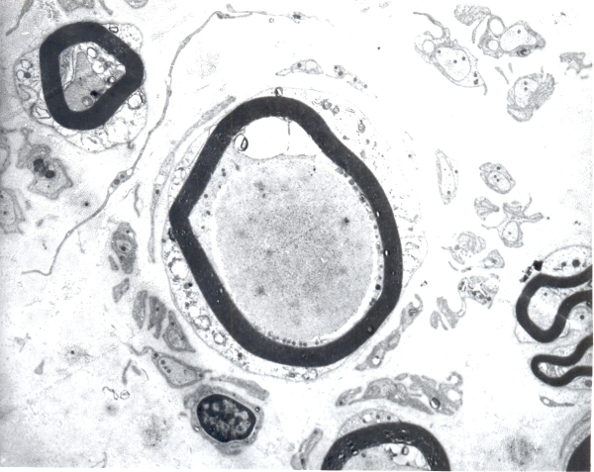
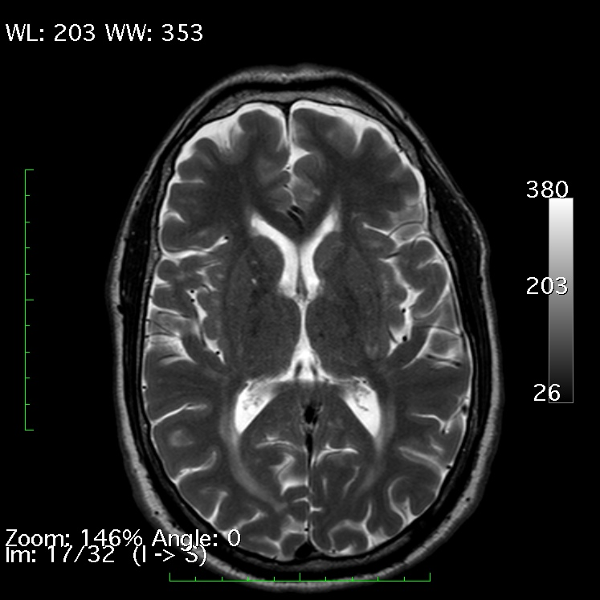
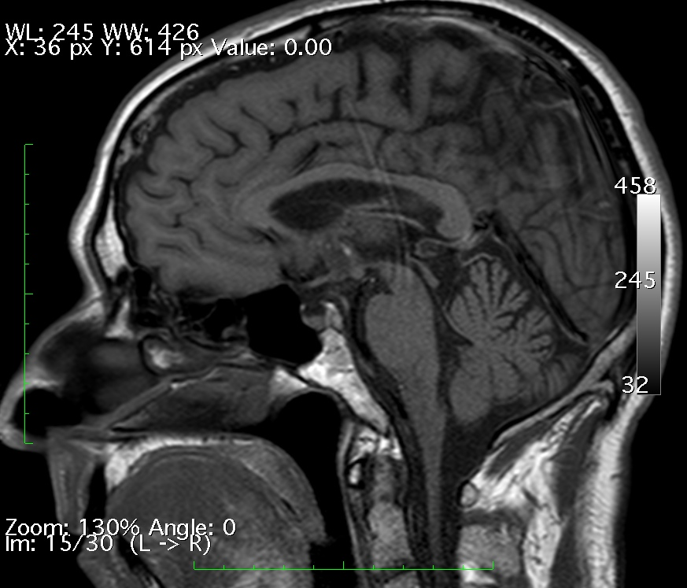
Pathological Hallmarks: Polyglucosan Bodies in Nerves and Brain MRI
Nerve Biopsy
Teased Nerve
Electron Microscopy
Brain MRI
2

Slide 6
Hypothesis
Decreased glycogen degradation leads to cellular energy deficit and that anaplerotic therapy via triheptanoin may augment energy production thus preventing or reversing cellular damage

Slide 7
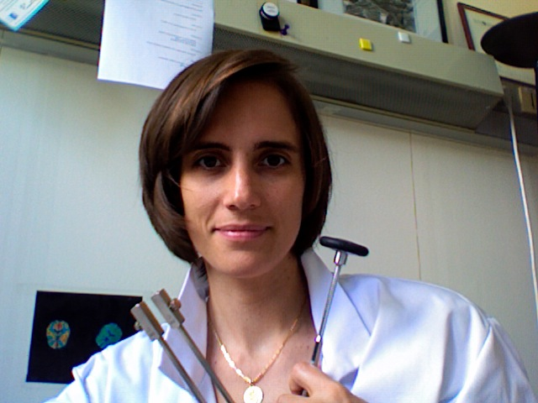
Patients and Methods
Dr. Fanny Mochel
Two center study (Dallas and Paris)
Crossover: Patients received either triheptanoin or placebo oil for 6 months and then switched for an additional 6 months
There was no washout period during cross over
Patients had the option to move to the open-label phase after the first year
Blinding: Both patients and investigators were blinding to group assignment

Slide 8
Study Methods: Endpoints
Primary: 6 Minute Walk Test (6-MWT)
  Subject walks at pace which can be maintained for 6 minutes on a flat surface (measured in meters)
Secondary Outcomes:
  Balance Measurements
  Motion Capture Gait Analysis
  Short form 36 Health Survey
  Spastic Paraplegia Rating Scale (SPRS)
  Neurological, Physical, and Strength Exams
  Creatinine Kinase (CPK)

Slide 9
Study Methods: Safety
Urine Organic Acids
Plasma Acylcanitine
Vital Signs
Adverse Events

Slide 10
Analysis Populations
Primary population – All subjects who were randomised, received any study drug, have baseline assessment, and at least one post-baseline assessment N=22
“Completing RCT” was defined as making at least baseline and 1 visit each while on each treatment, thus at least 3 visits (i.e. one baseline or pre- treatment, one on treatment 1, and one on treatment 2) N=19

Slide 11
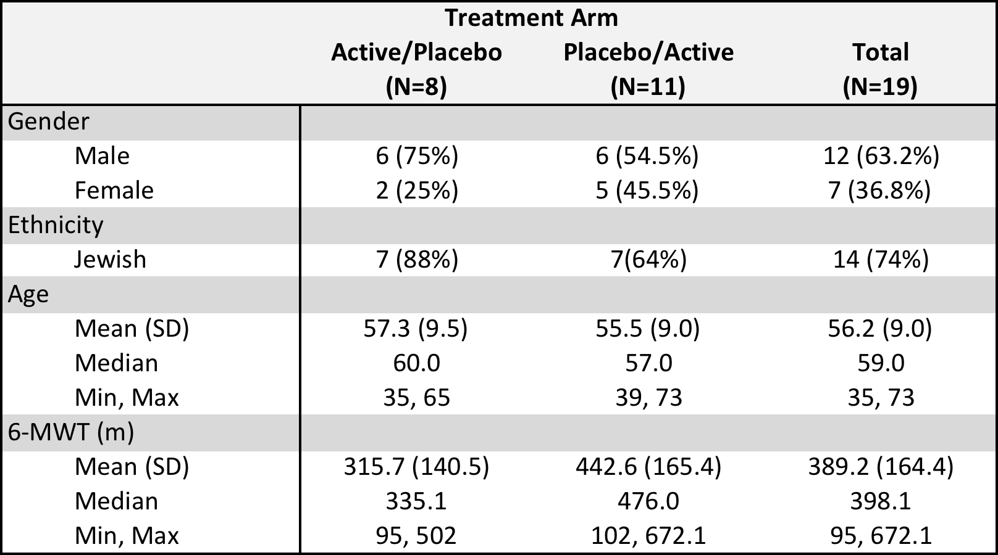
Study Subjects: Baseline Demographics – Completing RCT Population
Reference values: 50–59 yrs of age, 588±91 m (Casanova et al. ERJ 2011)
Notes:
95 meters (age 60 at time of test) - 672 meters (age 61 at time of test)

Slide 12
Overall Test of Triheptanoin Effect
A linear mixed model was conducted to analyze the cross over study
There was no significant carry over effect
The overall mean difference between subjects on Triheptanoin versus Placebo was 5.63 meters. (95%CI: -10.9, 22.2; p-value: 0.4982)
All secondary endpoints were statistically non-significant after False Discovery Rate adjustment

Slide 13
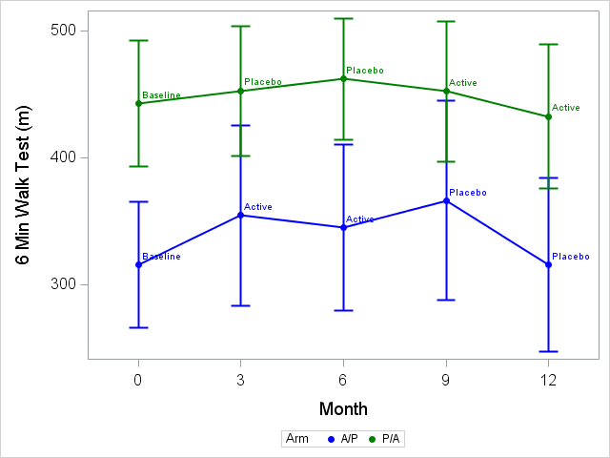
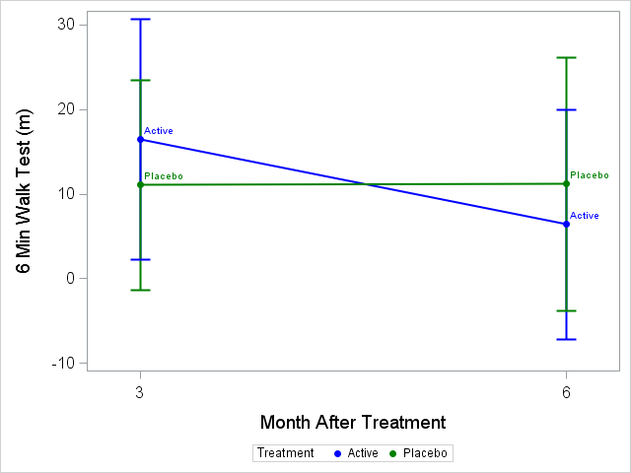
Placebo Controlled Triheptanoin Trial 6-MinWalk Test (m)
Actual Distance walked
Baseline Subtracted
Mean 6MWT by Treatment Arm and Month Relative to the start of the trial (Error bars: +/- 1 SE)
Notes:
A linear mixed model was conducted to analyze the cross over study.
Analysis was adjusted for baseline differences by analyzing baseline subtracted data

Slide 14
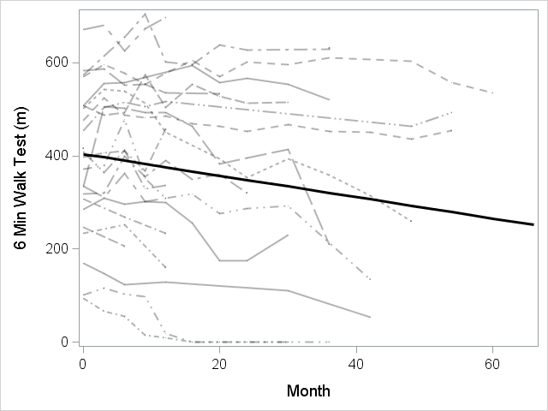
6 minutes walk test over time (n=23)
N=23

Slide 15
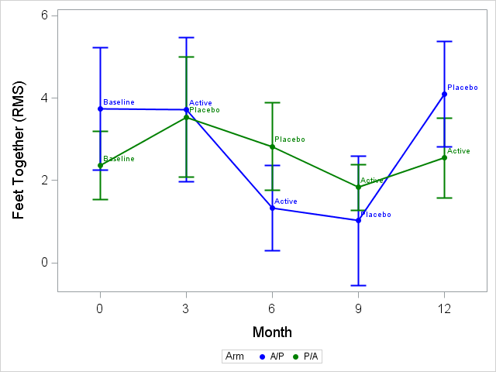
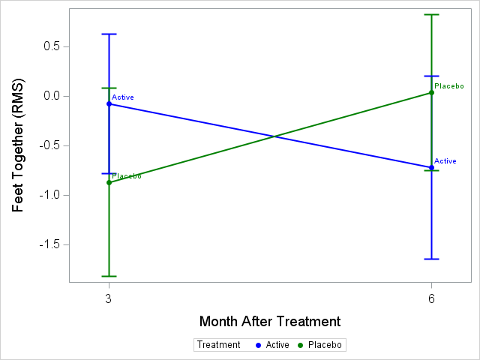
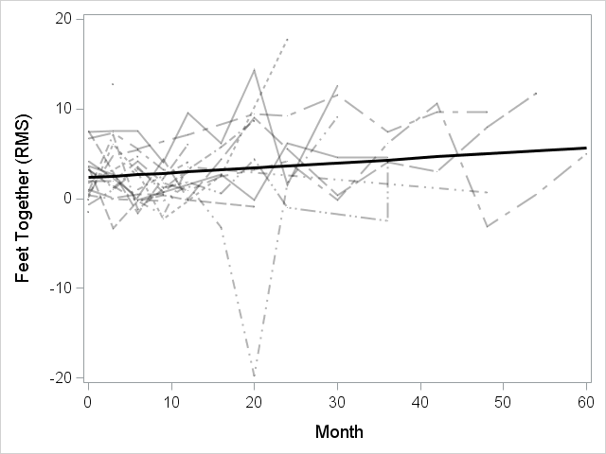
Balance Standing (Eyes closed-Eyes Open)
Actual Values
Baseline Subtracted
Change Over Time

Slide 16
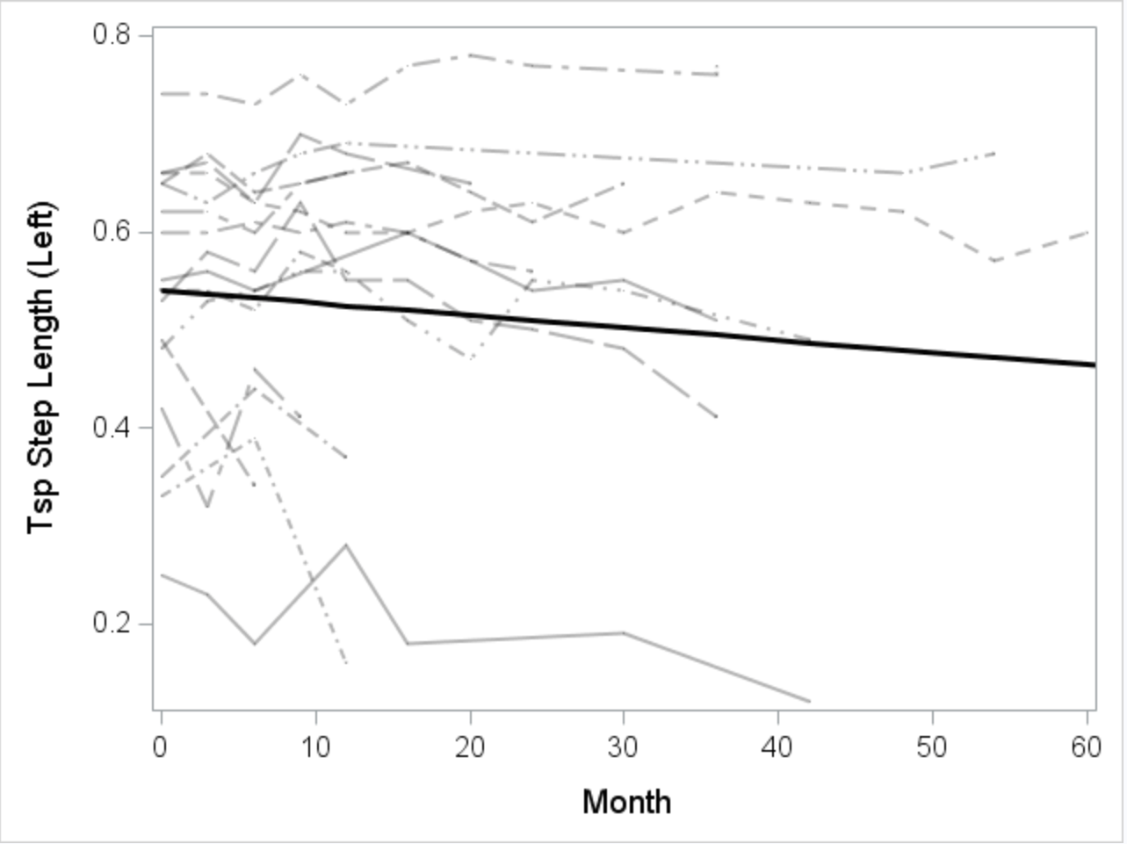
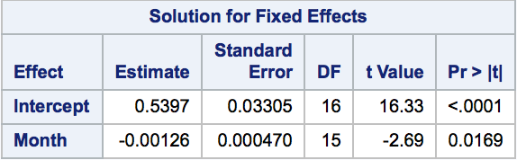
Motion Capture Gait Analysis Over Time (n=17)
Step Length

Slide 17
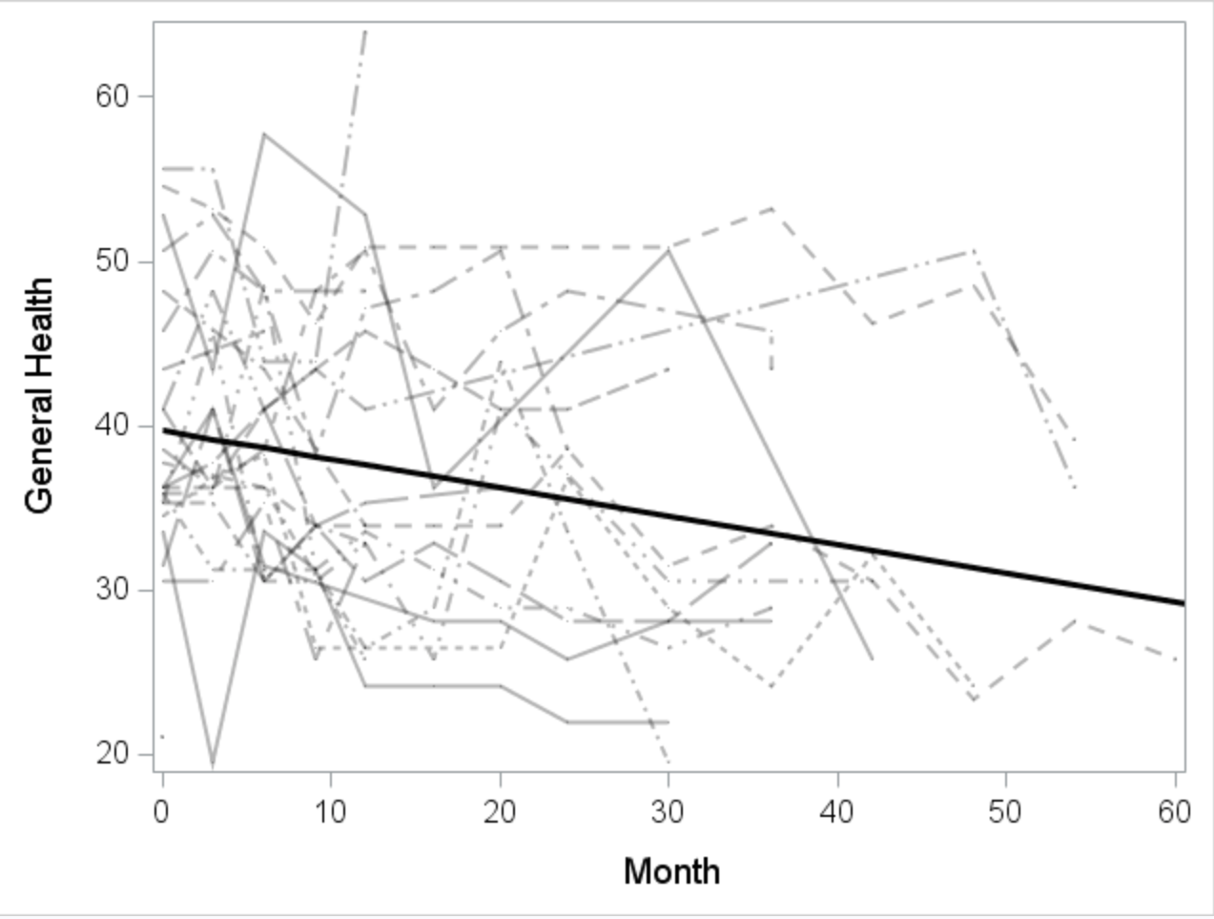
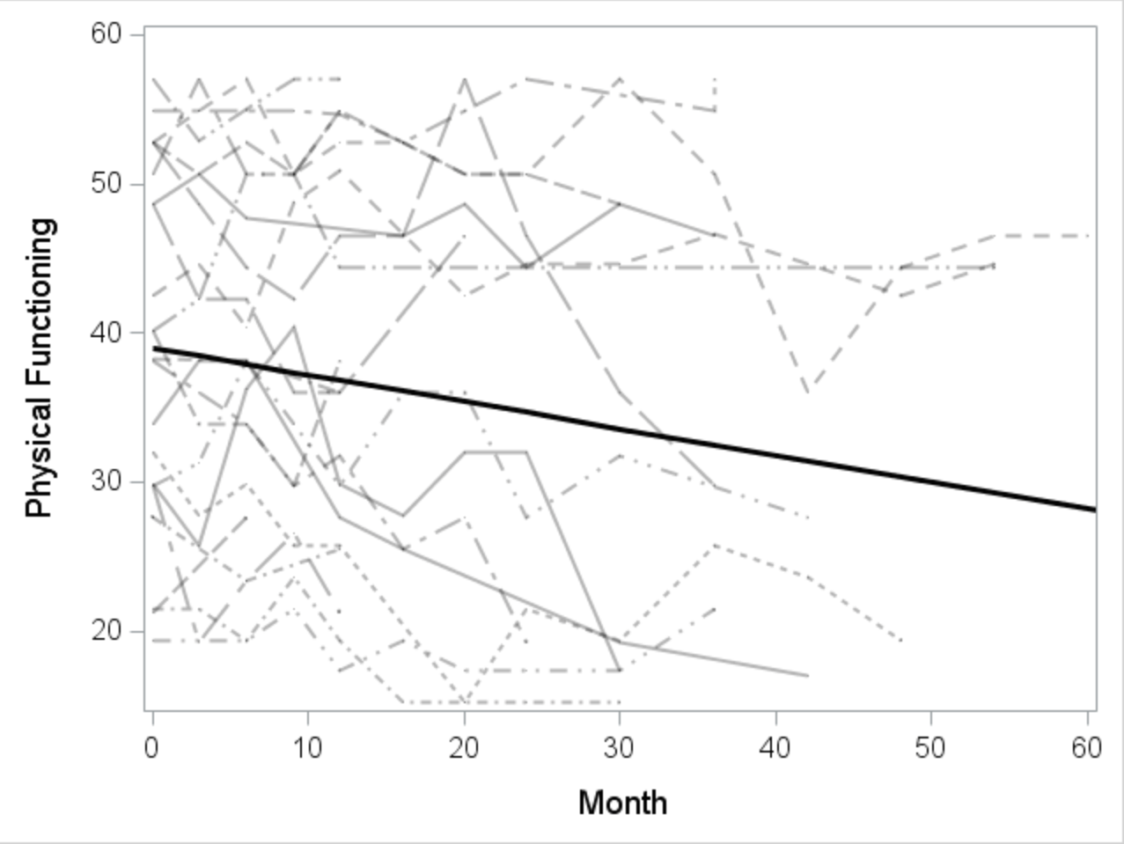
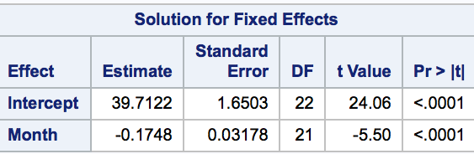
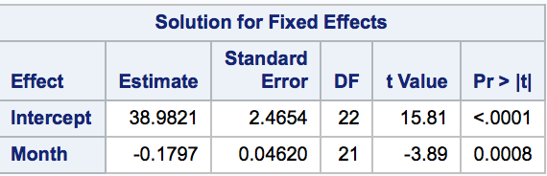
Quality of Life SF36 Over Time (n=23)
Disease Progression General Health
Disease Progression Role Physical

Slide 18
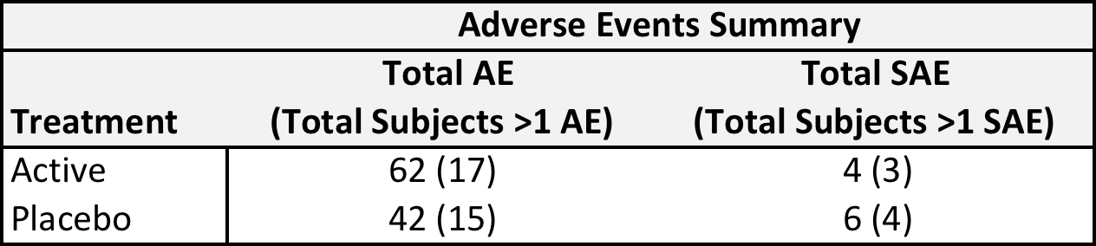
Safety: Adverse Events (n=19)
There was no significant difference in the number of patients experiencing adverse events in the two treatment groups

Slide 19
Conclusions
The study failed to show efficacy of triheptanoin in APBD patients over a 6-month period
Triheptanoin administration is safe
Non-triheptanoin-related adverse events may have impacted study assessments
We quantified gait, balance, and quality of life data over time to be used in future clinical trials
There are fast and slow progressors – has to be taken into account for clinical trials
Patients are susceptible to the placebo effect

