Slide 1
Research update: Generation of the mouse model of Gbe1 intronic insertion/deletion and approaches to treatments
H. Orhan AKMAN, PhD
Laboratory of Dr Salvatore DiMauro
Houston Merritt Neuromuscular Disease Research Center,
Columbia University Medical Center, New York, New York

Slide 2
Disclosures
Grants from
APBDRF
Keith B Hayes Foundation
Gifts from Lipsig and Kassab families

Slide 3
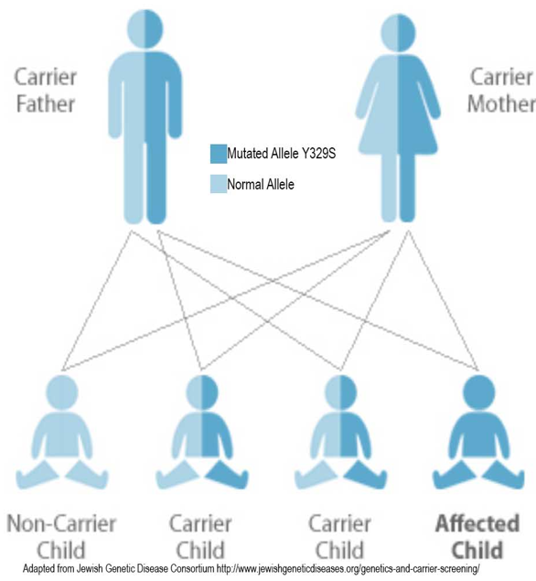
Adult Polyglucosan Body Disease
Autosomal recessive disease
Caused by the low glycogen branching enzyme activity
Mainly due to mutations that decrease enzyme activity
Such as p.Y329S and combination of p.Y329S and a genetic change in intron 15.

Slide 4
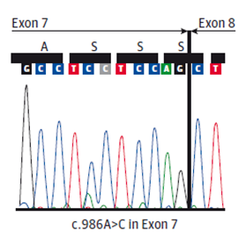
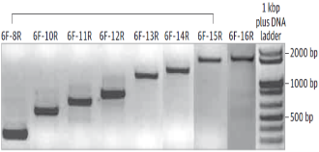
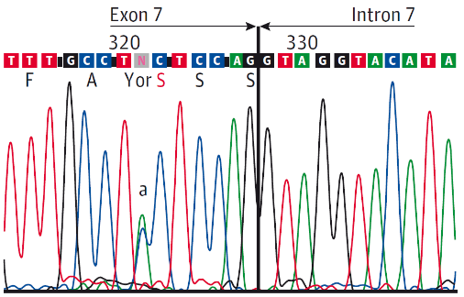
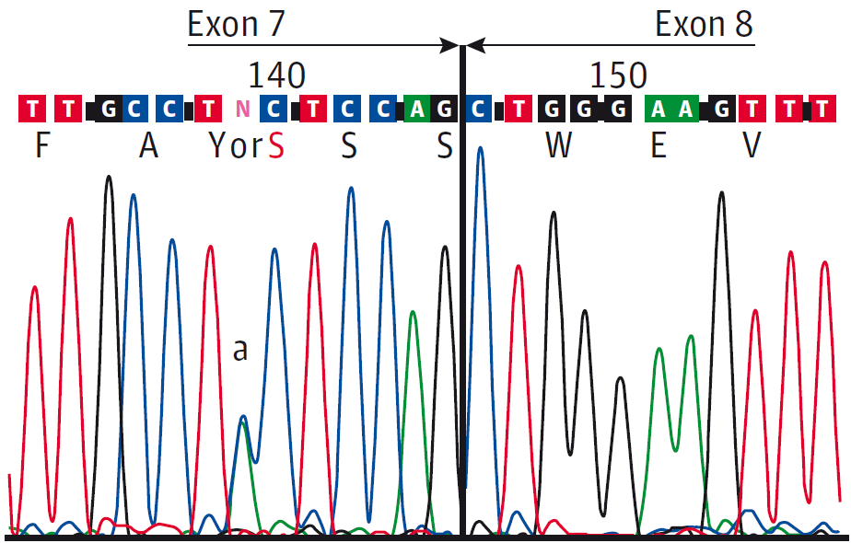
Heterozygous patients have homozygous mRNA for p.Y329S mutation
DNA
mRNA
1-2-3-4-5-6-7-8-9-10-11-12-13-14-15-P16
AAAAA(A)_{n}
1-2-3-4-5-6-7-8-9-10-11-12-13-14-15-16
AAAAA(A)_{n}
p.Y329S

Slide 5
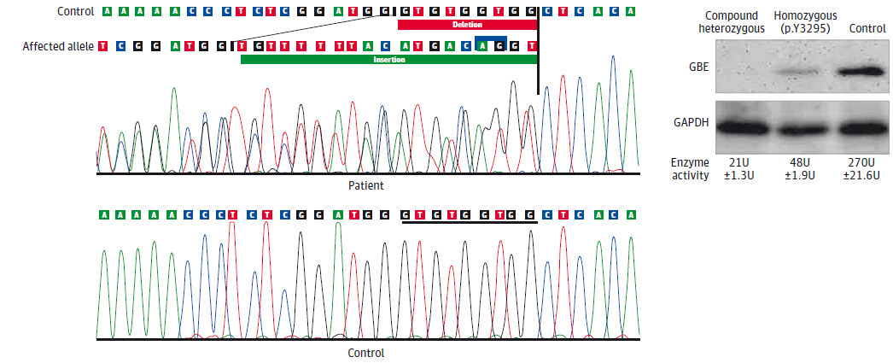
Intron 15 Contains the Mutation that Prevents the Proper Expression of GBE1 mRNA

Slide 6
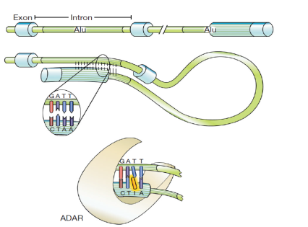
RNA Editing is Guided by Specific Sequences

Slide 7
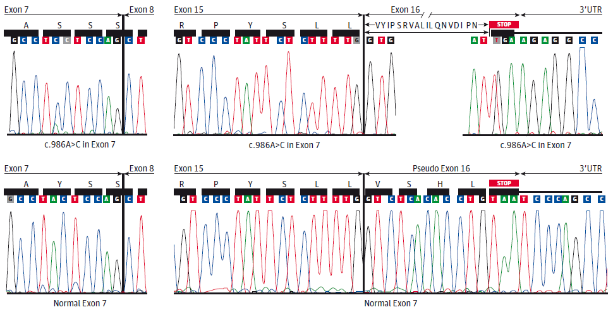
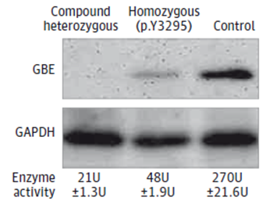
Pseudo Exon 16 Codes a Few Amino Acids Causes Unstable Truncated Protein.

Slide 8
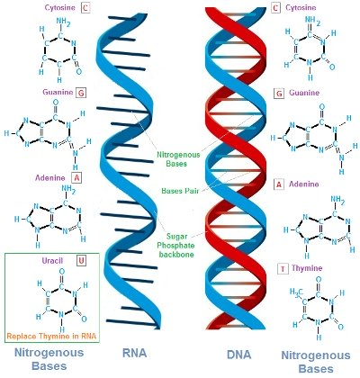
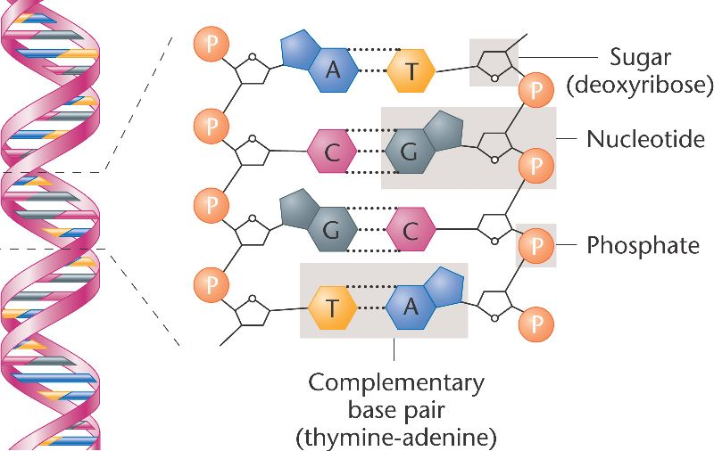
DNA is a Double and RNA is a Single Stranded Molecule
Pre mRNA

Slide 9
Second Mutation Can be Neutralized by Antisense Oligo Nucleotides
Intron 14 Intron 15 3’UTR
Miss Edited mRNA
Exon 14
Exon 15
Exon 16
STOP Codon
Exon 14
Exon 15
Pseudo exon 16
A_{(n)}
Abnormal
Protein Synthesis
Premature STOP Codon
Intron 14 Intron 15 3’UTR
Exon 14
Exon 15
Exon 16
Corrected mRNA Edition.
Antisense oligo nucleotide
blocks miss editing
Exon 14
Exon 15
Exon 16
A_{(n)}
Normal
Protein Synthesis
Deep Intronic mutation That Generates a New Splice Site
Antisense Oligonucleotide

Slide 10
IONIS Synthesized the Oligonucleotides

Slide 11
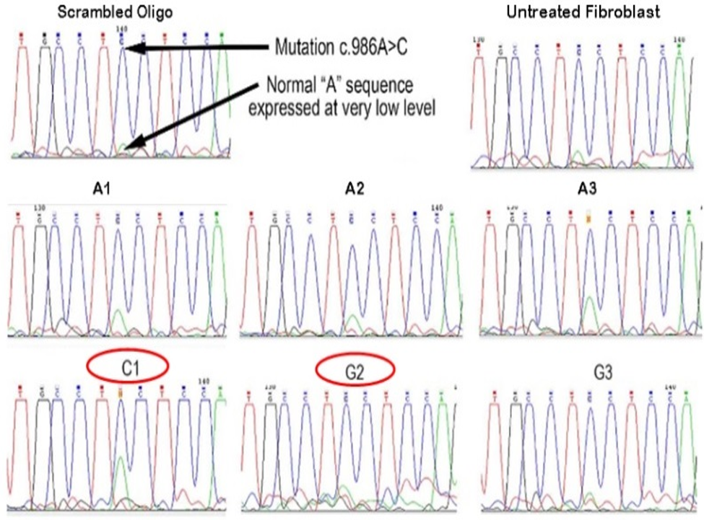

Slide 12
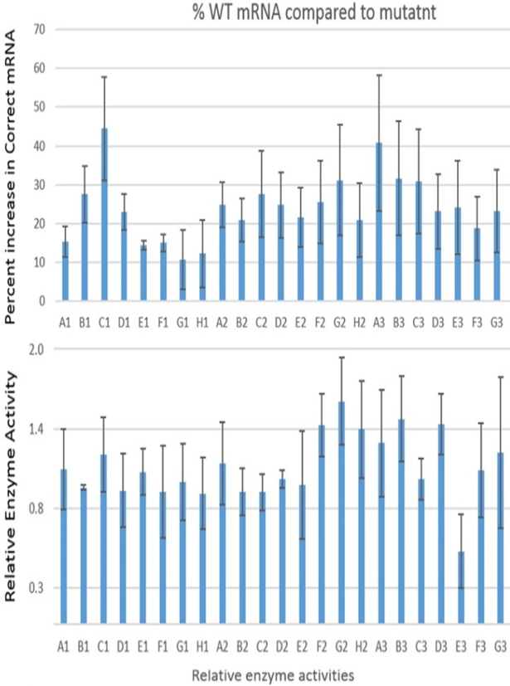

Slide 13
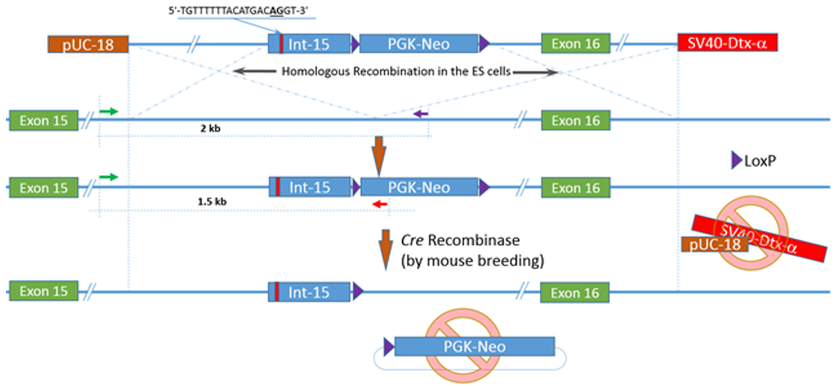
Approach for the Generation of the Mouse Model

Slide 14
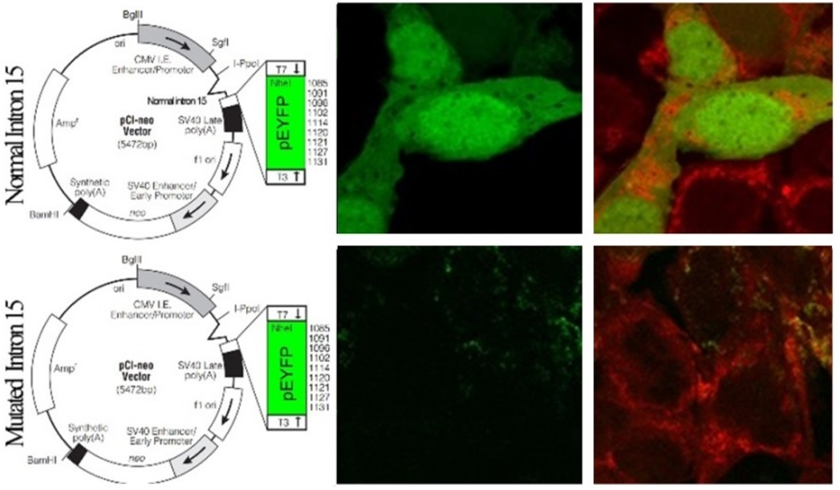
TGTTTTTTACATGACAGGT Sequence alters the normal splicing of human β-globin gene

Slide 15
Acknowledgements:
Michio Hirano, MD
Yasemin G Kurt, MD
Sindu Krishna, PhD
This study is funded by

Slide 16
