Slide 1
Advances in carrier screening: Making the case for APBD
Alana Cecchi, MS, CGC
12.6.2016
Notes:
Sample notes: Good afternoon, everyone. My name is Alana Cecchi and I am a genetic counselor at Counsyl. Some of you may be familiar with Counsyl, but for background, Counsyl runs a lab based in South San Francisco and we offer germline genetic testing with genetic counseling.

Slide 2
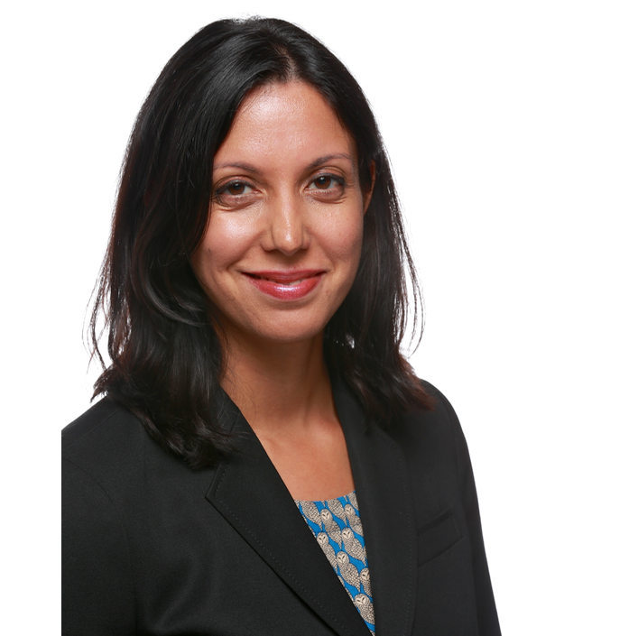
Introductions ...and our formal disclosures
Alana Cecchi MS, CGC
Medical Science Liaison, Counsyl
Board Certified Genetic Counselor
Shivani Nazareth, MS, CGC
Director, Medical Affairs, Counsyl
Board Certified Genetic Counselor
Notes:
Quick introductions. As I’ve mentioned I’m Alana, a genetic counselor. I function as a Medical Science Liaison at Counsyl and am based in NY. Prior to joining Counsyl, I was faculty at the University of Texas Medical School in Houston.
shivani
We are two of over 40 genetic counselors employed by Counsyl, and we know that technology is evolving rapidly. Very soon, you will be practicing genetic counselors...on the front lines, making crucial decisions about how much technology to incorporate into your clinic. Most physicians are not well-trained in this area, and they will look to you for your expertise.”

Slide 3
We are a DNA testing and genetic counseling service.
Confidential and Proprietary
Confidential and Proprietary
Notes:
Talking points: A little background on Counsyl: We are a DNA testing and genetic counseling service. We have 3 screening offerings: Family prep, IPS, ICS
Counsyl runs a fully automated lab with a focus on technological development that allows us to offer testing for rare genetic disease at scale. Thiss essentially translates to allowing broader access to genetic testing by offering it at an affordable price and including genetic counseling as part of the service. Shivani and I are just 2 of the 45 genetic counselors at Counsyls
I’m going to play a short clip of what goes on inside our lab so help give you a better sense. Having come from from working in an academic lab prior to joining Counsyl, this was even new to me and sums up what i can’t necessarily articulate in a short period of time

Slide 4
A day in the life of a patient sample
Notes:
Ted to play video. This video nicely sums up what I can’t necessarily articulate in such a short period of time.
EMBED COUNSYL VIDEO, https://www.youtube.com/watch?v=chxxVY0F-zM

Slide 5
Progression of carrier screening
Results from JAMA study
Considerations for adding new diseases
Increasing accessibility
Notes:
My agenda is today is pretty straightforward. We know that many patients slip through the cracks when it comes to genetic testing, and that represents a missed opportunity for them to take advantage of this powerful information. First, I’ll provide an overview of how ECS has progressed, the status quo and where we are headed. Second, I’ll highlight a recent JAMA publication on this topic and then provide some insight into how Counsyl selects diseases to include in an expanded panel and what we are doing to improve accessibility.

Slide 6
Progression of carrier screening
Results from JAMA study
Considerations for adding new diseases
Increasing accessibility
Notes:
It’s worth mentioning that counsyl’s first ECS product was launched in 2009 and has significantly evolved over the years in terms of disease selection and inclusion and also with advances in technology

Slide 7
Making progress The journey to expanded carrier screening (ECS)
2016 Largest expanded carrier screening study (JAMA)
2015 ECS Joint Statement - Repro Med
2013 ACMG Position Statement
2011 CF screening update - ACOG
2009 Counsyl introduces first ECS
Development of carrier screening
2008 SMA screening - ACMG
2005 CF screening - ACOG
1988 Cystic fibrosis (CF) screening - NIH
1970 Tay Sachs screening in Ashkenazi Jewish (AJ)
70s
80s
90s
00s
10s
Notes:
If we fast forward from the 70s and look at what’s going on today, there’s been an explosion in the number of genes we can include on a carrier screening panel. In part, this is because of the introduction of technology that allows for “expanded carrier screening.” As is usually the case, the technology outpaced the medical guidelines (and continues to do so).
Talking points: genetic screening has come a long way, from Tay Sachs screening in people of Ashkenazi Jewish descent in 1970, to universal screening for cystic fibrosis, and now expanded carrier screening. As more focus was put towards genetics and the human genome in the past 2 decades, things have really picked up. The technology improved. Public interest grew. Companies, like Counsyl, were formed. And you can see that Counsyl has led the way in expanded carrier screening. We launched our Family Prep Screen in 2009--the first commercial expanded carrier screen. That spawned other followers, but Counsyl has led the way with research (like the recently published landmark study published in JAMA) and we’ve also led the way by taking the time to create a test that would identify more at-risk couples than any other.

Slide 8
Current carrier screening guidelines Current guidelines support limited screening in select ethnic groups
Current carrier screening guidelines
 | Caucasian | AJ | African / AA | Asian | Hispanic | Meditter. | S.E. Asian
Cystic Fibrosis
Spinal Muscular Atrophy
Tay Sachs Disease
Canavan Disease
Familial Dysautonomia
Gaucher Disease
Fanconi Anemia Type C
Mucolipidosis IV
Neimann-Pick Disease Type A
Sickle Cell Anemia
Thalassemia
ACOG
ACMG
Notes:
Talking points:
Current ACOG guidelines only support pan-ethnic cystic fibrosis screening, and additional single-gene screening based on ethnicity and family history.
This is based on the belief that only certain individuals -- based on self-reported ethnicity or family history -- are at higher risk to pass down serious inherited conditions.
Note: Other factors to limited guidelines include practical considerations, such as, interpretation and discussion of results, access to genetic counselors, rapid advancements in technology (quicker than guidelines), and cost to patients. (All of which Counsyl addresses.)
Current medical guidelines support
limited
screening in select ethnic groups

Slide 9
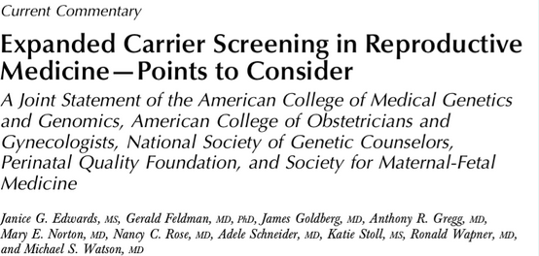
The need for more data to facilitate general pan-ethnic testing:
“... determining the frequency of variants in previously untested ethnic and racial groups is required...”
Notes:
Talking points: The joint statement was issued by 5 organizations and really added credibility and validity to the debate abou expanded carrier screening. This statement (2015) does not replace current screening guidelines, which are published by individual organizations to direct the practice of their constituents. But it opened a serious conversation about the merits of rethinking the way we offer carrier screening, with some discussion points about requiring need for further research was requested to better quantify and qualify the clinical impact of ECS across ethnic groups. Specifically, the 2015 joint statement on ECS suggested a need for more data on “the frequency of variants in previously untested racial and ethnic groups” to facilitate general pan-ethnic testing.
Talking points:
Though medical societies like ACOG and ACMG have commented on the value of ECS, they have remained cautious in recommending it as routine care.
The need for further research was requested to better quantify and qualify the clinical impact of ECS across ethnic groups. Specifically, the 2015 joint statement on ECS suggested a need for more data on “the frequency of variants in previously untested racial and ethnic groups” to facilitate general pan-ethnic testing.
Talking points: Here’s what ACOG says the point of carrier screening is…”the goal is to provide couples with information to optimize pregnancy outcomes based on their personal values and preferences.”
This statement was made in 2016 by ACOG, ACMG, NSGC, PQF and SMFM in a paper that validated the role of expanded carrier screening for patients. You will notice that it doesn’t say that the goal is to find carriers in certain ethnic groups, but to give couples information. One issue that was highlighted in this article is that the cost of screening has decreased, while ethnic admixture has increased.
NOTE: (can’t say experts “recommended” expanded carrier screening, but

Slide 10
ECS study in JAMA
N=346,790
Published in the Journal of the American Medical Association (JAMA)
August 16, 2016
Notes:
Talking points:
To address the need for additional data, Counsyl has conducted the largest Expanded Carrier Screening (ECS) study ever published to date, with a diverse study population of nearly 350,000 individuals.
This study was published in the Journal of the American Medical Association (JAMA) in August, 2016.

Slide 11
Study design & methods
Study design and methods
Self-reported ethnicity: 15 ethnic categories
Unbiased: Excluded known disease carriers, or those with family history of a condition, infertility, etc.
Clinically relevant: 94 severe/profound diseases
Exclusions: Mild/moderate phenotypes, VUS
Technology: Targeted genotyping and NGS
<Each ethnic population in the study was well-represented in number, with the smallest group in the ECS study outnumbering the total population of some of the largest genetic studies>
Notes:
Talking points:
Results: In major US racial and ethnic categories, ECS identifies more potential pregnancies at risk for severe/profound conditions than current screening guidelines.
Data is based on self-reported ethnicity and assumes that people reproduce within the same ethnic group
At least 5,000 people had to self-identify in each ethnic category to be included in the analysis (11 of 15 groups fit this criterion)
To minimize bias, individuals with self-reported personal or family history, infertility or other reason of testing were excluded.
The study was designed with a focus on 94 serious or “severe and profound” recessive conditions on the Counsyl Family Prep Screen.
Severe conditions were defined as those that if untreated cause intellectual disability or a substantially shortened lifespan (e.g., spinal muscular atrophy); profound conditions were those causing both (e.g., Canavan disease).^{2,6}
Gene variants with known mild, moderate or highly variable phenotypes or incomplete penetrance were excluded from this study.
Analysis was done on the Counsyl Family Prep Screen using targeted genotyping and next-generation sequencing.
Use as needed for technical audiences who may want more technical details about study design.
>430,000 patients screened; statistical analysis only performed on people who were referred for “routine screening”, amounting to >346,000 patients
>300,000 genotyped and >38,000 sequenced for up to 110 diseases; a total of 94 were included in the analysis
SMA and FrX performed separately
VUS and mild diseases/alleles excluded, as well as diseases with highly variable clinical presentation (i.e. familial Med fever and alpha-1)
Anything that was categorized as Moderate or Mild was removed: e.g., GJB2, MTHFR, hemochromatosis.
Within severe and Profound diseases, alleles that were found to consistently cause mild phenotypes or considered VUS were removed.
There is a supplementary table that shows all that was included/excluded.
Diseases were categorized as “profound” or “severe” based on the previously published PLOS paper that assessed 13 disease characteristics, such as shortened lifespan, intellectual disability, impaired movement, internal physical malformations, and sensory impairment, to assign severity.
Severe: those that if left untreated cause intellectual disability OR shortened lifespan to adolescence or earlier (Fr X, CF)
Profound: those that if untreated cause intellectual disability AND shortened lifespan to adolescence or earlier (Canavan, Pompe)

Slide 12
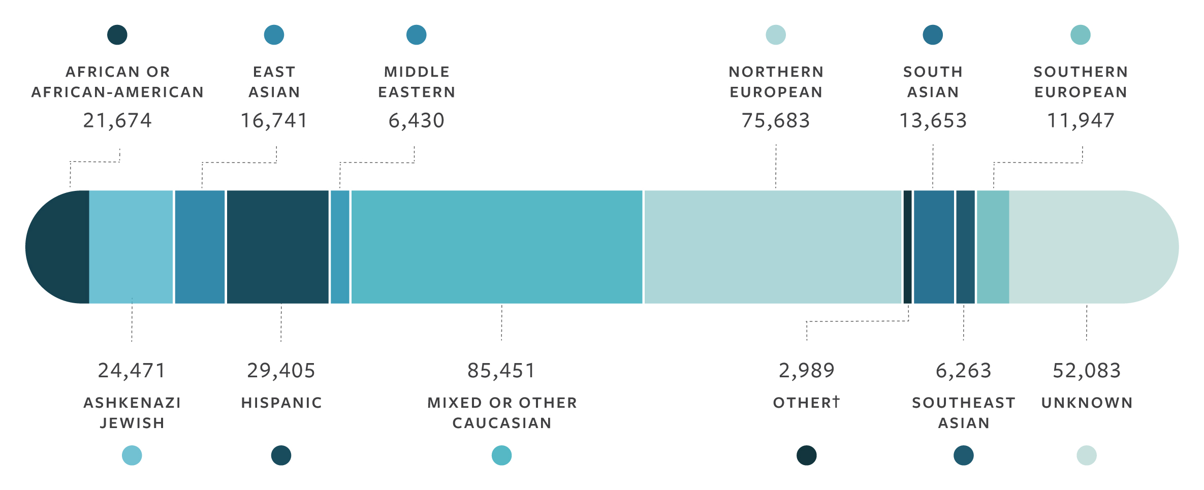
ECS study population N=346,790
The largest, most diverse expanded carrier screening study published to date
Notes:
Talking points:
We are proud to release results from the largest expanded carrier screening study ever published from nearly 350,000 ECS patient results.
The study population—unmatched in magnitude to date—is more diverse than any previous genetic study published to date.
The sample size of each of these individual ethnic groups is substantial. Even the sizes of individual populations (e.g., Hispanic, East Asian) eclipse the total population of other similar genetic testing studies published to date.³
Examples of other studies that show our study’s magnitude and diversity in comparison. (Some have similar total N, but focus on single gene or one condition; some have a total N that is smaller than the n for just one of our ethnic groups.)

Slide 13
Progression of carrier screening
Results from JAMA study
Considerations for adding new diseases
Increasing accessibility
Notes:
Here is what this study showed us

Slide 14
Current guidelines can miss affected pregnancies
Guideline-based carrier screenings miss a significant percentage of pregnancies affected by serious conditions:
Notes:
Talking points:
When analyzed and compared to the current ACOG and ACMG guidelines, the data showed that:
Guideline and single-gene carrier screening practices can miss a significant number of pregnancies affected by serious conditions.
In all populations, ECS uncovered affected pregnancies beyond what can be identified using current routine practices.
For Example:
>90% of hypothetically affected pregnancies would be missed in East Asian patients
Similarly, nearly 80% of potentially affected pregnancies would be missed in Hispanic patients
This was consistent even for ethnic groups where screening is more common:
>60% for Northern Europeans,
>50% for AJ

Slide 15
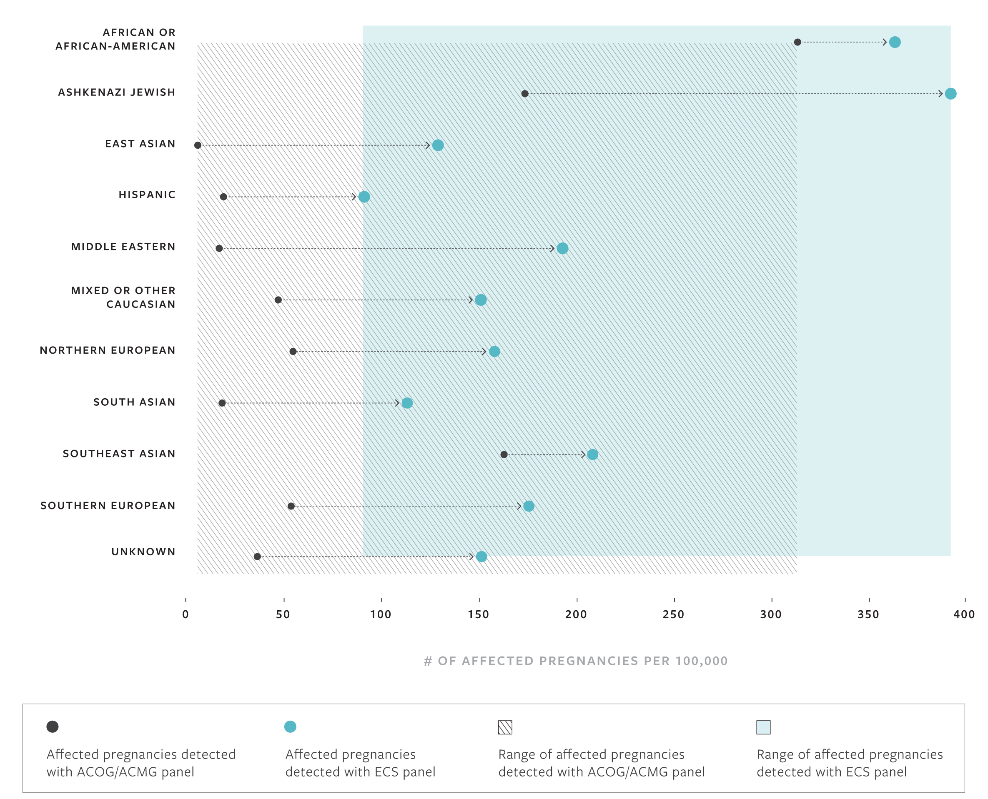
Increased detection of affected pregnancies with ECS by ethnicity
Notes:
Use this slide to drill down on the increased detection of affected pregnancies for each ethnic group compared to current guidelines-based screening, as needed.
Talking points:
This graph shows the number of affected pregnancies per 100,000 plotted across ethnicities.
Black points = affected pregnancies detected by status quo (current screening guide
Blue points = true risk your patients have of an affected pregnancy, which can be detected with ECS
(Drill down by ethnicity, as necessary.)
Conclusion: ECS detects more pregnancies affected by serious conditions across ethnicities that could otherwise be missed by guidelines…
Reference - Table 5: Cumulative Risk of Recessive Disease by Screening Panel
Key take-away: Guideline and single-gene carrier screening practices miss a significant number of pregnancies affected by serious conditions… whereas ECS enables the detection of more affected pregnancies in patients across ethnicities.

Slide 16
Key findings — a clear case for ECS
Compared to guidelines, ECS identifies more pregnancies affected by serious conditions across ethnicities
Ethnicity and family history should not be used to limit carrier screening.
Risk of significant number of severe and profound conditions is present across the population.
Standard risk assessment of serious, actionable disorders is needed for all couples.
Notes:
Talking points: What we found is that ECS identifies more pregnancies affected by serious conditions. This means that there is a clear case for offering ECS to all patients, regardless of ethnicity.
Ethnicity and family history should not be used to limit carrier screening.
The risk of of severe and profound conditions is present across the population.
It’s what’s best for patients: It’s time to further re-evaluate how we assess risk of serious, manageable/actionable disorders for all couples (during preconception and prenatal care).

Slide 17
Progression of carrier screening
Results from JAMA study
Considerations for adding new diseases
Increasing accessibility
Notes:
Talking points: When taken as a whole, you can see that the expanded carrier screening has been heavily-researched and found to be valuable to all couples. One panel for all patients. And that brings me to talking about COUNSYL and our Family Prep Scree

Slide 18
Designed to exacting standards
Counsyl Family Prep Screen, Design Blueprint
Systematic Design and Comparison of
Expanded Carrier Screening Panels
Kyle A. Beauchamp, PhD; Dale Muzzey, PhD; Kenny Wong, MS CGC; Sophie I. Candille, PhD; Eric A. Evans, PhD; James D. Goldberg, MD; Imran S. Haque, PhD; Gregory J. Hogan, PhD; H. Peter Kang, MD; Kambiz Karimi, PhD; Gabriel A. Lazarin, MS CGC; Nikita Mehta, MS CGC; Rebecca Mar-Heyming, PhD;
fps.counsyl.com/blueprint
Notes:
Talking points: The design blueprint for our expanded carrier screen has been authored by our in-house team of experts, and it will be made publicly available. It explains the methodologies, how they were chosen, how they stack up against other approaches, disease selection, and more.

Slide 19
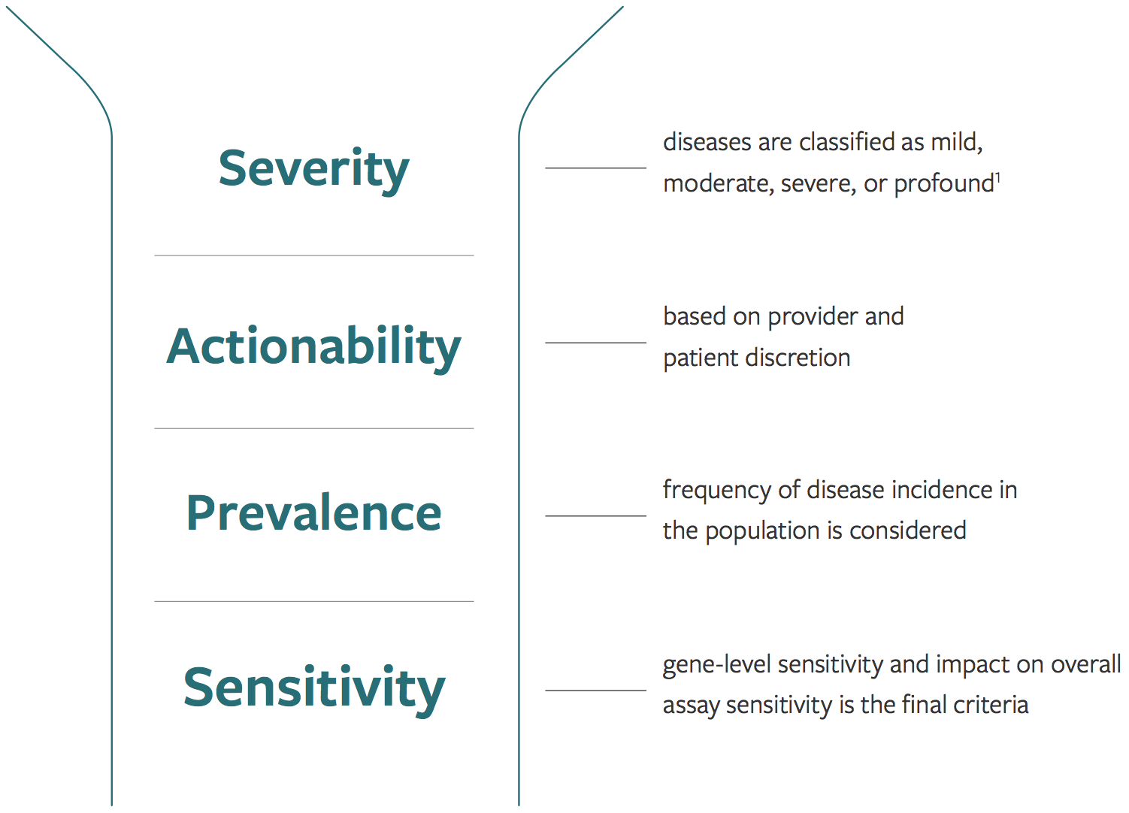
Selecting the right diseases, not just more
Family Prep Screen disease selection criteria
Reviewed >650 genes
>175 diseases
Universal + Expanded Jewish Panel (>225 genes)
All 52 diseases recommended by JGDC (Jewish Genetic Disease Consortium)
Notes:
serious, clinically-actionable and prevalent, where the gene-level sensitivity has been maximized
Talking points: Our challenge is to select the right diseases, not simply to put more diseases on the panel. In order to do so, we reviewed over 650 genes and used a multi-tiered approach, which included evaluating:
Disease classification by severity
The actionability of a disease...is there something that can be done if you find out the couple is at-risk?
Is the condition prevalent enough to be of value
And can we reliably identify carriers
Using this criteria resulted in the over 175 diseases that have been thoughtfully selected for our panel.
------------------------------------
ADDITIONAL CONTENT FOR EXISTING CUSTOMERS
Many new genes have been added to the Family Prep Screen, but a few have also been removed, based on:
An assessment of severity (mild or moderate)
Clinical validity - whether the gene causes disease the majority of the time
Customer research and feedback
If the customer is interested, you can review the updated Family Prep Screen Universal Panel disease list in the Appendix.
Reference: 1. Lazarin GA, Hawthorne F, Collins NS, et al. Systematic Classi cation of Disease Severity for Evaluation of Expanded Carrier Screening Panels. PLoS One. 9, e114391 (2014).

Slide 20
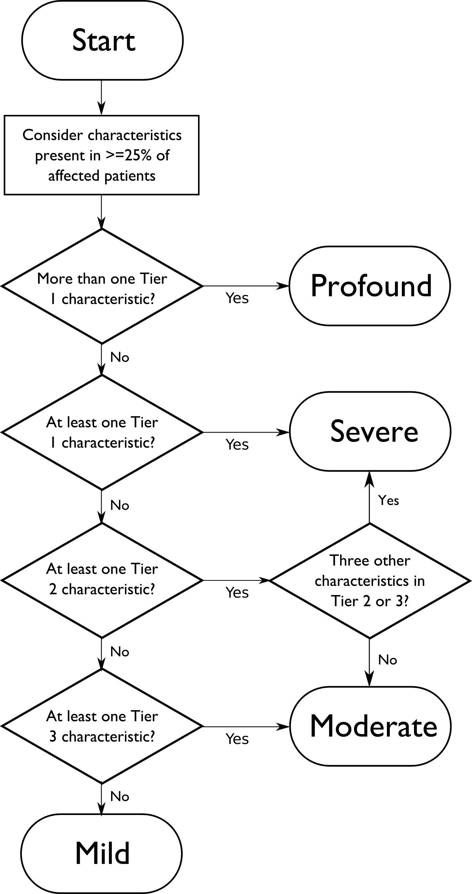
GBE1-related disorders selected for inclusion
PLoS ONE 2014: ‘Systematic Classification of Disease Severity for Evaluation of Expanded Carrier Screening Panels’
Meets criteria as a severe disease
Increased incidence in Ashkenazi Jewish population
Incidence likely underestimated pan ethnically
Panel-wide deletion calling
Full Exon Sequencing
For GBE1, novel deletions will be detected,
curated, and reported if found to be deleterious
Notes:
The incidence of GSD IV is estimated to be in 1 in 600,000 to 800,000 individuals worldwide, GeneReviews: GSD IV.
The exact incidence of APBD is unknown. Greater than 50 cases have been reported in the medical literature. Most affected individuals are Ashkenazi-Jewish. It is estimated that approximately 1 in 4,900 individuals of Ashkenazi Jewish descent have adult-onset polyglucosan body disease, Hussain 2012.

Slide 21
A historical perspective on carrier screening
Results from JAMA study
Considerations for adding new diseases
Increasing accessibility
Notes:
Talking points: When taken as a whole, you can see that the expanded carrier screening has been heavily-researched and found to be valuable to all couples. One panel for all patients. And that brings me to talking about COUNSYL and our Family Prep Scree

Slide 22
New model of pre- and post-test counseling for carrier screening
Informed consent
Education through videos
Telephone counseling
Streamlining the service
Kerri B. & David A.
Counsyl Family Prep Screen patients

Slide 23
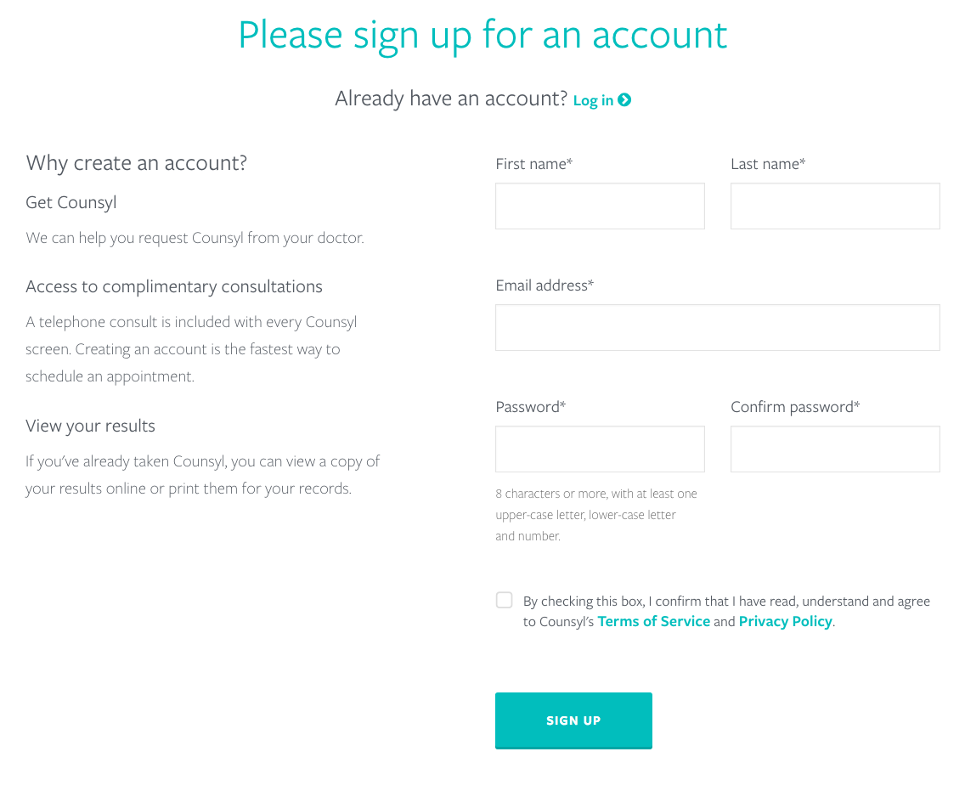
The patient experience
Notes:
All patients are asked to create a secure online account. This is not such a foreign concept anymore, considering we have online accounts for banking and other important areas of our lives.

Slide 24
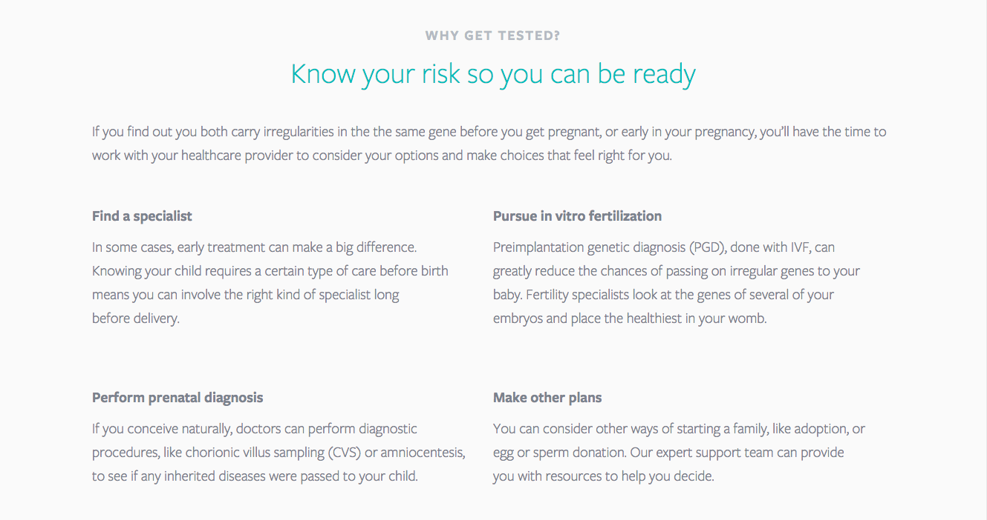
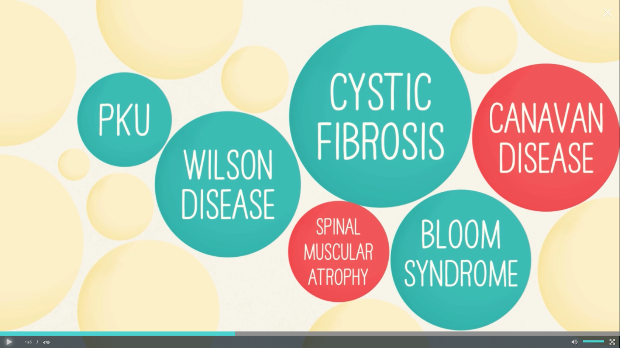
Pre-test education
Notes:
Educational videos, which are designed to help patients understand what they are being screened for, and what they can do with the information.

Slide 25
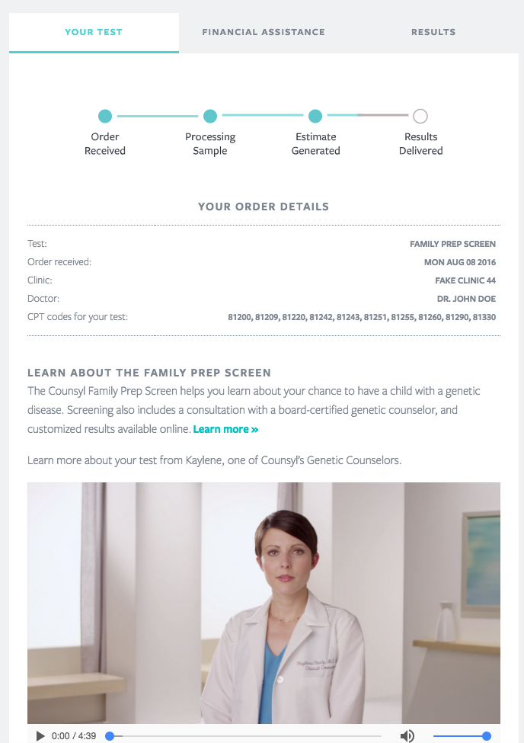
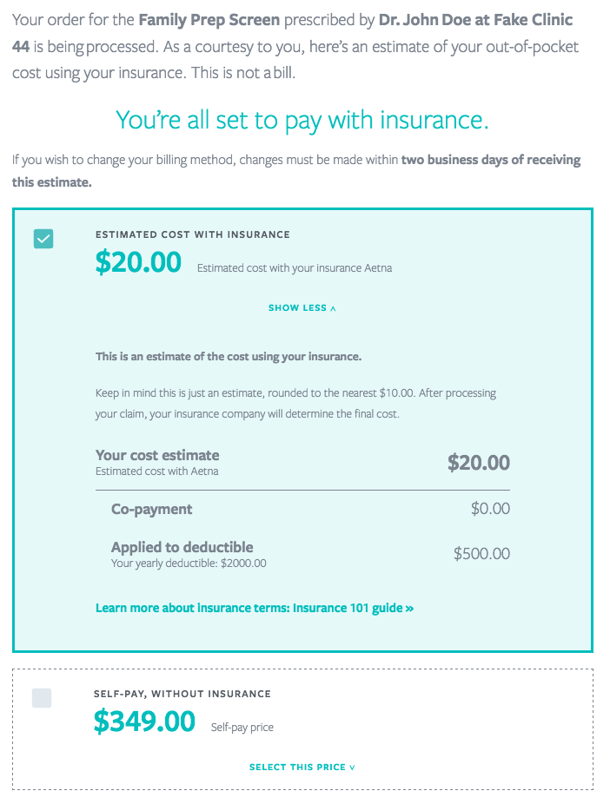
Coverage and estimates

Slide 26
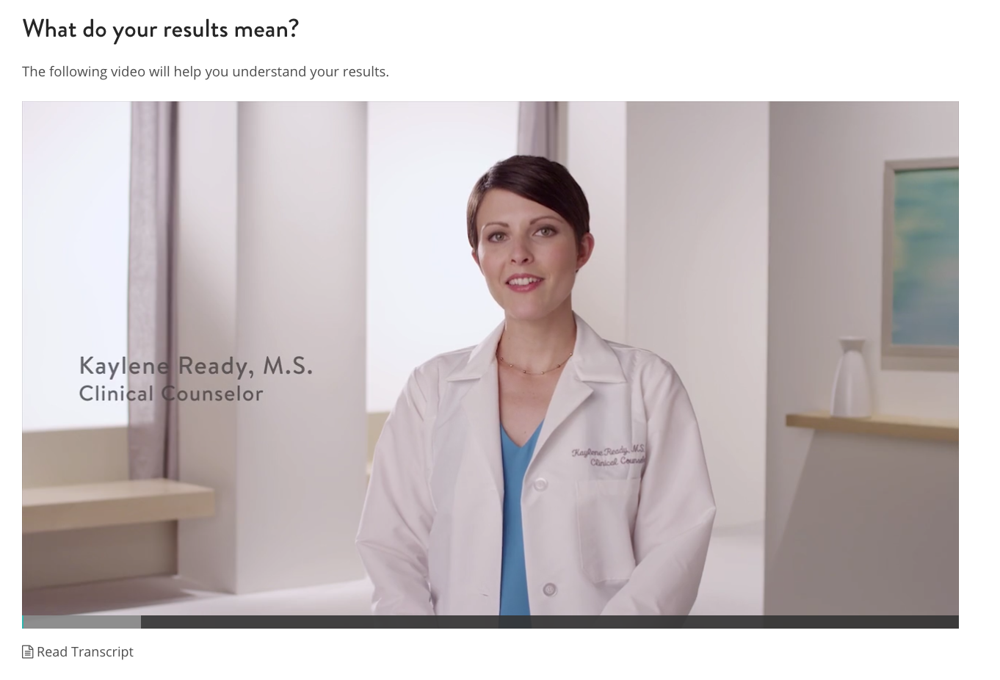
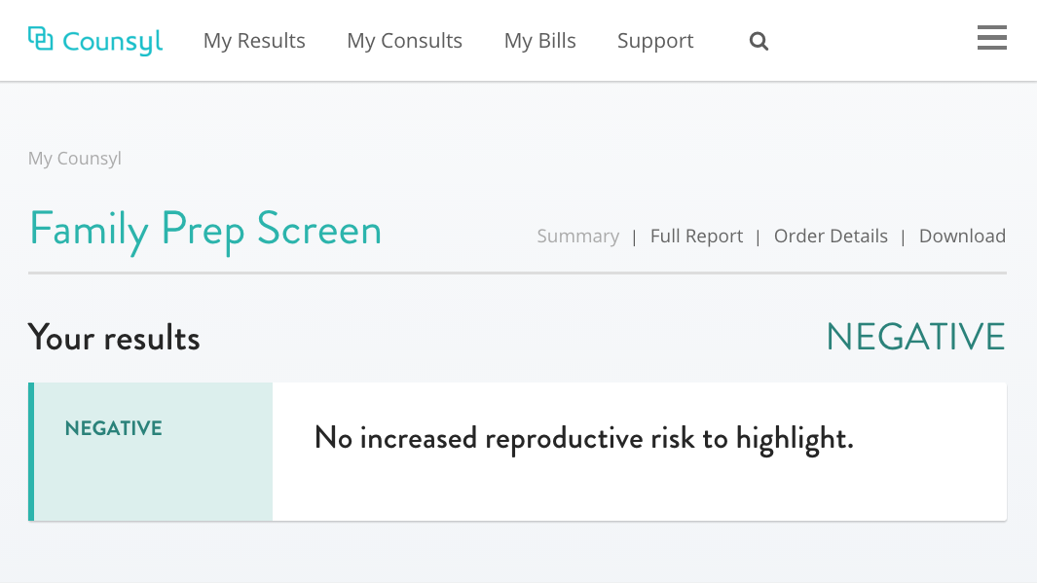
Checking for results

Slide 27
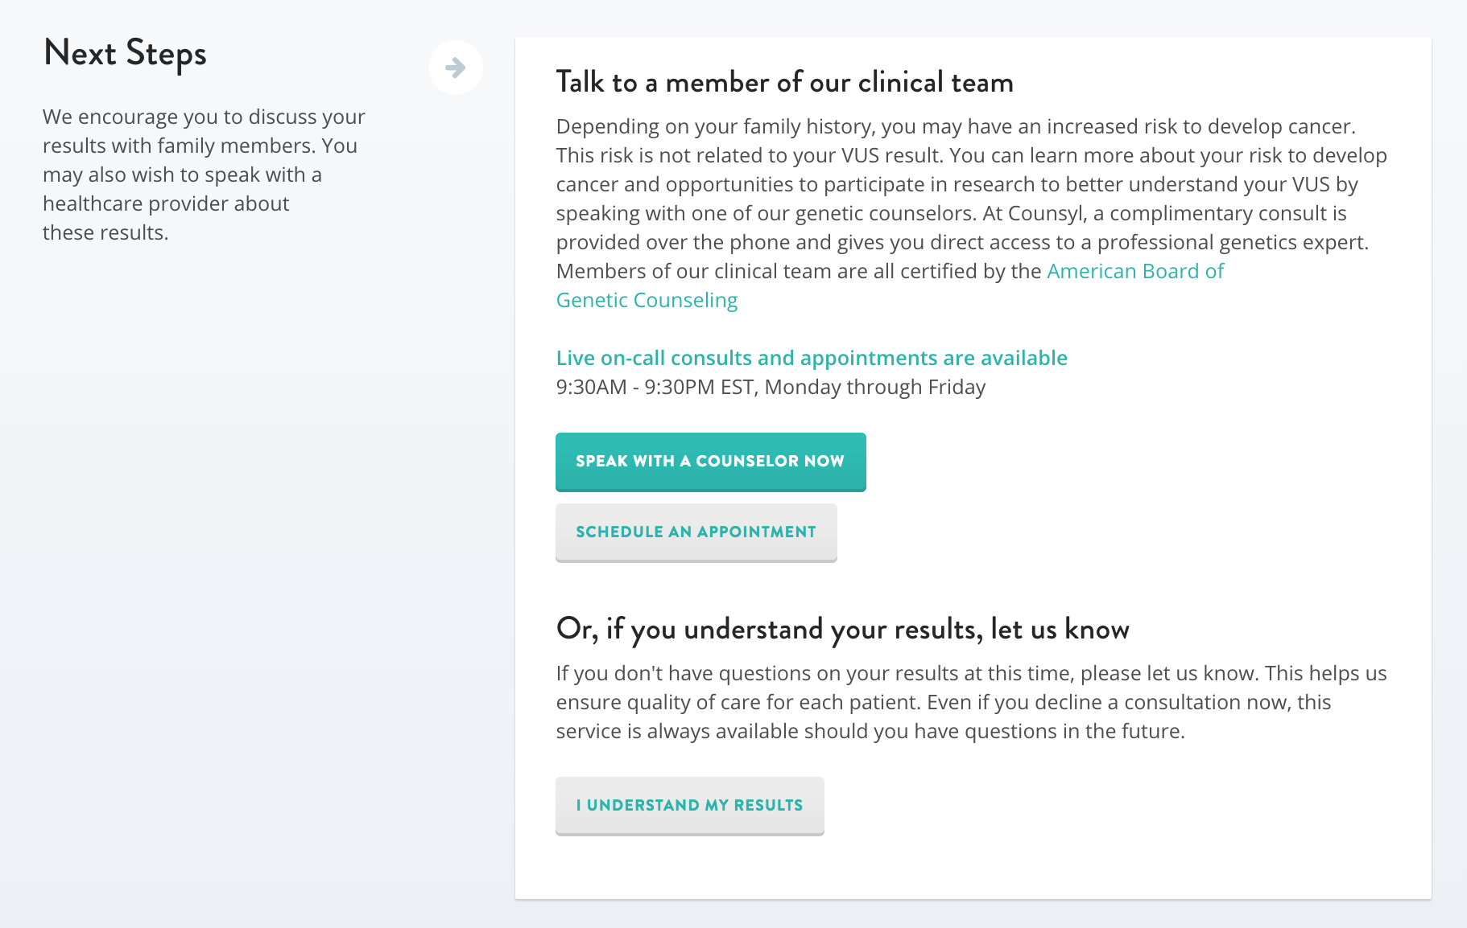
Post-test guidance
Notes:
Talking points:
Something else you get is visibility into whether your patients followed through with viewing their report online, scheduling and speaking to a genetic counselor, and in this activity log, you can see that Counsyl will contact your patient to make sure that patients are following through. Here you can see that the patient spoke to a genetic counselor on Feb. 12th. This keeps you totally in the loop. That’s a good segue way into our next topic, which is TRANSPARENCY.
4 million pregnancies in the US every year
Only 3500 genetic counselors, not all are prenatal
If half of them are prenatal counselors, that makes 1400
Each counselor would have to see 2800 patients per year, which is 55 patients per week, which is 11 patients per day ONLY for carrier screening (not all the other things we see patients for). Assumes you’re just seeing patients and not doing any paperwork.
NOT SUSTAINABLE

Slide 28
Supporting genetic screening with end-to-end practice workflow support
Ordering
Pre-test education
Coverage & estimates
Results delivery
Genetic counseling
Notes:
Talking points:
Our 45+ genetic counselors can also help you explain results. Our reports are clear, informative, and available online for both you and your patients. On-demand or scheduled genetic counseling is included with every Counsyl test, because we believe every patient should understand the meaning of their results.
Our extensive insurance network means that Counsyl testing is typically covered and will go towards patient deductibles. We work directly with patients and their insurance to determine coverage and provide upfront cost estimates and billing support. Payment options are available for patients who lack adequate coverage.
Counsyl partners with you to simplify the integration of screening into clinical practice. We can integrate with your EMR, submit prior authorizations, and follow up with patients to help ensure they don’t slip through the cracks. Every interaction is documented in a secure online portal.

Slide 29
Thank you!
alana@counsyl.com

Slide 30
ADDENDUM

Slide 31
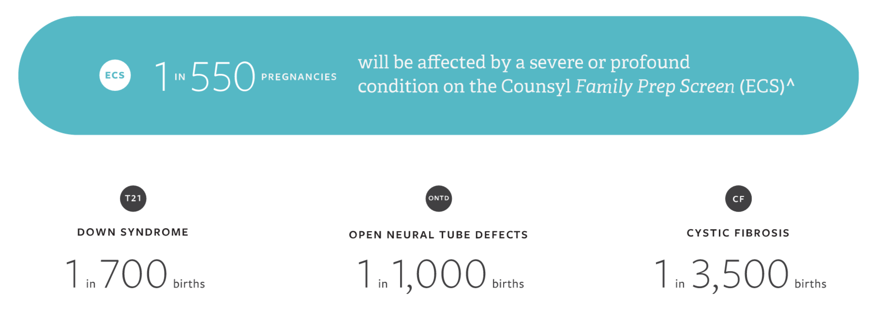
Comparison: ECS detects more affected pregnancies
Comparatively, the total risk of serious disorders identified through ECS is higher than the incidence of
routinely screened for conditions.^{4,5}
Notes:
Talking points:
Comparatively, the total risk of serious disorders identified through ECS is higher than the incidence of routinely screened for conditions such as Down syndrome.^{4,5}
1 in 550 pregnancies are at risk to be affected by a severe/profound condition on the Counsyl Family Prep Screen.
This is a weighted average of total risk across ethnicities for all 94 severe and profound disorders based on US census population estimates. (Data on ethnicity-specific risk is on the next slide.)
The total risk of serious disorders detected by ECS (1 in 550) is higher than the incidence of routinely screened for conditions, such as Down syndrome (1 in 700 births), open neural tube defects (1 in 1000 births), and for CF alone (1 in 3,400 births). (Note: this includes guideline AND non-guideline conditions.)
References
[Down Syndrome and Neural Tube Defects incidence in AMA style]
Parker SE, Mai CT, Canfield MA, et al. Updated National Birth Prevalence estimates for selected birth defects in the United States, 2004-2006. Birth Defects Res A Clin Mol Teratol. 2010 Dec;88(12):1008-16.
[Cystic Fibrosis incidence in style recommended by CFF] - make sure to use population risk, find source
Cystic Fibrosis Foundation Patient registry 2012 annual data report. Bethesda, Maryland. ©2013 Cystic Fibrosis Foundation
Use this slide to drill down on data on total recessive condition risk for each ethnic group compared to routinely screen for conditions, as needed.
Talking points
And the data are consistent across ethnicities… this chart shows the total risk of serious disorders detected by ECS is higher than the incidence of routinely screened conditions, when looking across each ethnicity in our study.
<More detailed alternative: The total risk of serious disorders detected by ECS for each ethnicity is higher than the incidence of routinely screened for conditions, such as Down syndrome (1 in 700 births), open neural tube defects (1 in 1000 births), and for CF alone (1 in 3,400 births). (Note: this includes guideline AND non-guideline conditions.)>
References
[Down Syndrome and Neural Tube Defects incidence in AMA style]
Parker SE, Mai CT, Canfield MA, et al. Updated National Birth Prevalence estimates for selected birth defects in the United States, 2004-2006. Birth Defects Res A Clin Mol Teratol. 2010 Dec;88(12):1008-16.
[Cystic Fibrosis incidence in style recommended by CFF] - make sure to use population risk, find source
Cystic Fibrosis Foundation Patient registry 2012 annual data report. Bethesda, Maryland. ©2013 Cystic Fibrosis Foundation

Slide 32
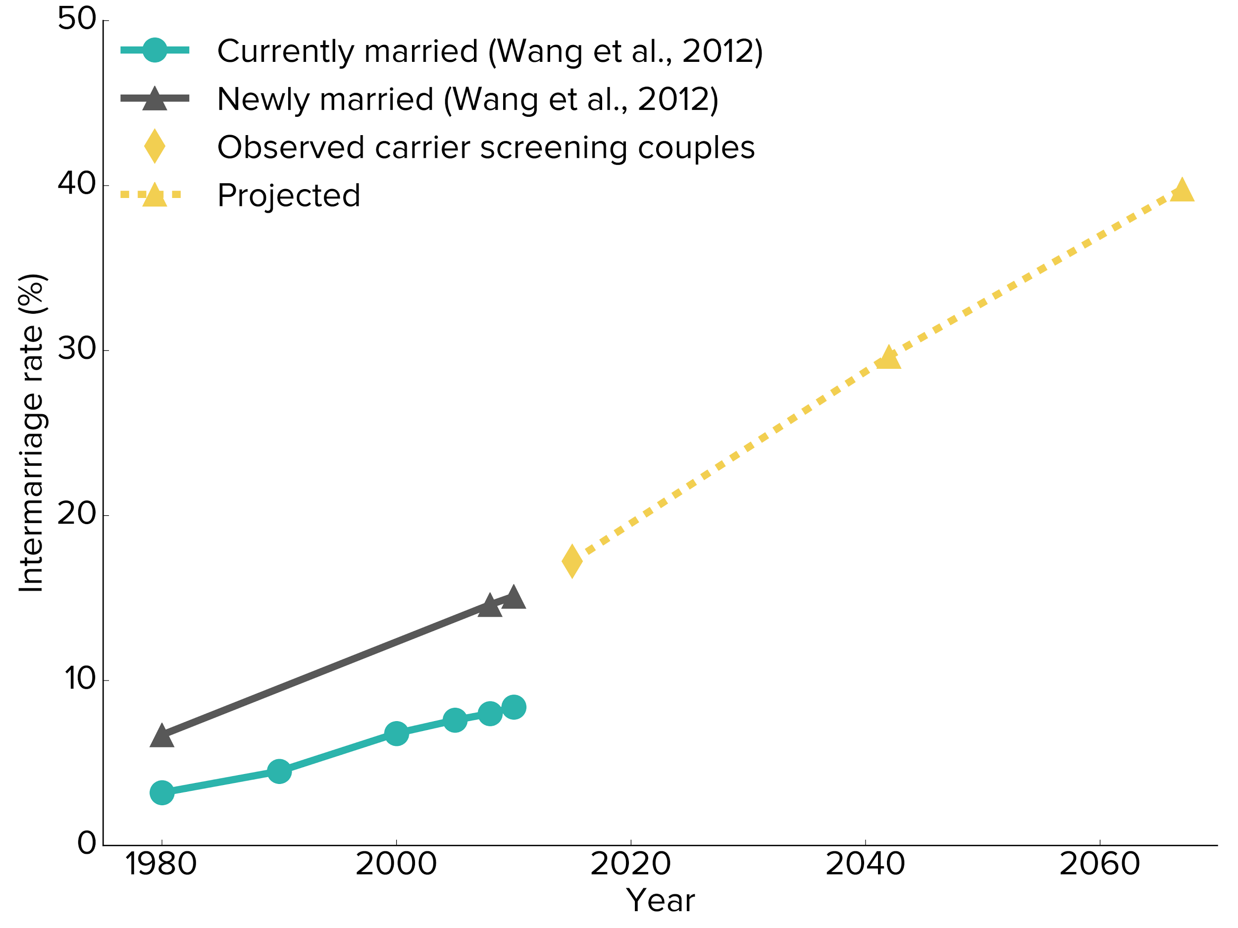
Intermarriage rates are expected to rise
17.2%
Notes:
This is from NSGC poster presented in 2016. Essentially we looked at 30,000 mixed couples and plotted it against the US Census data for intermarriage. If we predict out 2 generations ahead, then by 2060 nearly 40% of couples will be interracial. So, how do we ask people to define themselves ethnically?

Slide 33
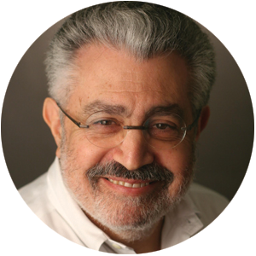
Distinguished authors
“
… even though current guidelines target a number of diseases prevalent in those of European descent (such as cystic fibrosis), they do not identify risk for other conditions that may be important to diverse populations.
-Haque, et al.
Imran S. Haque, PhD
Gabriel A. Lazarin, MS
H. Peter Kang, MD
Ronald J. Wapner, MD, FACOG, FACMG
Eric A. Evans, PhD
James D. Goldberg, MD, FACOG, FACMG
Notes:
Talking points:
This study conducted and the paper authored by Counsyl in partnership with distinguished MFM and genetics expert, Dr. Ron Wapner

Slide 34
“... as more diseases are added to [Ashkenazi Jewish] panels, some carrier states in the targeted populations begin to approach the prevalence in the general population leading one to consider whether it is more appropriate to employ panethnic screening…”
Notes:
Talking points: In 2006, a group of prominent geneticists attended a conference about how to approach population-based screening, and they published a commentary in 2008, stating the future is now. This was very forward-thinking at that time, but if the “future was now” in 2006, then I would argue that ten years later, the future is “definitely now.”

Slide 35
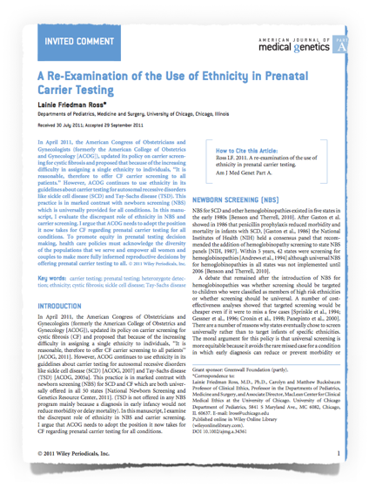
Re-examining pan-ethnic screening
Re-examining pan-ethnic screening
“ACOG needs to adopt the position it now takes for CF regarding prenatal carrier testing for all conditions.”
“To promote equity in prenatal carrier testing opportunities, health care policies must acknowledge the diversity of the populations that we serve and empower all women and couples to make more fully informed reproductive decisions.”
*Source: Counsyl, internal data, 2009 - 2011.
Notes:
Talking points: Genomics has also called into question the reification of “racial” categories in clinical guidelines, as high-throughput assays now allow a physician to prescribe the same test for every patient, regardless of ethnicity, with little or no increase in cost. In part, there have been a lot of arguements about the benefit of reducing the diagnostic odyssey (even if the disease itself is not treatable) and informing other “at risk” relatives.
What’s been very interesting from a clinical perspective is that our internal data based on almost 8000 patients shows that 45% of carriers of “Jewish” diseases report no AJ ancestry. This either means that people are unaware of their heritage, or these diseases are more common to the general population than previously thought. My sense is that it’s likely a combination of both of these factors.

Slide 36
When people have information, they use it! Retrospective analysis of at-risk couples
Preconception
Findings from a study of couples who were found to be at-risk for an autosomal recessive disorder through expanded carrier screening
62%
Pursued alternative reproductive options
Prenatal
53%
Pursued or planned for prenatal diagnosis
Ghiossi, C, et al. Clinical utility of expanded carrier screening: reproductive behaviors of at-risk couples.
Notes:
Talking points: The findings of the study published in JAMA certainly support the value of ECS, but what about the actual use of that information in making decisions? Well, we studied that too. This was done in cooperation with California State University, Stanislaus. We looked at couples found to he at-risk for an autosomal recessive disorder as identified using our Family Prep Screen. Most of the population was preconception, but a subset was prenatal. What we found is that over half of the couples took action with the information. In the preconception group, they sought alternative reproductive options. While in the prenatal group, they focused on prenatal diagnosis of the condition identified on the panel.
The important point here is that when you give couples information they can act on, they will take action. This is why we focus on serious, actionable diseases only. At Counsyl, we want providers and couples to have information that will truly aid in family planning.
REF: Ghiossi, C, et al. Clinical utility of expanded carrier screening: reproductive behaviors of at-risk couples.

Slide 37
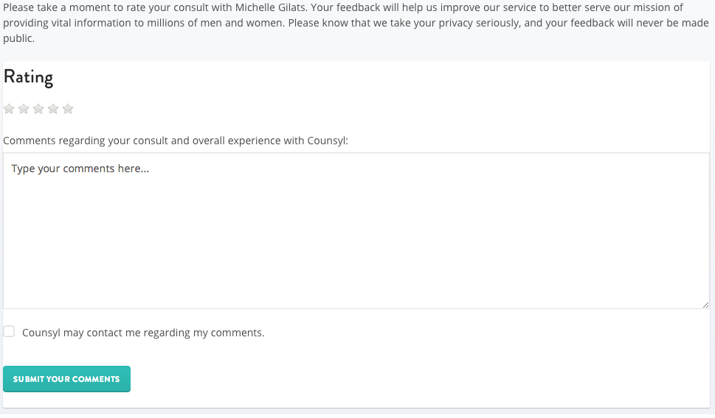
Patient ratings overall
4.9
Started July 2014
>50,000 consults completed
Over 8200 ratings

Slide 38
Informed consent in the new era
“
A counseling model that was born in an era when a small number of women needed information about a finite number of heritable diseases will not suffice when virtually all pregnant women need information about an enormous number of genetic disorders.
— Minkoff & Berkowitz, Obstet Gyn. 2014

Slide 39
Informed consent By “bucketing” conditions into four distinct categories
Lead to shortened life expectancy
This category of diseases is defined as a decrease in average lifespan for >60% of affected individuals.
Associated with intellectual disability
Conditions in this category are associated with a significant risk of intellectual disability, either with or without standard treatment.
Improve with early intervention
This category of diseases includes those with a standard, recommended treatment that is reasonably accessible to most affected individuals.
Limited or no treatment options
This category of diseases are not currently curable and effective treatment options are lacking.
Cystic fibrosis, Tay-Sachs disease, spinal muscular atrophy
Fragile X syndrome, Smith-Lemli-Opitz syndrome, metachromatic leukodystrophy
Phenylalanine hydroxylase deficiency (PKU), Wilson disease, Galactosemia
Krabbe disease, Bloom syndrome, Pompe disease

Slide 40
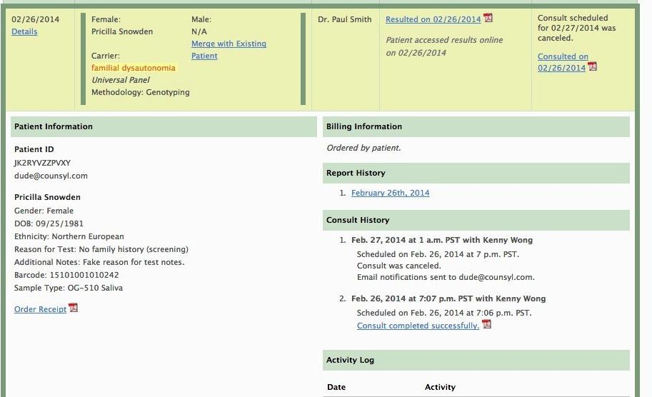
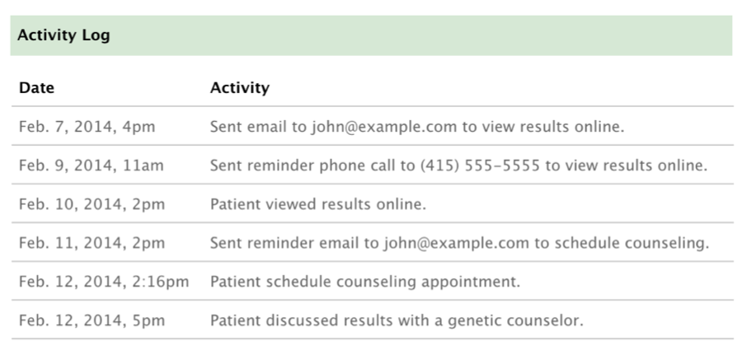
Audit log of all patient activity and consultation reports
Ordering provider stays in the loop
Ordering provider stays in the loop Audit log of all patient activity and consultation reports
Tracking and Reminder Systems Guidelines Compliant
Notes:
Sample notes: Something else you get is visibility into whether your patients followed through with viewing their report online, scheduling and speaking to a genetic counselor, and in this activity log, you can see that Counsyl will contact your patient to make sure that patients are following through. Here you can see that the patient spoke to a genetic counselor on Feb. 12th. This keeps you totally in the loop. That’s a good segue way into our next topic, which is TRANSPARENCY.
Note: highlights are animated.

Slide 41
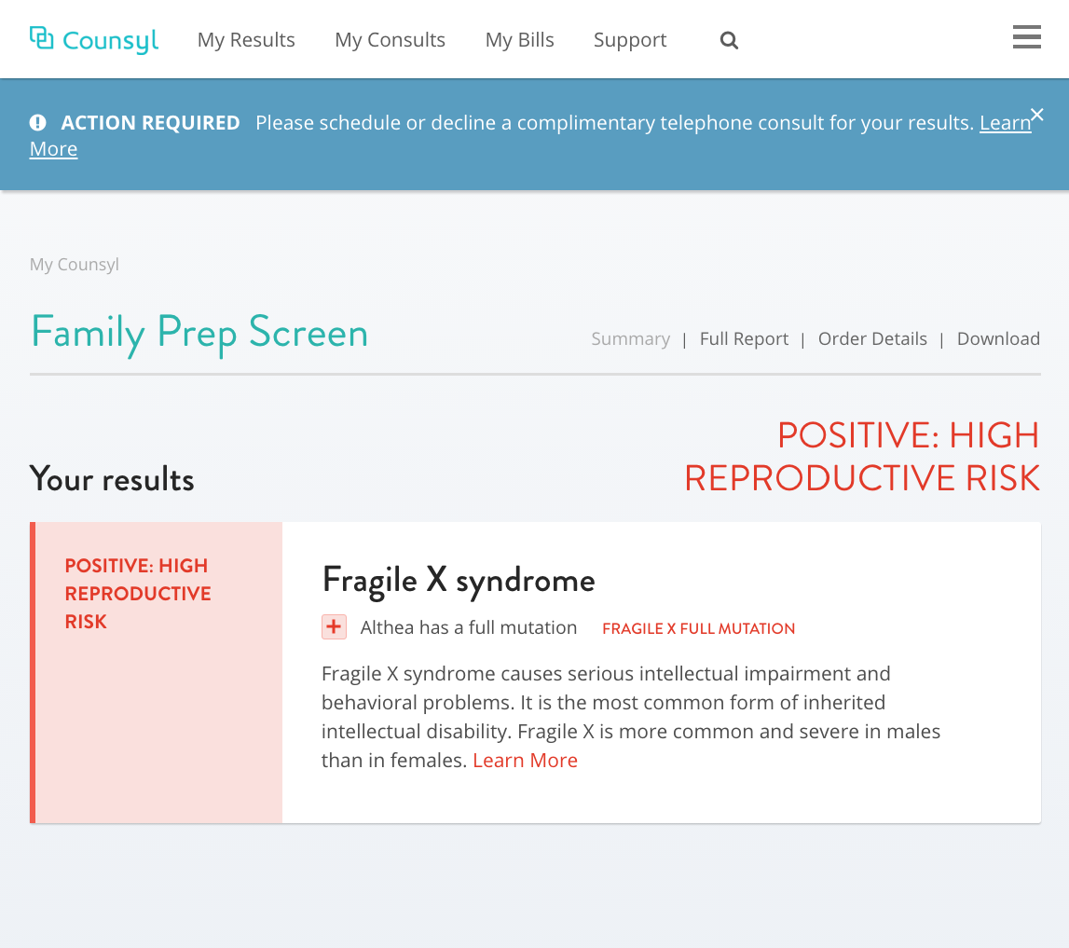
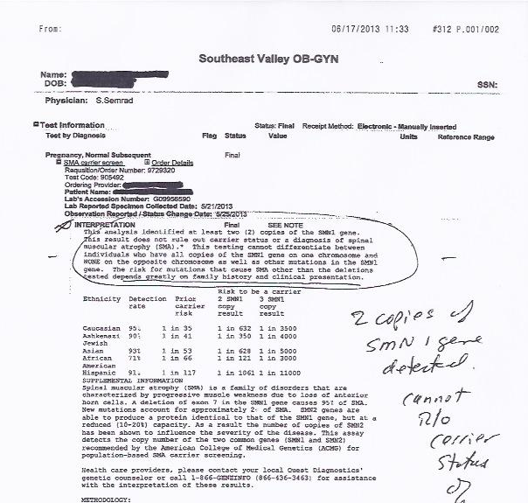
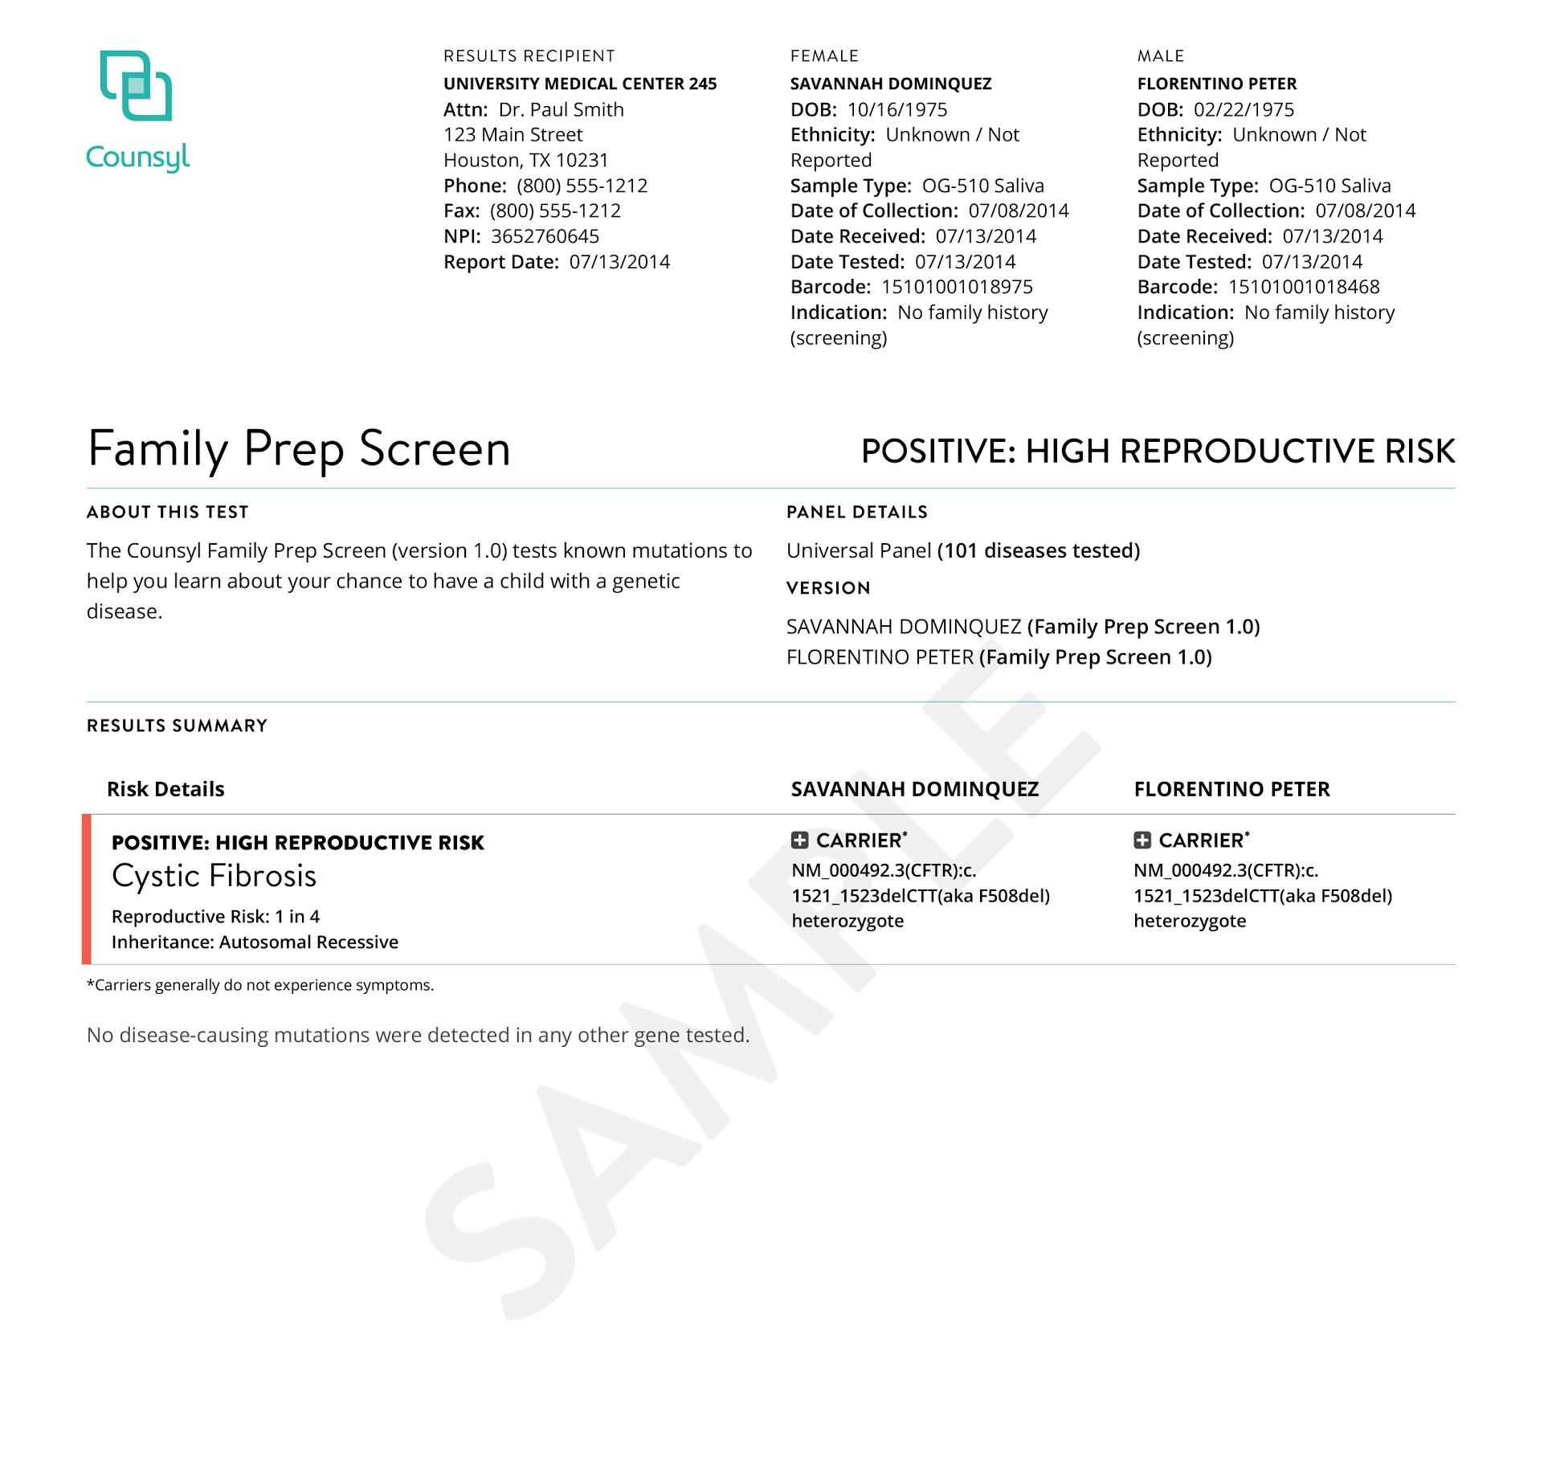
Patient-friendly Reports
Traditional results
Cluttered, unclear results with no follow up
Counsyl results
Clear, patient friendly explanation of results
Notes:
Sample notes: We’re also leveraging technology and design to reinvent what a medical report looks like. A user-friendly results means less time trying to figure out what the report is trying to say, and more time addressing the points of concern.We’ve gone to great lengths to make sure reports are clear. All the information you need is on the first page, with PPV or Residual Risk calculations included, where appropriate. The end result is TIME SAVED for your clinic. {What would you do if you received the report on the left? It would probably be multiple phone calls back and forth to ensure you understand the report…. that translated to time spent on something that should have been straightforward.)
Optional: We’re also working on a “sharing” tool that patients can easily use to share their results with family members, if they so choose.

Slide 42
Disease Selection & Panel Updates
What about the Jewish Organizations?
Have all 52 genes recommended by JGDC (Jewish Genetic Disease Consortium)
New concept - added >45 Jewish genes as Opt-In (not on Universal Panel due to severity or clinical validity)
2 Panels available for these organizations only - need approval.
Expanded Jewish Panel: >105 genes (Jewish genes on Universal Panel + Jewish genes on Opt-In).
We have the largest “Expanded Jewish Panel” (Natera has 96 genes)!!!
Universal + Expanded Jewish Panel (>225 genes)
Notes:
>55 Jewish genes to offer the most comprehensive Opt-in Jewish Panel
Also offering a new Severe & Profound Panel to replace the Prenatal Panel

Slide 43
Challenge ourselves to further maximize detection of at-risk couples (ARC), while minimizing residual risk
Focus on serious, prevalent disorders that are actionable
Employ the most advanced technology and methods that deliver the highest quality results
Streamline genetic screening practice workflow with end-to-end support
1
2
Our philosophy
3
Counsyl is committed to moving ECS forward in a responsible way
4
Notes:
Talking points: We see expanded carrier screening as a great opportunity for the medical community and couples planning families, but we take it very seriously. We want to advance ECS in a responsible way, hence our philosophy.
Focus on serious disorders that you can take action on if you so choose
Push the technology to provide the best results available
Always challenge ourselves to detect more at-risk couples
And make the process of expanded carrier screening as easy as possible on you (the provider) and your practice

