Slide 1

TGMs regulate the interaction of wild type and Y329S GBE1 with membranes: implications for GBE1 activity, and for APBD pathophysiology and therapy
Rafael Alvarez, Jesús Casas, David J. López, Maitane Ibarguren, Ariadna Suari-Rivera, Silvia Terésª, Francisca Guardiola-Serrano, Alexander Lossos, Xavier Busquets, Or Kakhlon and Pablo V. Escribá

Slide 2
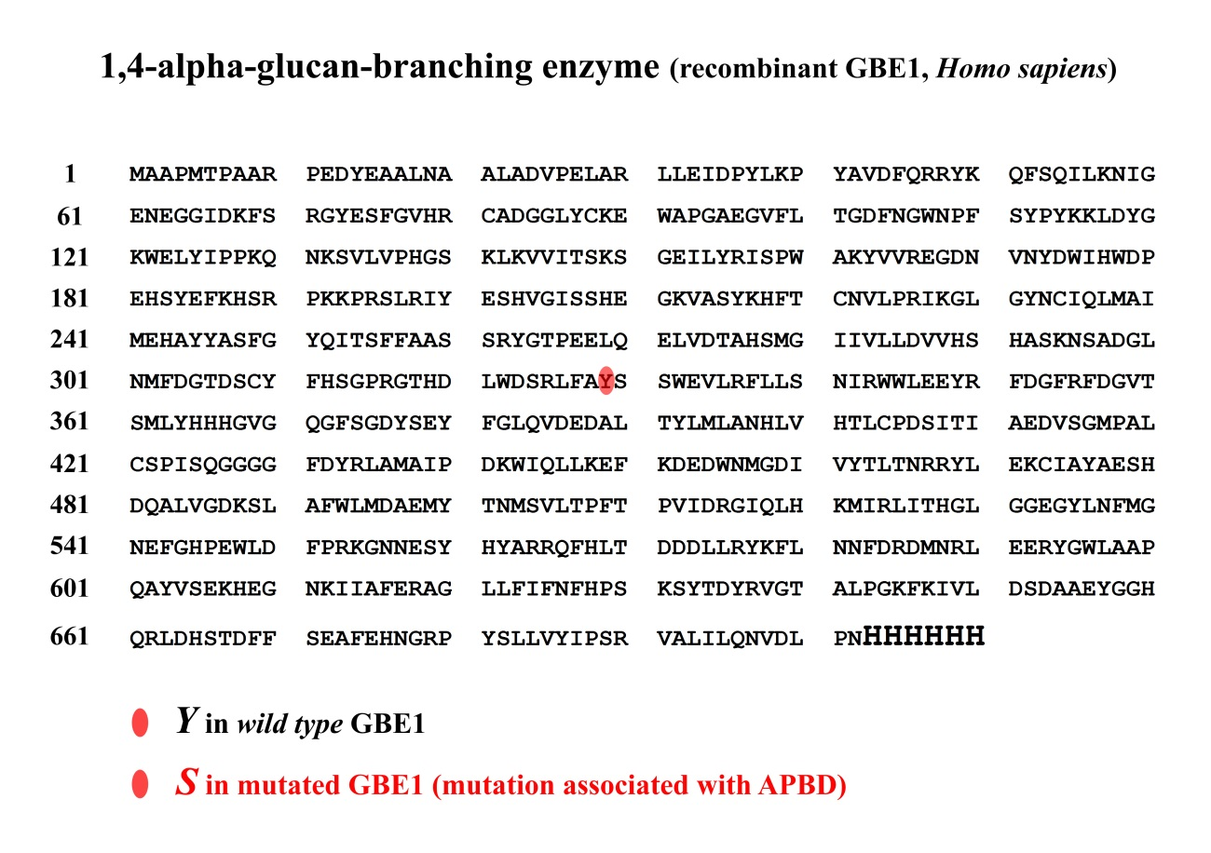

Slide 3
GBE1 purification by affinity chromatography
GBE1 purification
GBE1
Imidazol
Hystidine tag
Ni²⁺ matrix
*
*
*
*

Slide 4
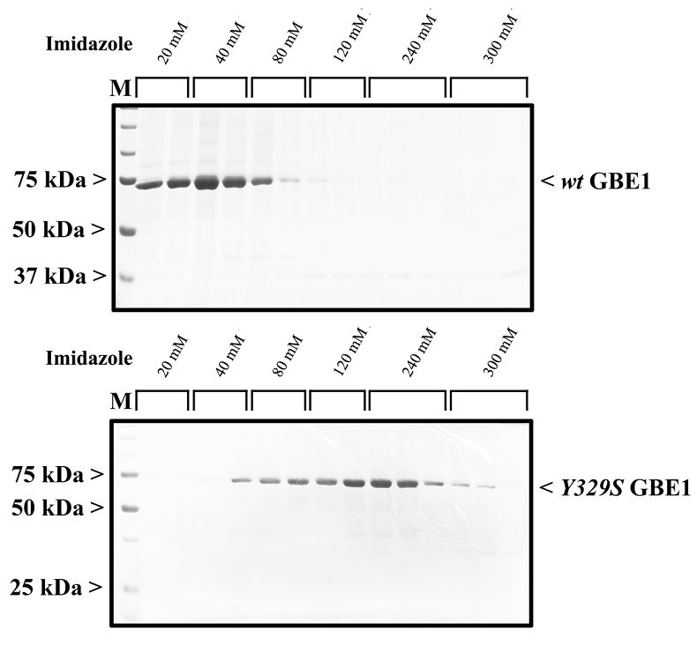
GBE1 protein purification

Slide 5
Localization of GBE1 in U118 cells
Hoechst 33342 GBE1 Merge
Confocal microscopy image of U118 cells. Upper and lower panels represent two different representative cells stained with the nucleus-staining- probe Hoechst 33342 (blue) and anti-GBE1 antibody (red). GBE1 overexpression was not induced in these cells . Bar=10 μm.

Slide 6
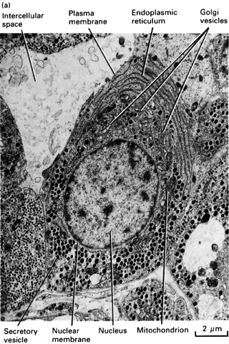
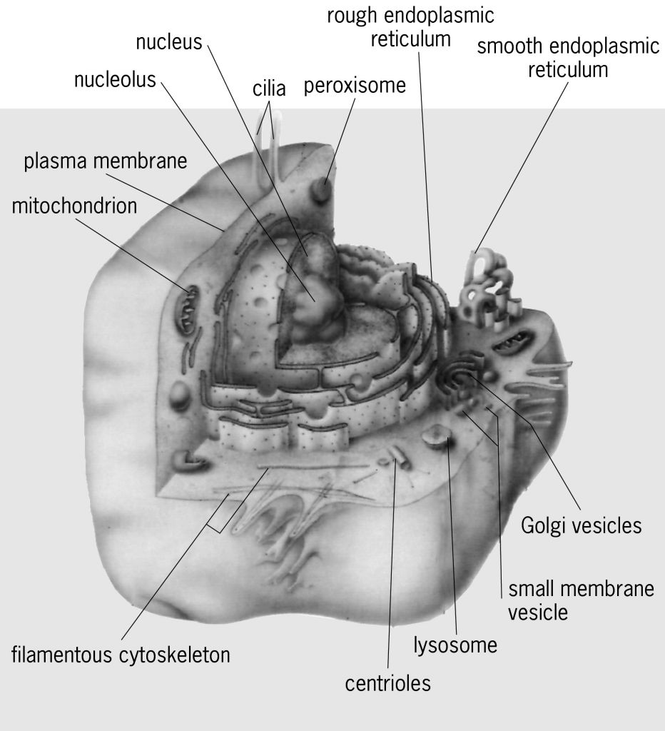
Membranes in the cell

Slide 7
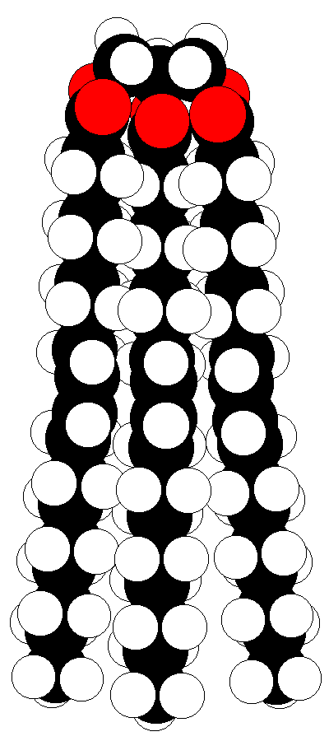
TGMs structure
CH₂ – CH – CH₂
| | |
O O O
| | |
CO CO CO
| | |
HOCH HOCH HCOH
| | |
R1 R2 R3
TGM1

Slide 8
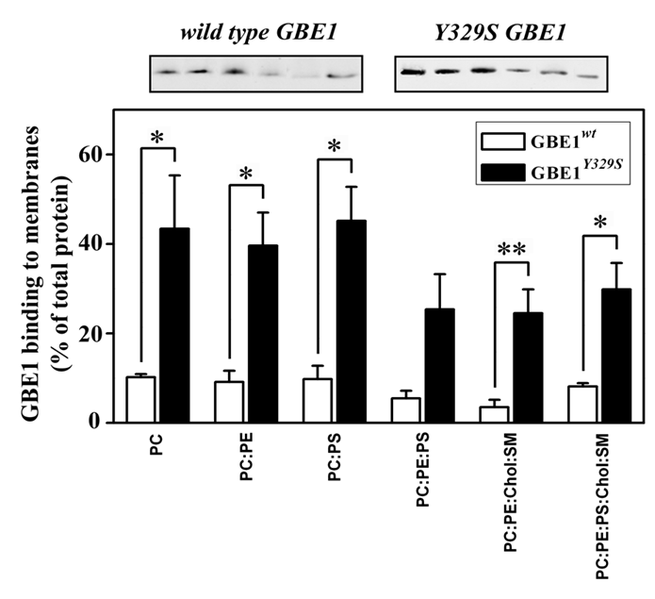
GBE1 binding to membranes

Slide 9
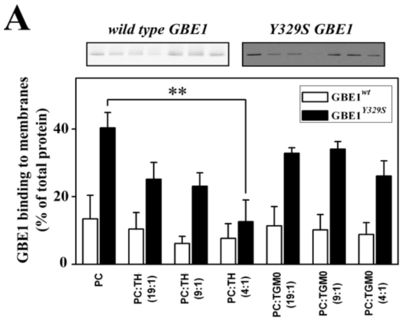
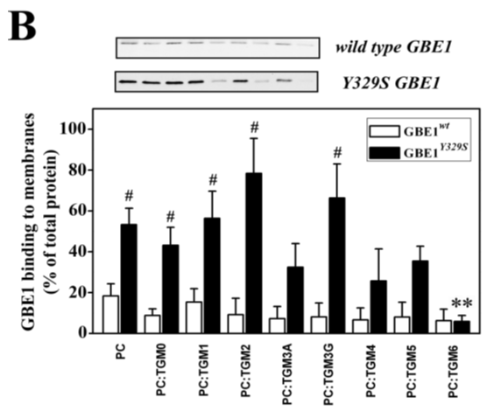
TGMs on GBE1-membrane binding

Slide 10
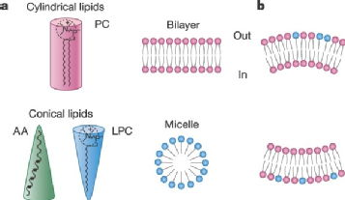
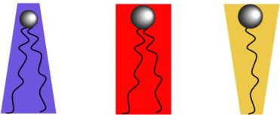
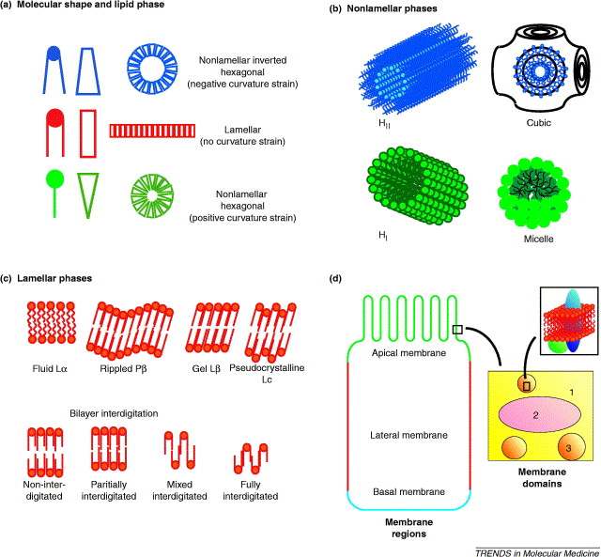
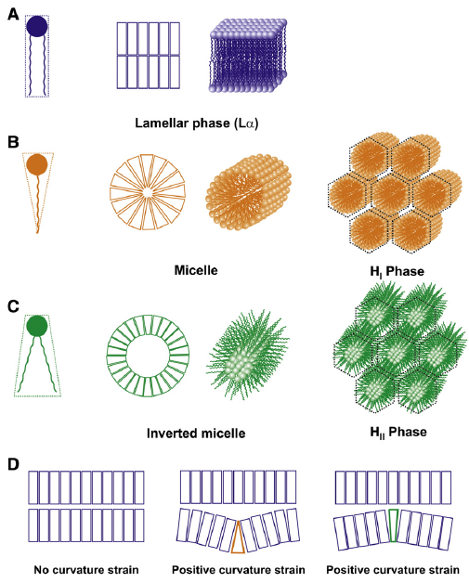
Membrane structure

Slide 11
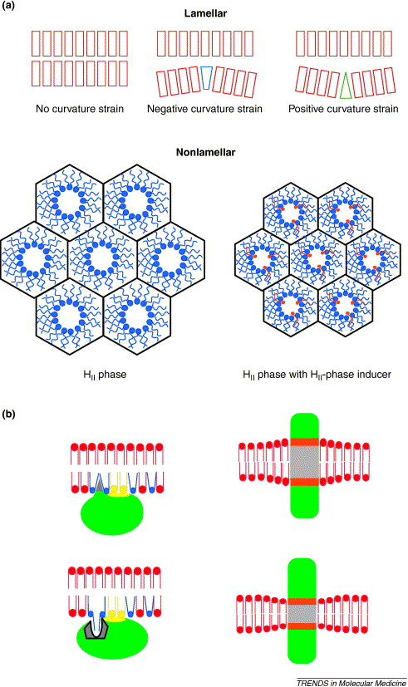
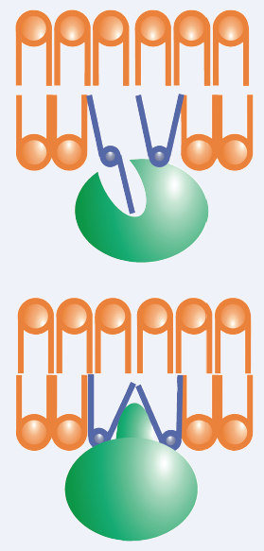
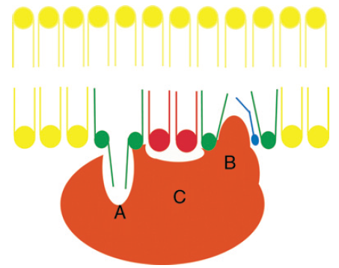
Membrane structure & protein-lipid interactions

Slide 12
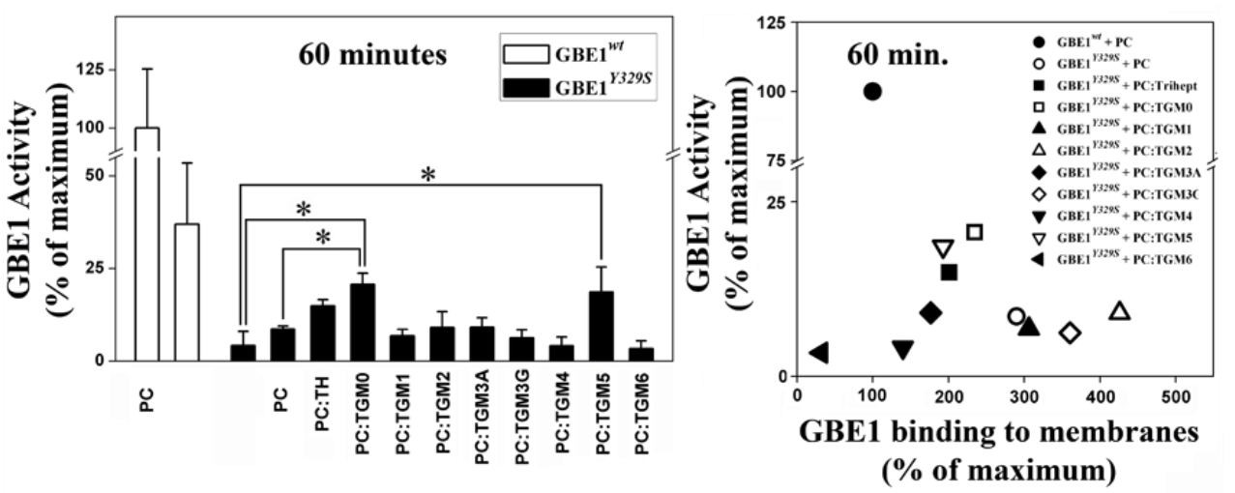
TGMs GBE1-membrane binding and activity

Slide 13
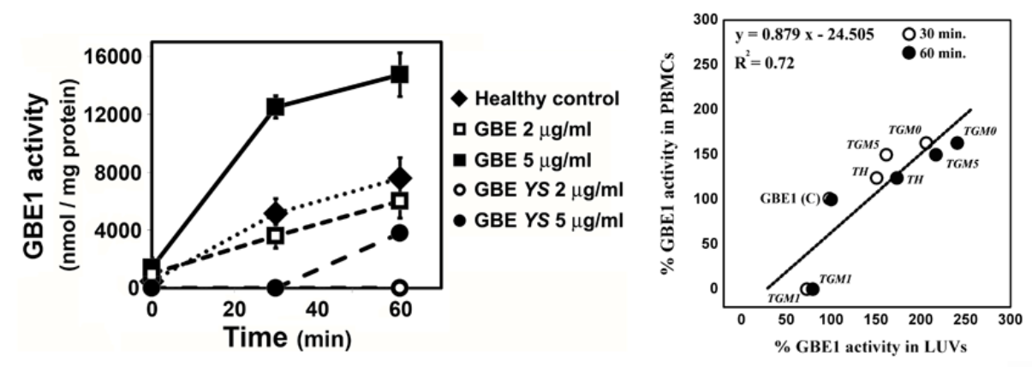
TGMs GBE1-membrane binding and activity

Slide 14
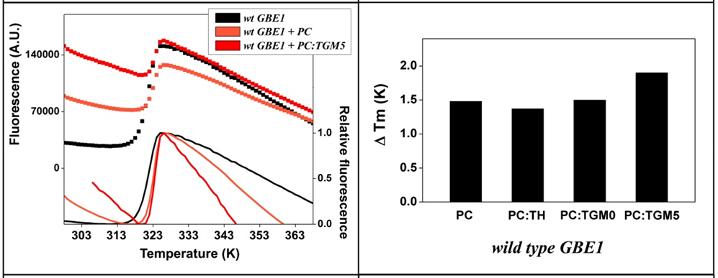
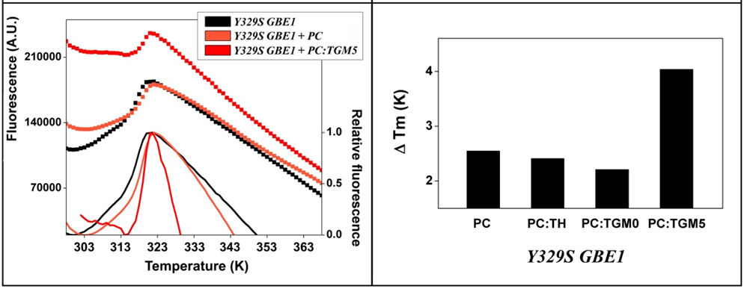
TGMs on GBE1 thermal stability

Slide 15
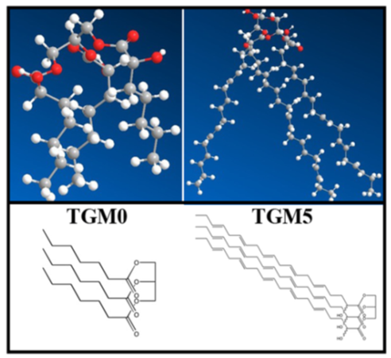
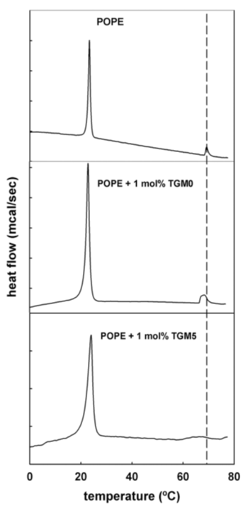
TGMs on membrane structure

Slide 16
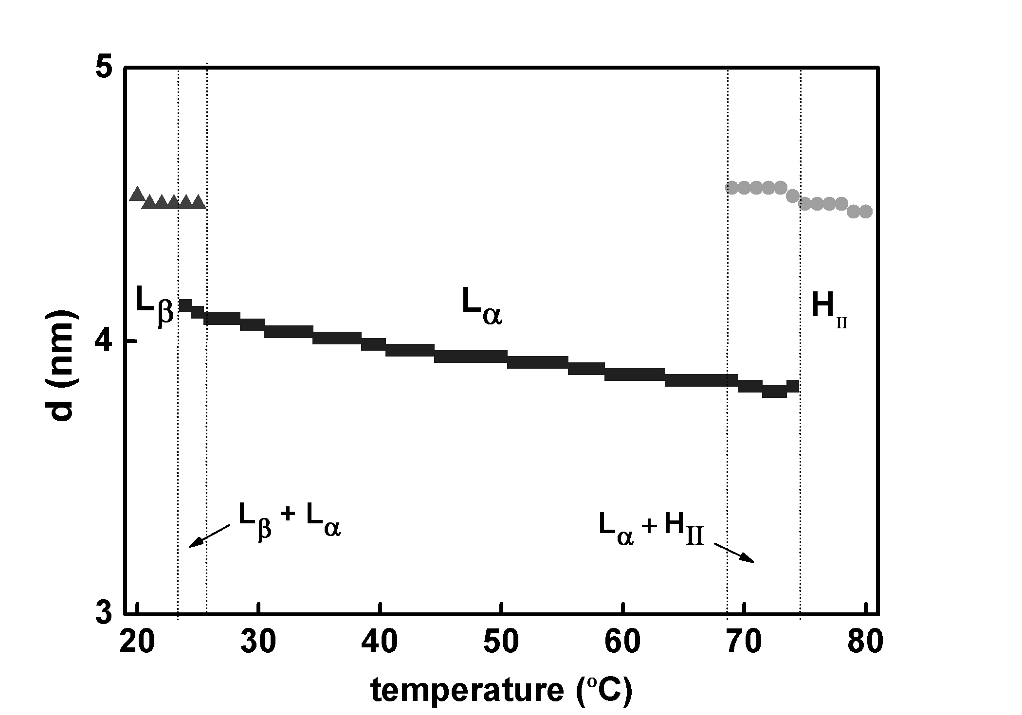
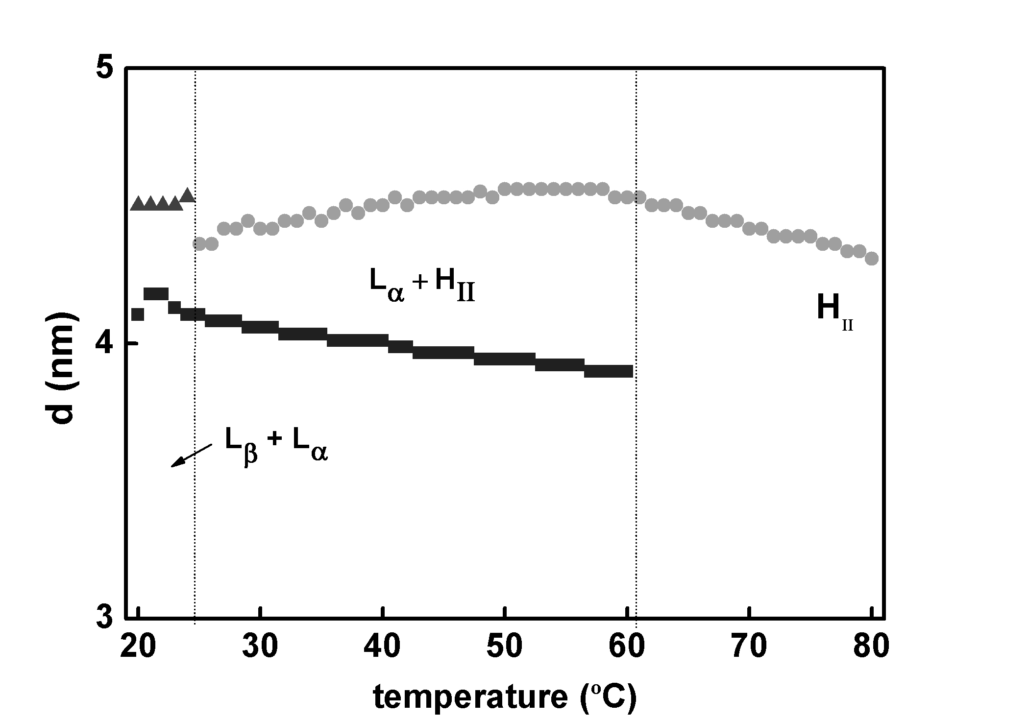
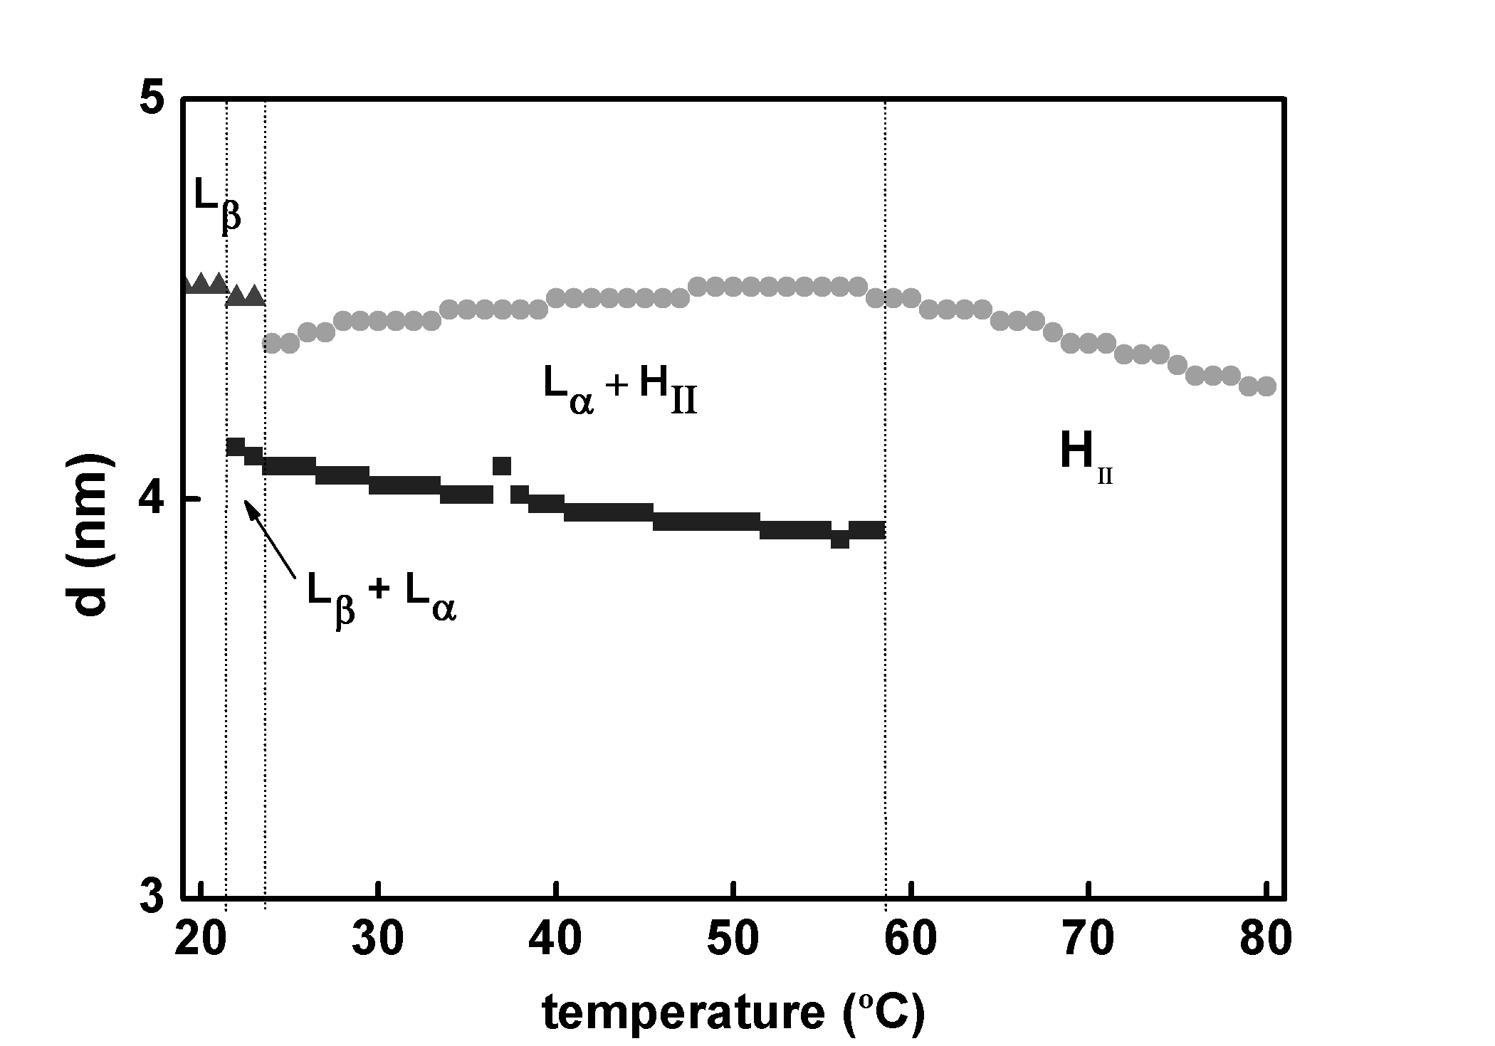
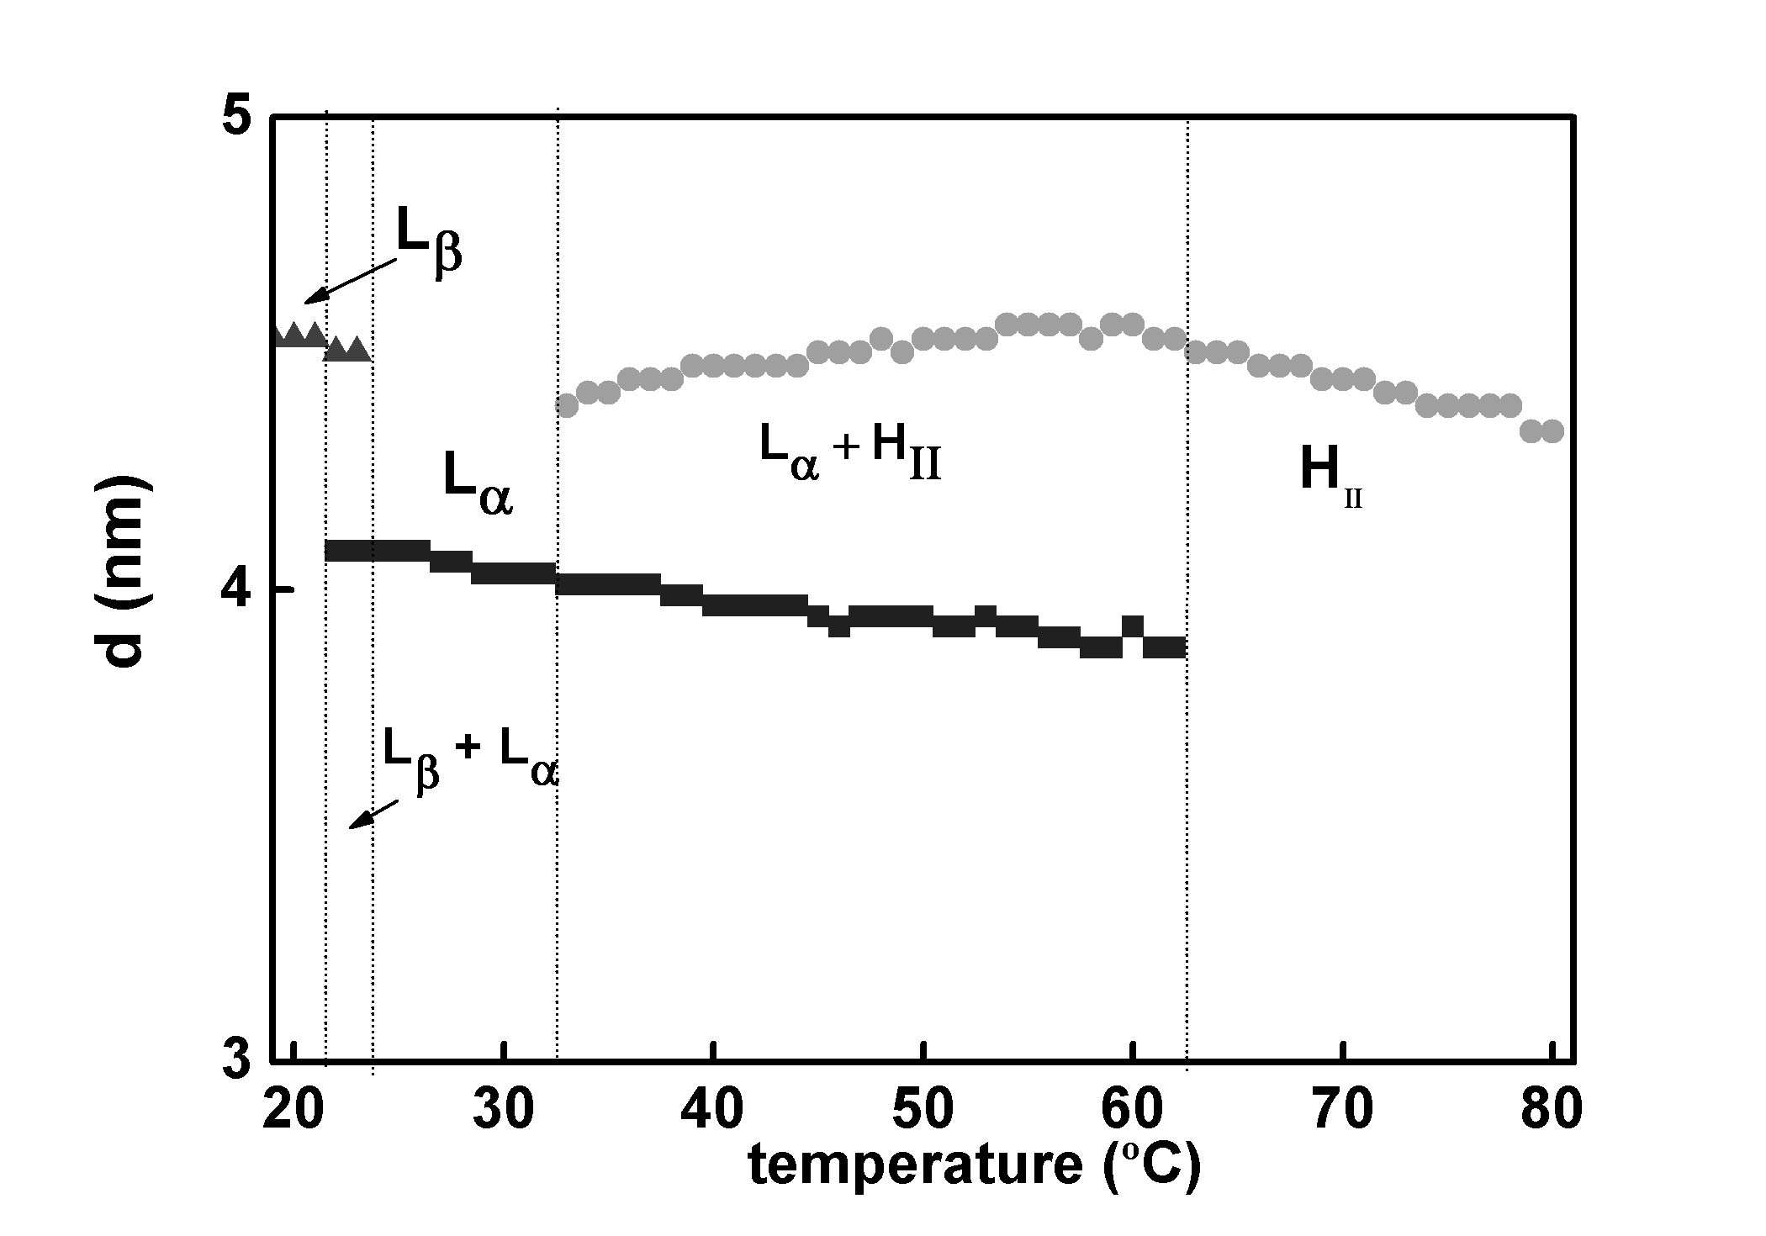
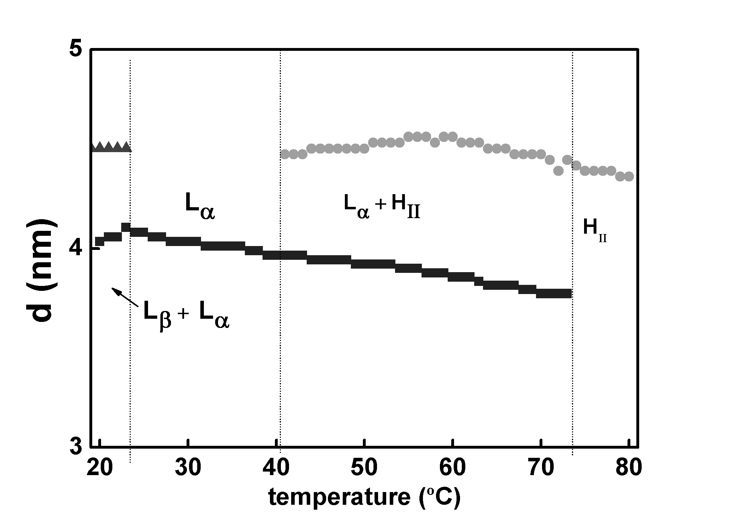
TGMs on membrane structure
POPE
POPE + 5 mol% TGM1
POPE + 5 mol% TGM2
POPE + 5 mol% TGM4
POPE + 5 mol % TGM6
A
X-ray diffraction (SAXS/WAXS)
B
C
D
E

Slide 17
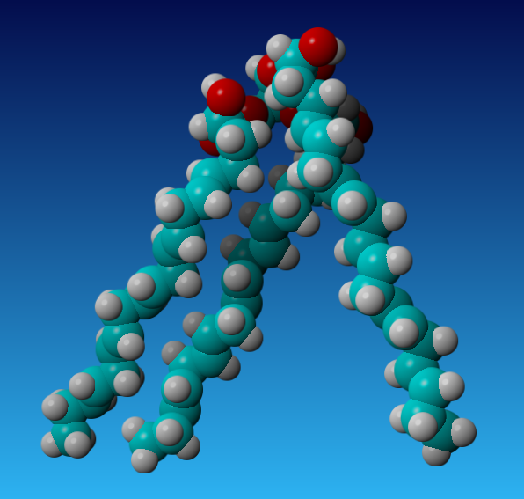
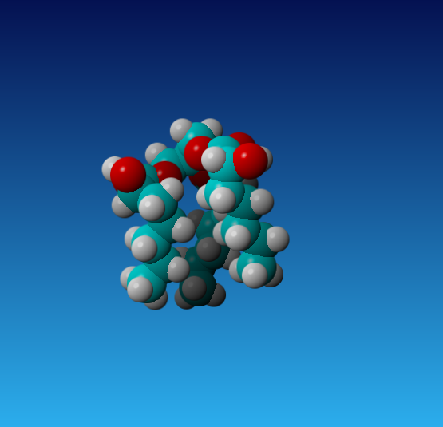
TGMs structure
TGM5
TGM0

Slide 18
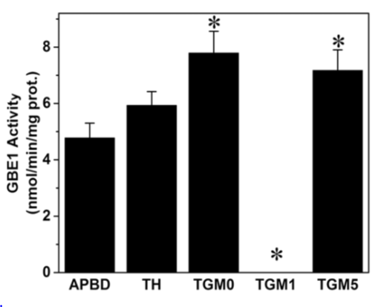
TGMs on GBE1 Y329S activity in patient’s cells

Slide 19
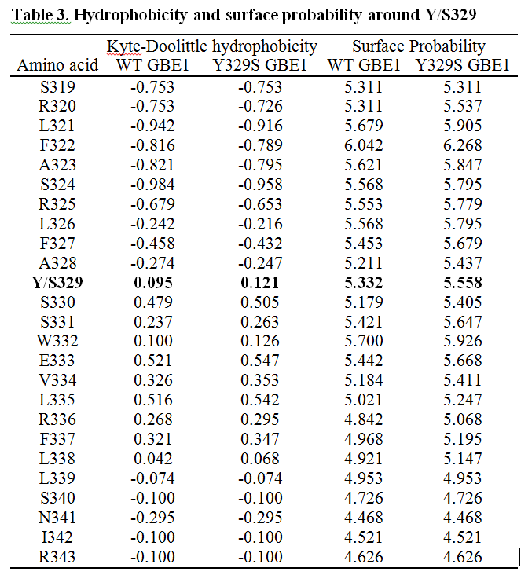
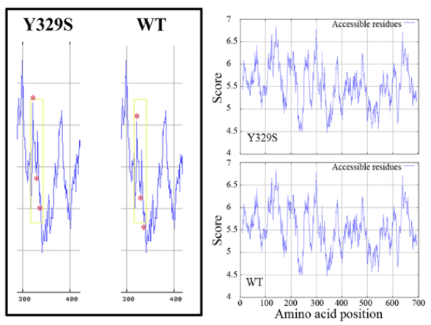
Effect of Y329 on GBE1 structure:
Amino acid surface probability

Slide 20
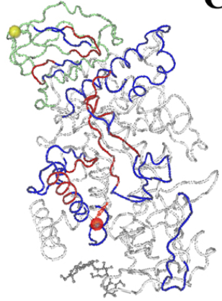
GBE1 structure
Orange: Y329
Yellow: C-terminus

Slide 21
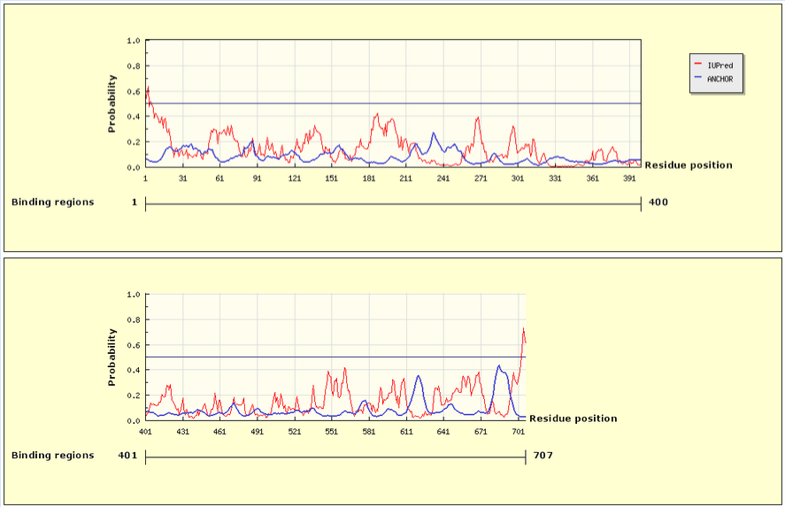
No potential Ca²⁺ binding sites
Anchor IUPred analysis

Slide 22
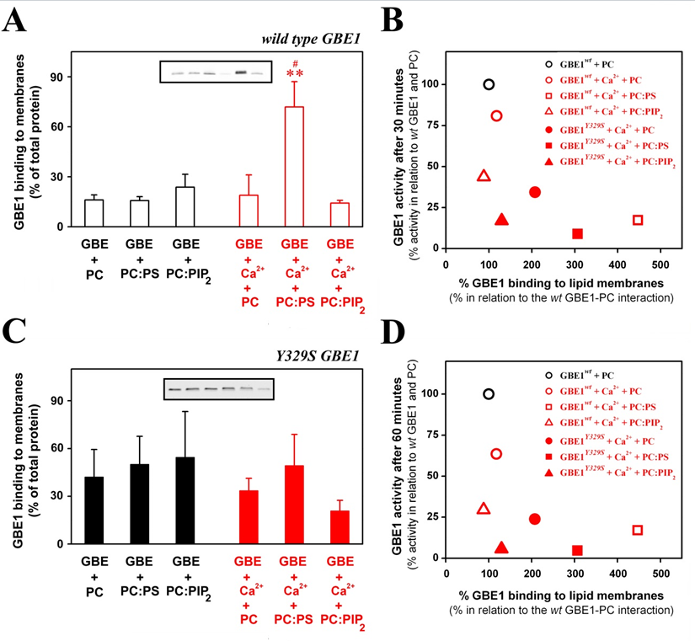

Slide 23
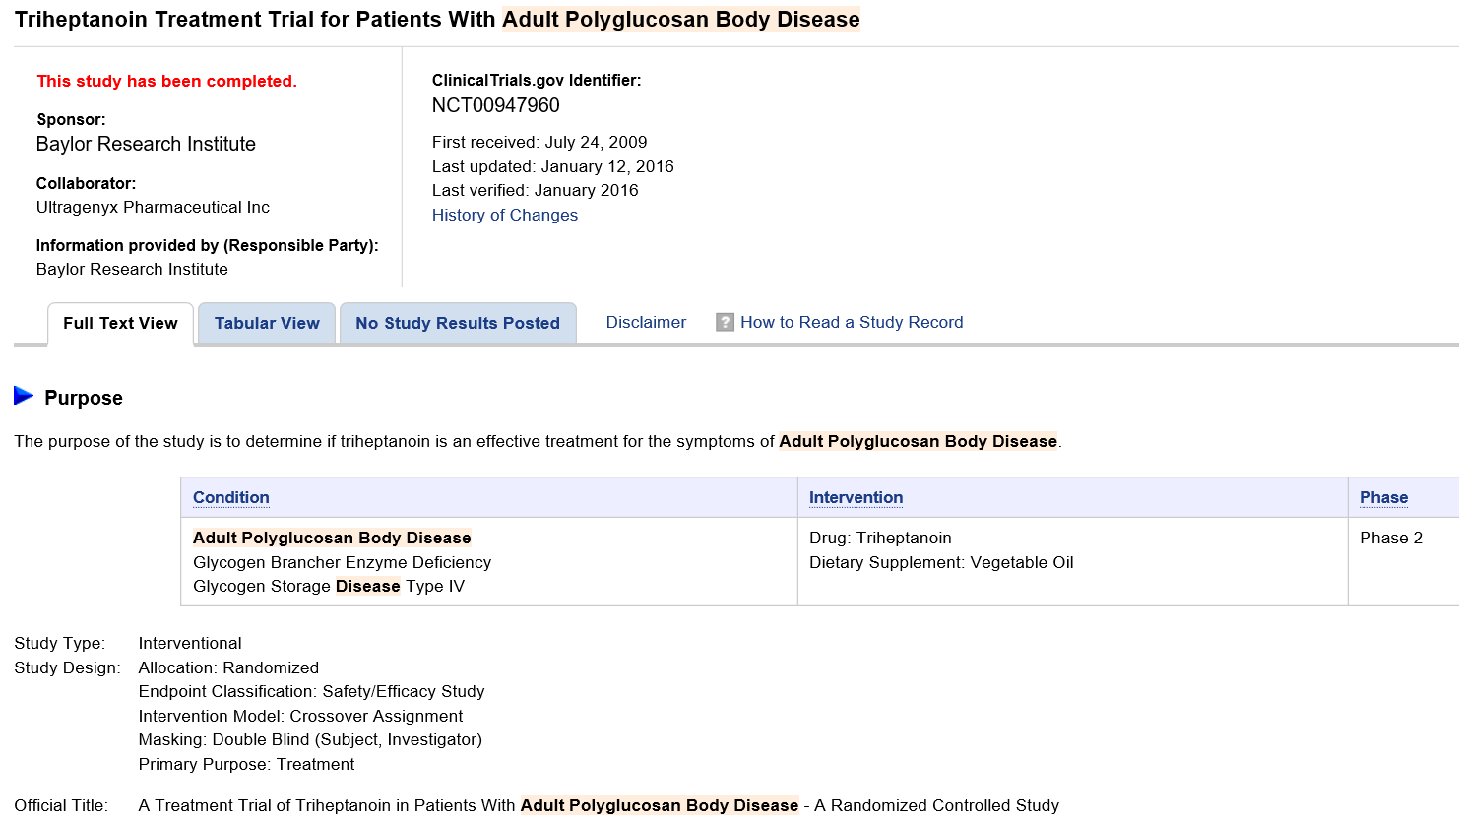
APBD Phase II Clinical Trial with TH

Slide 24
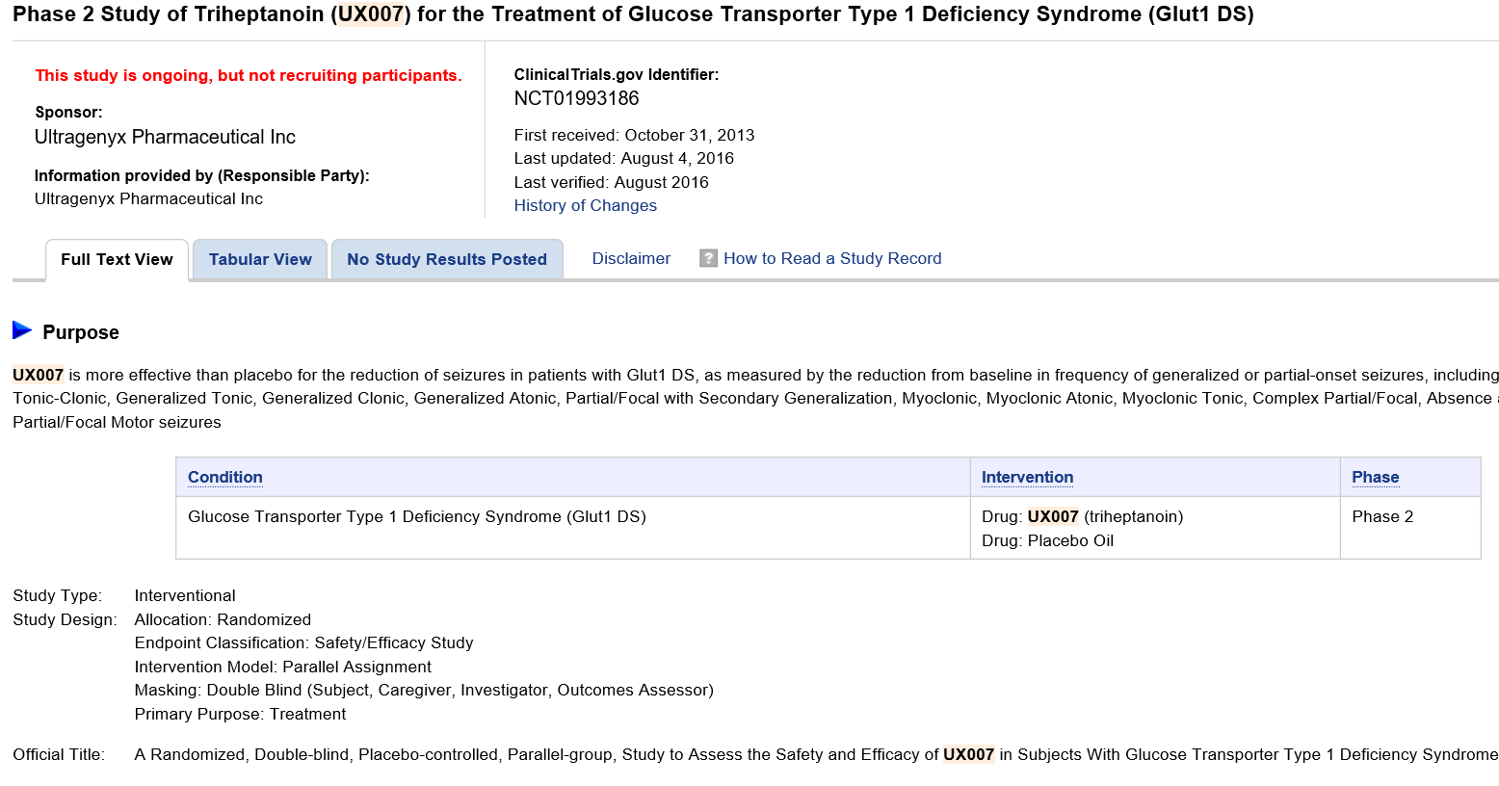
Glucose Tranporter Deficiency Type I Phase II Clinical Trial with TH

Slide 25
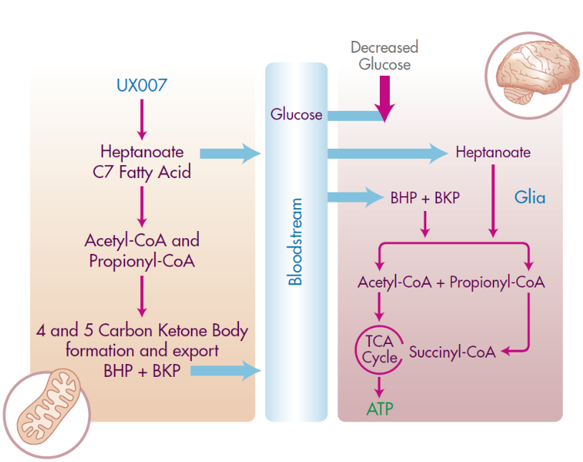

Slide 26
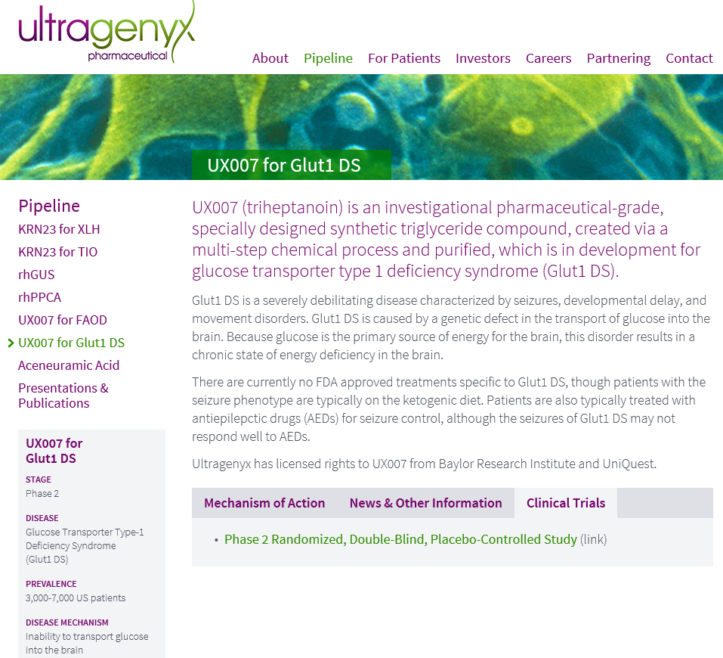

Slide 27

TGM5 as a food supplement
TGM5 has been registered and approved in the European Union as a food supplement and notified to various EU countries.
It is produced by BEGA under the brand name of EPApother because it is a molecule based on EPA for Adult polyglucosan body therapy.
www.begapharma.com

