Slide 1
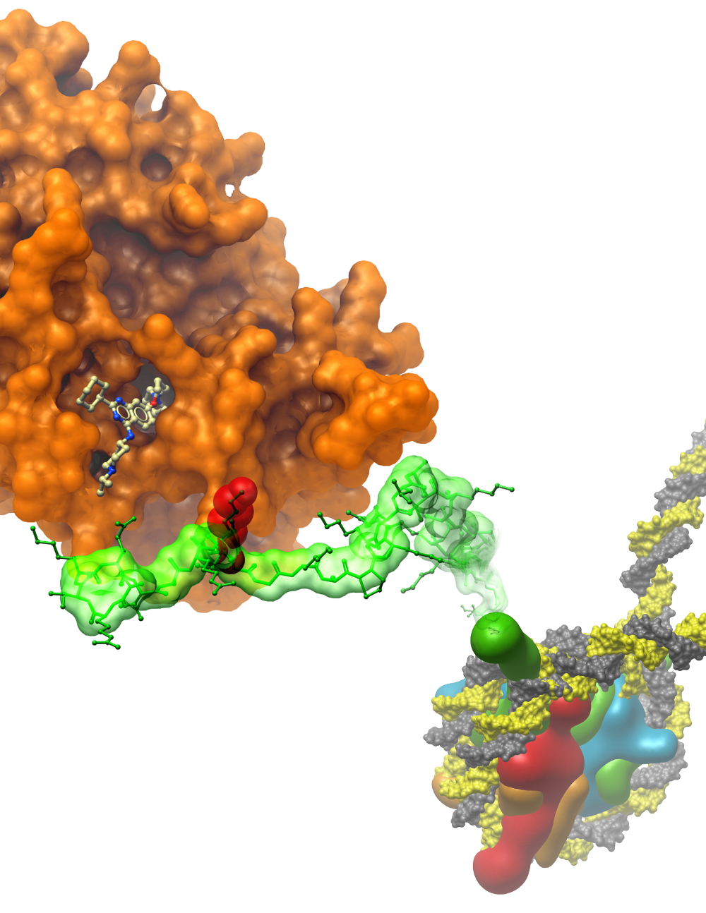
Using recombinant glycogen branching enzyme, in combination with structural biology techniques, to understand therapeutic opportunities
Wyatt W. Yue
Structural Genomics Consortium
Nuffield Department of Medicine
University of Oxford

Slide 2
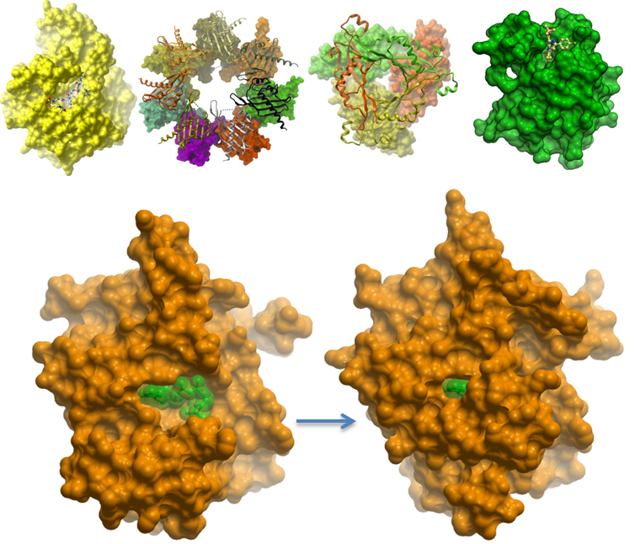
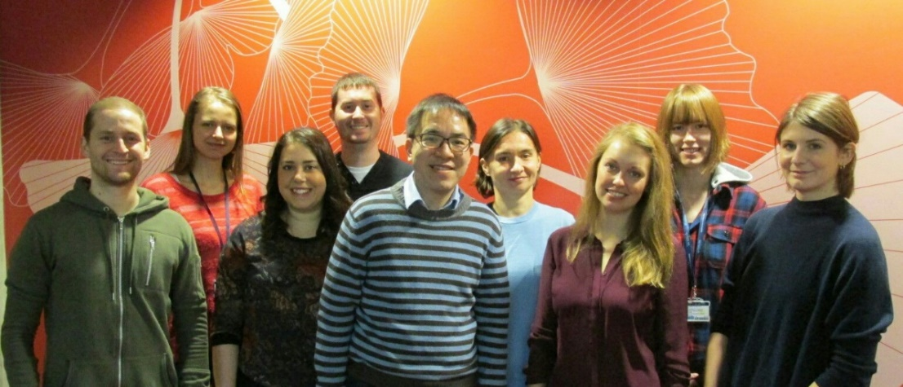
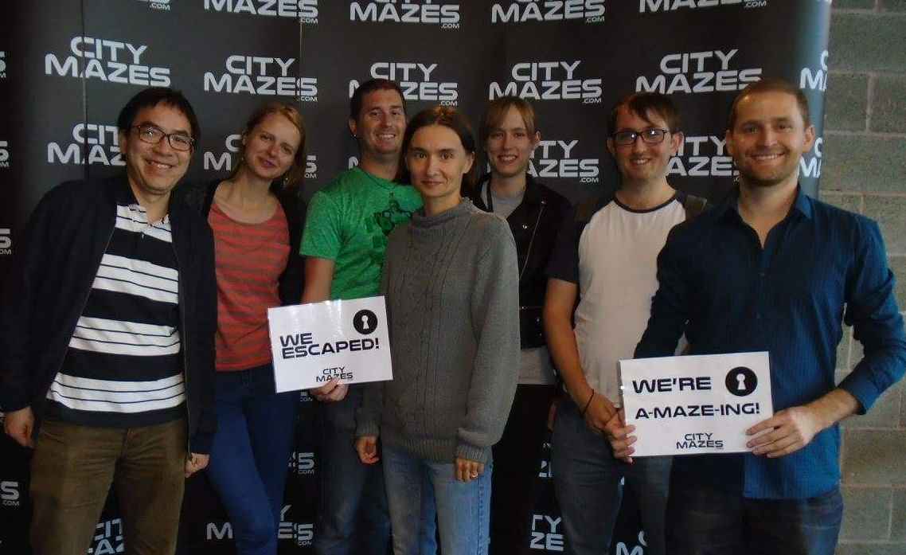
Seeing Molecules in Actions
Molecules have various shapes
Shapes can change too!
Understanding 3D structures:
enzyme functions
disease mutations
drug design
Combining structural biology, protein biochemistry to understand rare genetic diseases
2016
Nick
Igor
Ela
Jola
Sabrina
Anna
Hannah
Stephanie
Notes:
Structural biology sees inside
shed lights/ blueprint to understand/opening a black box of
is a blu
Government agencies, Wellcome Trust, charities & leading pharma companies
+300-strong team in six countries: Oxford, Toronto, Stockholm, Campinas (Brazil), Chapel Hill (US) & Frankfurt

Slide 3
3 Enzymes involved in glycogen synthesis
priming
elongation
branching
branching
enzyme
glycogen
synthase
glycogenin
2011
2015

Slide 4
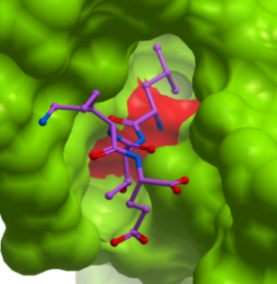
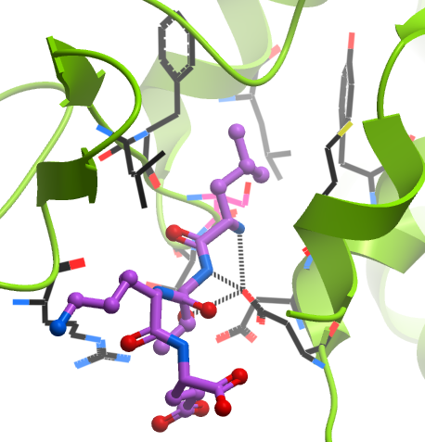
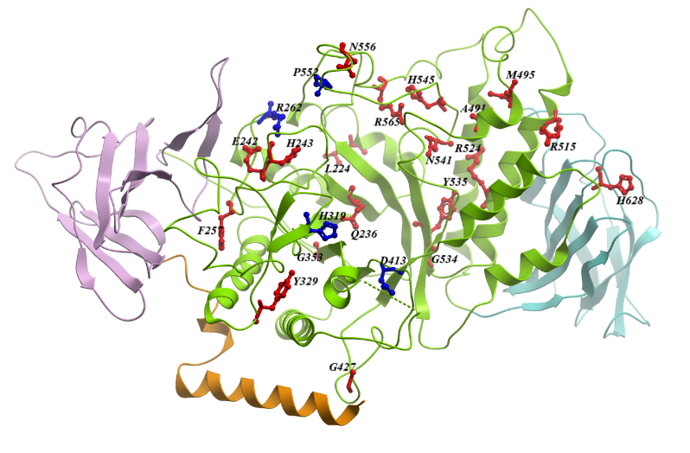
Creating a molecular ‘strut’
In silico design of tetrapeptide (Leu-Thr-Lys-Glu)
Peptide designed to bind mutant protein and fill the Y329S cavity
Experimental GBE1 structure
In silico modelling
F327
Y392
L335
M362
Leu_{i}
L328
S329
S330
Lys_{iii}
D386
Thr_{ii}
D388
R316
Tyr329->Ser mutation creates a hole at protein surface
LTKE
peptide
Glu_{iv}
Amit Michaeli
Notes:
In collaboration with researchers from a patient foundation, we aim to stabilize mutant protein with a synthetic peptide designed to target this cavity

Slide 5
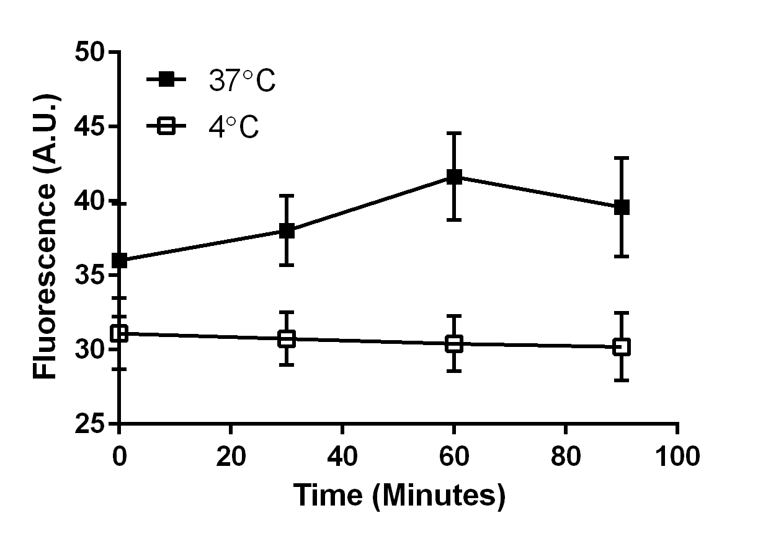
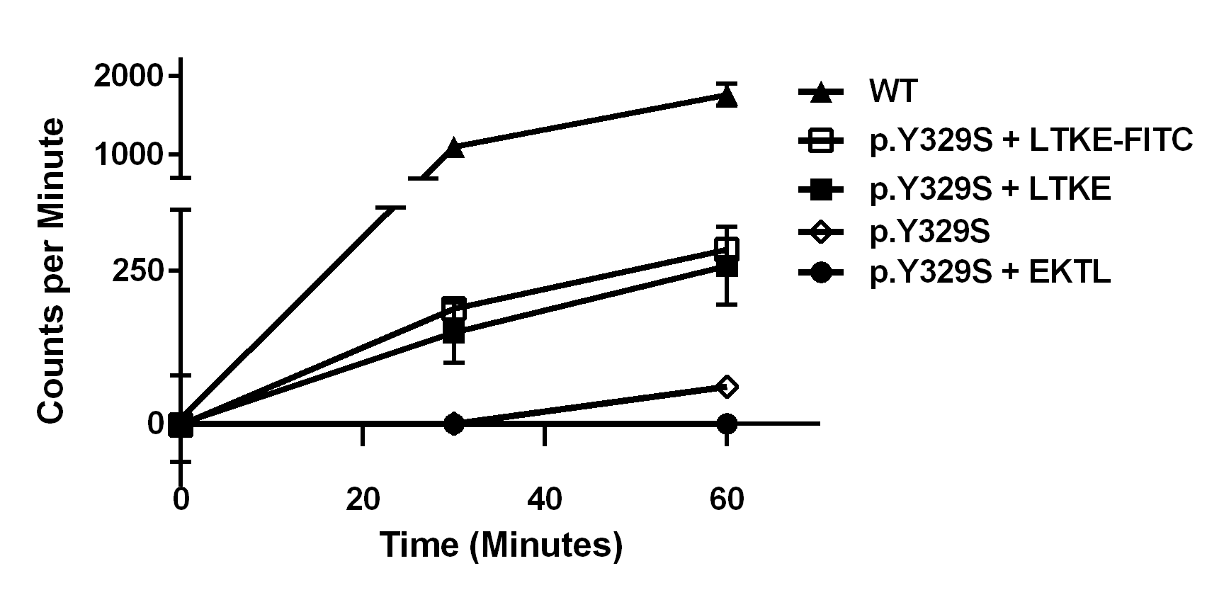
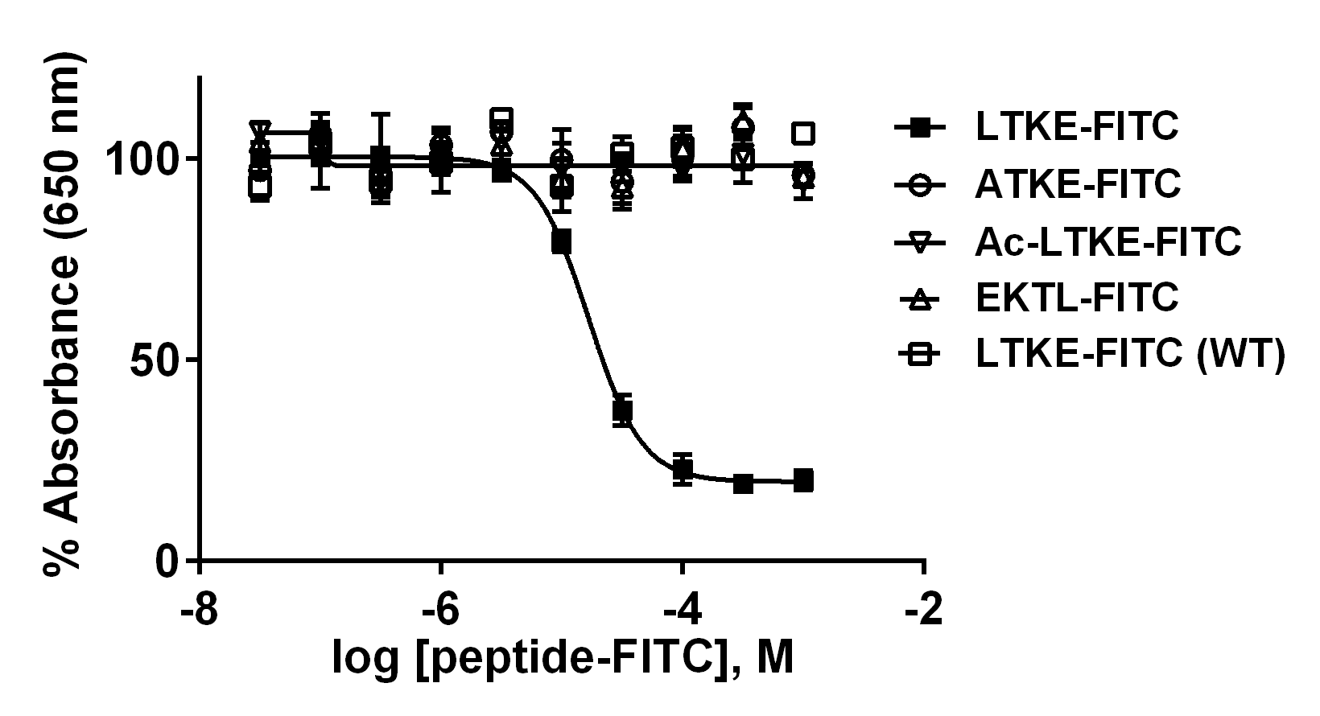
Peptide Proof-of-Concept
Uptake in cell
Improves in vivo expression
−
Y329S
EKTL
LTKE
WT
GBE
75kDa
Tubulin
50
Improves enzyme activity
Bind specifically to mutant
Or Kakhlon

Slide 6
Y329S mutant protein is destabilizing
Our new mutant construct yields large quantities of purified protein for screening by thermal shift
Full-Length GBE1 with a cleavable C-terminal His₁₀ and FLAG Tag
As purified GBE1_{Y329S} is soluble and active like GBE1_{WT}, but thermally less stable
PAS stained gel shift
+UDPG
Y329S (GBE1A-c021)
WT (GBE1A-c226)
GYG-GYS as purified
GYG-GYS + GBE1_{WT}
differential scanning fluorimetry
GYG-GYS
GYG-GYS + GBE1_{Y329S}
GYG
Y329S 49.7c
WT 54.7c
GYS
GBE1
Notes:
The catalytic core harbours almost all GSDIV and APBD mutations, some of which, such as Y329S, lead to lower expression in vitro and in vivo and reduced protein stability

Slide 7
Screening cascade for GBE1
collaborations
Wild-type protein, crystal
Mutant protein
hit finding
HTS, Virtual screening, Medicinal Chemistry
xtal soaking
DSF Screen
Validation
Binding, Biochemistry
DSF, ITC, BLI, co-xtal
dose response, domain mapping
Characterization
Mode of Action (WT vs mutant)
cellular assays
enzyme, folding, proteolysis assays
Human cells, animal model, iPS
Effects on activity, stability
Rescue in vivo?

Slide 8
Novel Approach: Fragment Screening
Conventional High-Throughput Screening
Fragment Screening
100,000’s complex molecules
100-1000’s of small molecules
Fragment molecules (MW <300Da) are better chemical starting points than conventional compounds
more efficiently survey protein space
requires fewer compounds in screening
potential for optimization by medicinal chemistry
Smaller MW of fragments require a sensitive screening method
Drug target
Drug target
Notes:
Meanwhile in our own lab, we would like to find screening methods to survey these different pockets.
Taking advantage of two emerging technologies:
Fragment screening (300 Da molecules, unlike the larger drug compounds, fragments sample chemical space using less molecules, and they can survey small/cryptic pockets
Because of weaker binding of fragment, a sensitive detection method is needed. Use of crystallography soak uM, mM fragments
We now reach an exciting opportune stage, where we can apply our structural repertoire of

Slide 9
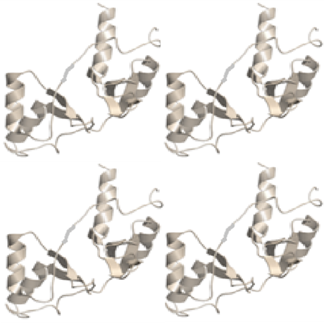
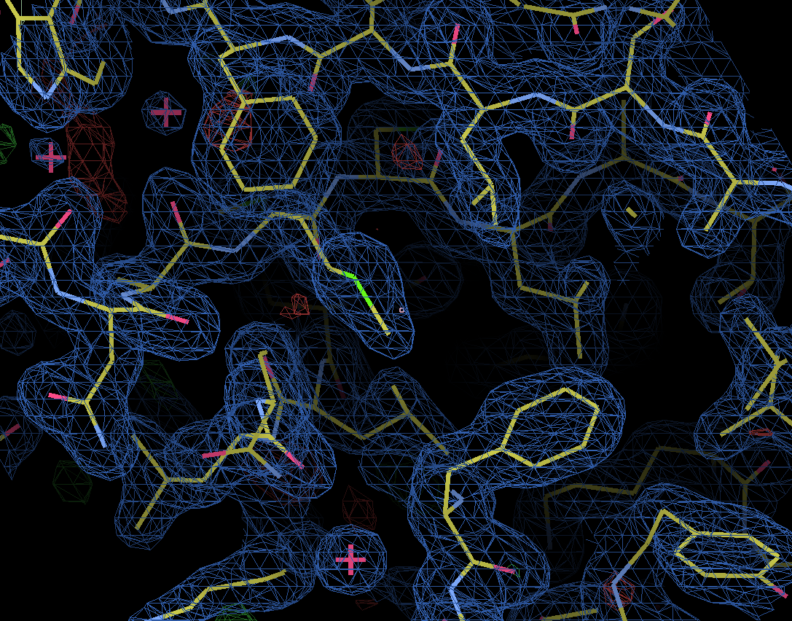
Fragment screening by crystallography
Fragments
Sabrina MacKinnon
Individual protein crystals
X-ray beam
One crystal-one compound soaking
Fragment bound structures
Electron density map to reveal bound fragments
X-ray diffraction pattern for protein xtals

Slide 10
Screening cascade for GBE1
collaborations
Wild-type protein, crystal
Mutant protein
hit finding
HTS, Virtual screening, Medicinal Chemistry
xtal soaking
DSF Screen
Validation
Binding, Biochemistry
DSF, ITC, BLI, co-xtal
dose response, domain mapping
Characterization
Mode of Action (WT vs mutant)
cellular assays
enzyme, folding, proteolysis assays
Human cells, animal model, iPS
Effects on activity, stability
Rescue in vivo?

Slide 11
Therapeutic Opportunity
Normal glycogen formation
( glucose unit)
Adult Polyglucosan Body Disease, APBD (gbe mutation)
activator
Notes:
In the last few minutes i would like to use a final example, to present ongoing work on targeting two proteins on the glycogen synthesis pathway in the study of one disease.
Normal glycogen synthesized by three enzymes:
But in patients with a form of glycogen storage disorder, mutations of the branching enzyme lead to

Slide 12
Therapeutic Opportunity
Normal glycogen formation
( glucose unit)
Adult Polyglucosan Body Disease, APBD (gbe mutation)
inhibitor
Down-regulate
Notes:
In the last few minutes i would like to use a final example, to present ongoing work on targeting two proteins on the glycogen synthesis pathway in the study of one disease.
Normal glycogen synthesized by three enzymes:
But in patients with a form of glycogen storage disorder, mutations of the branching enzyme lead to

Slide 13
ACKNOWLEDGEMENTS
The MOB
Jolanta Kopec
Nicholas Fox
Igor Ferreira
Ela Rembeza
Stephanie Oerum
Hannah Brazier
Sabrina MacKinnon
Henry Bailey
Jack Kelly
Anna Montgomery
Thomas McCorvie
Dipali Patel
Fiona Fitzpatrick
Sean Froese
Wasim Kiyani
2013
Contact
Fiona
Izabella
Thomas
Email: wyatt.yue@sgc.ox.ac.uk
Web: www.thesgc.org/wyatt
Twitter: @Wyatt_Yue
2016
Dipali
Nick
Igor
Ela
Jola
Sabrina
Anna
Hannah
Stephanie
Med Chemistry
Paul Brennan
Crystallography
Frank von Delft
Tobias Krojer
Biotechnology
Nicola Burgess-Brown
Claire Damerell
Pravin Mahajan
Leela Shrestha
Berge Minassian
Or Kakhlon
Amit Michaeli
Pablo Escriba
Orhan Akman
GBE/GYS Collaborators
All SGC PIs!
Chas Bountra
Aled Edwards
Cheryl Arrowsmith
Bioinformatics
Brian Marsden
David Damerell

